Slide 1
XVI WORLD LAW CUSTOMS MEETING
CUSTOMS IN TIMES OF GLOBAL CHANGE
THE WTO TRADE FACILITATON AGREEMENT:
STATUS OF IMPLEMENTATION
Panel 1: Worldwide Topics Review
Speaker: Alejandro Gamboa Alder
alejandro.gamboa-alder@hotmail.com
27 -29 September, 2023
Berlin, Germany

Slide 2
History and General Features of the TFA
Adopted in 2013 in Bali
Entered into forced: 22 February 2017
Three Sections:
  Section I: Substantive Provisions (Arts. 1 – 12)
  Section II: S&D for Developing and LD Countries (Arts. 13 – 22)
  Section III: Institutional Arrangements: NCTF (Arts. 23 – 24)

Slide 3
Transparency and Notifications
For developing and least developed countries:
  Categories A, B and C
  For ALL WTO Members:
    Publication: Art. 1.4
    Operation of the SW: Art. 10.4.3
    Use of customs brokers: Art. 10.6
    Contact point for exchange o information (customs cooperation): Art. 12.2.2

Slide 4
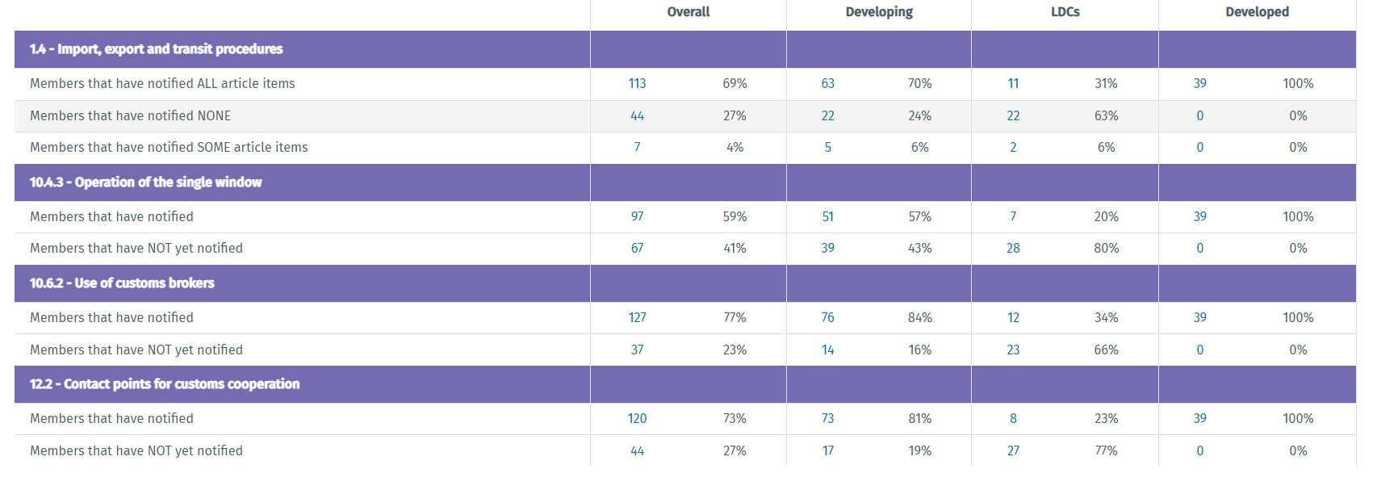
Transparency and Notifications

Slide 5
Implementation Commitments and other relevant data on the TFA: where to find them ….
      https://www.tfadatabase.org/

Slide 6
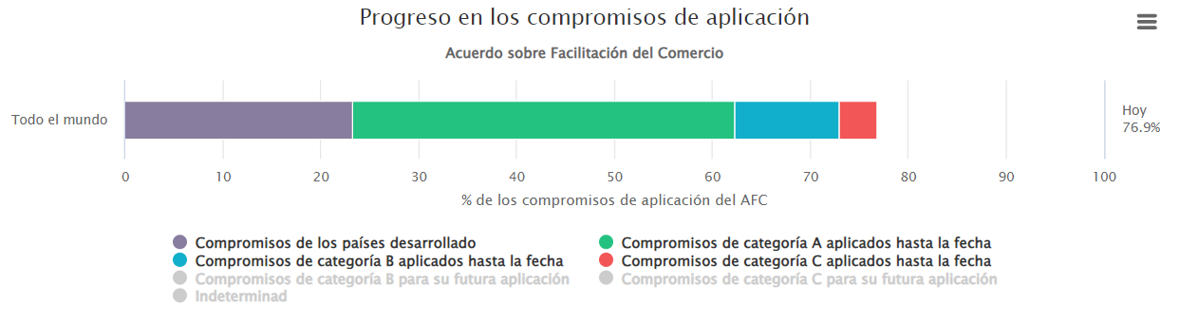
IMPLEMENTATION OF THE TFA (Source: tfadatabase.org)

Slide 7
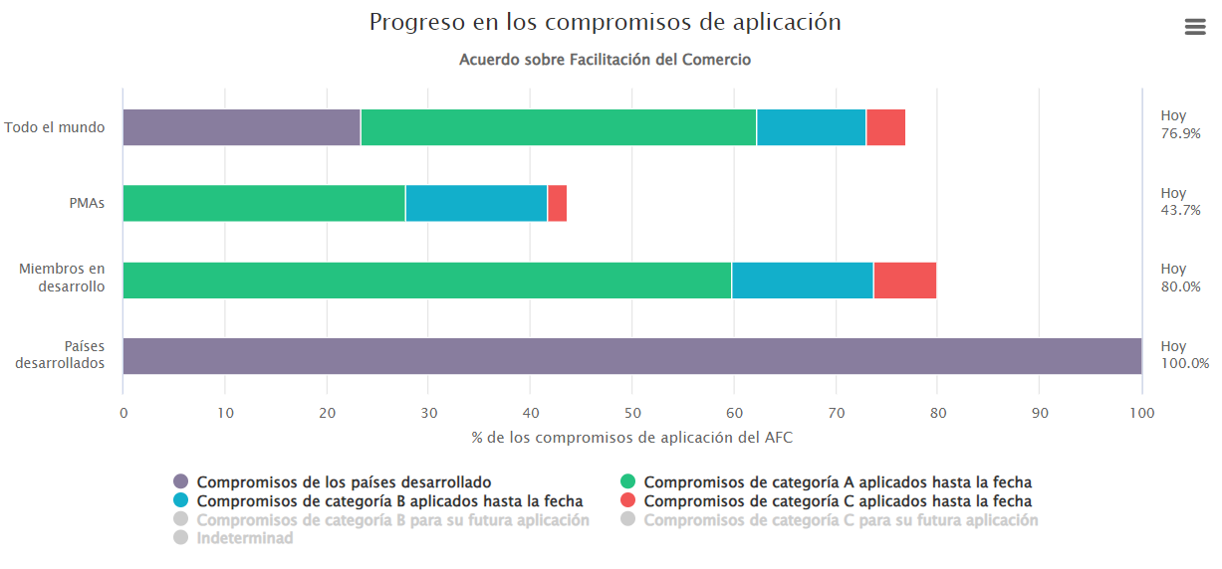
IMPLEMENTATION OF THE TFA (Source: tfadatabase.org)

Slide 8
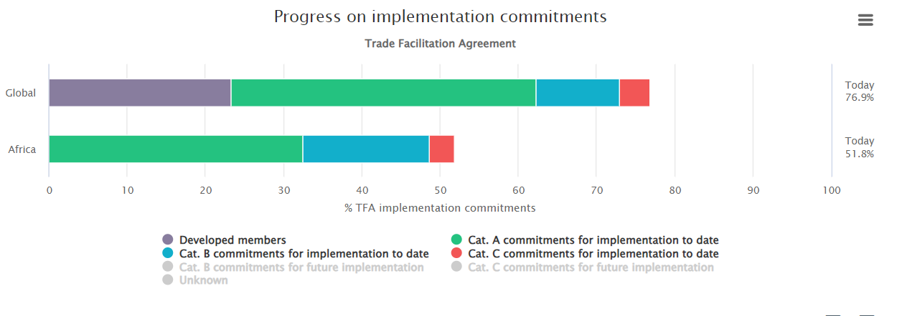
IMPLEMENTATION OF THE TFA (Source: tfadatabase.org)

Slide 9
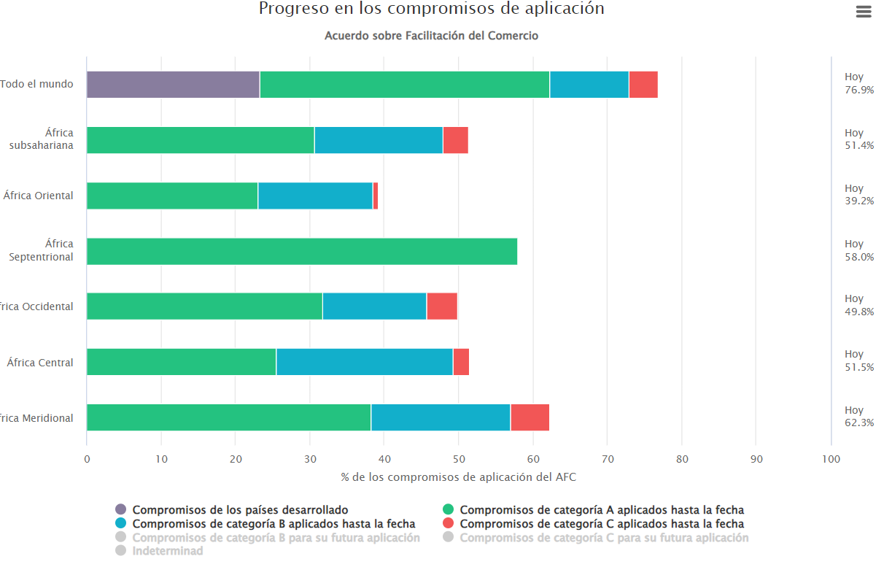
IMPLEMENTATION OF THE TFA (Source: tfadatabase.org)

Slide 10
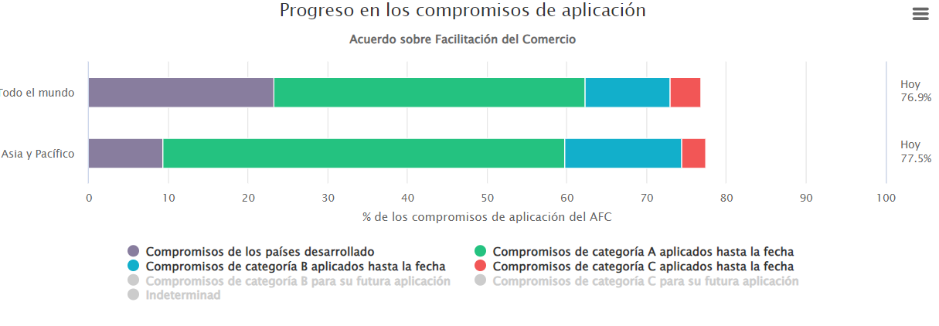
IMPLEMENTATION OF THE TFA (Source: tfadatabase.org)

Slide 11
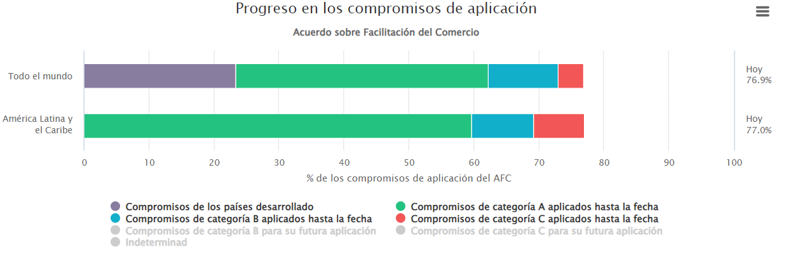
IMPLEMENTATION OF THE TFA (Source: tfadatabase.org)

Slide 12
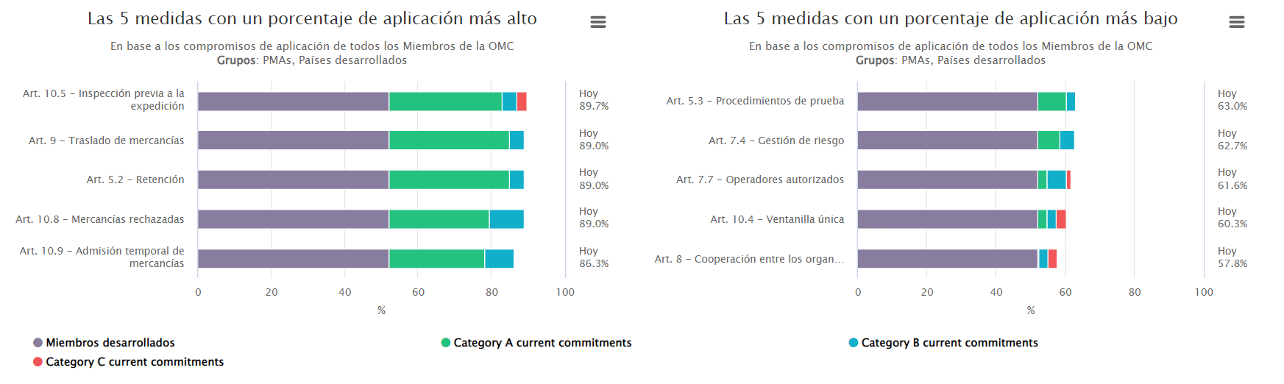
IMPLEMENTATION OF THE TFA (Source: tfadatabase.org)

Slide 13
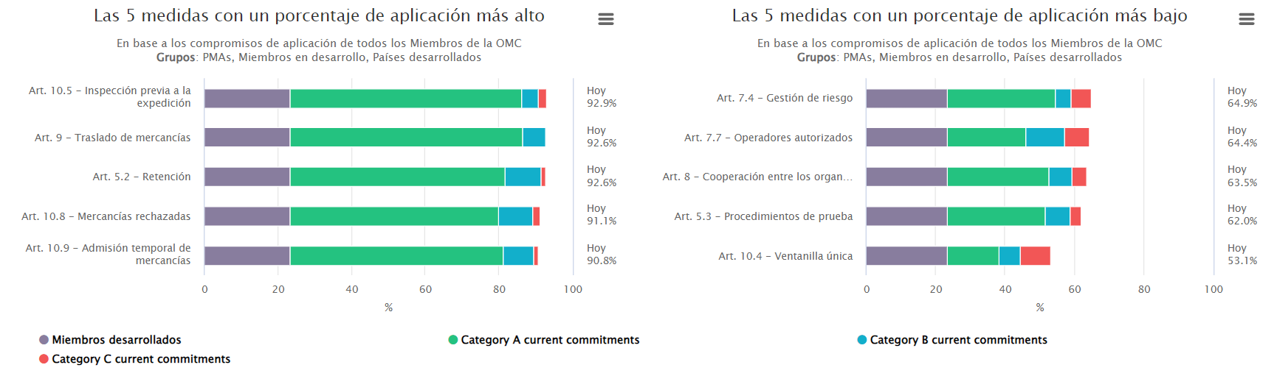
IMPLEMENTATION OF THE TFA (Source: tfadatabase.org)

Slide 14
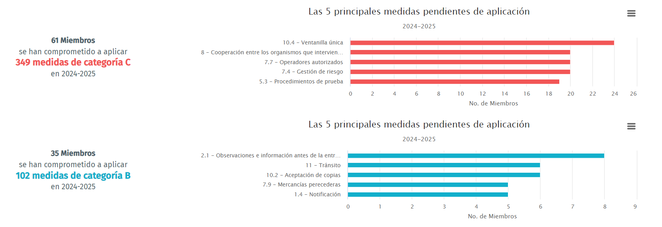
IMPLEMENTATION OF THE TFA (Source: tfadatabase.org)

Slide 15
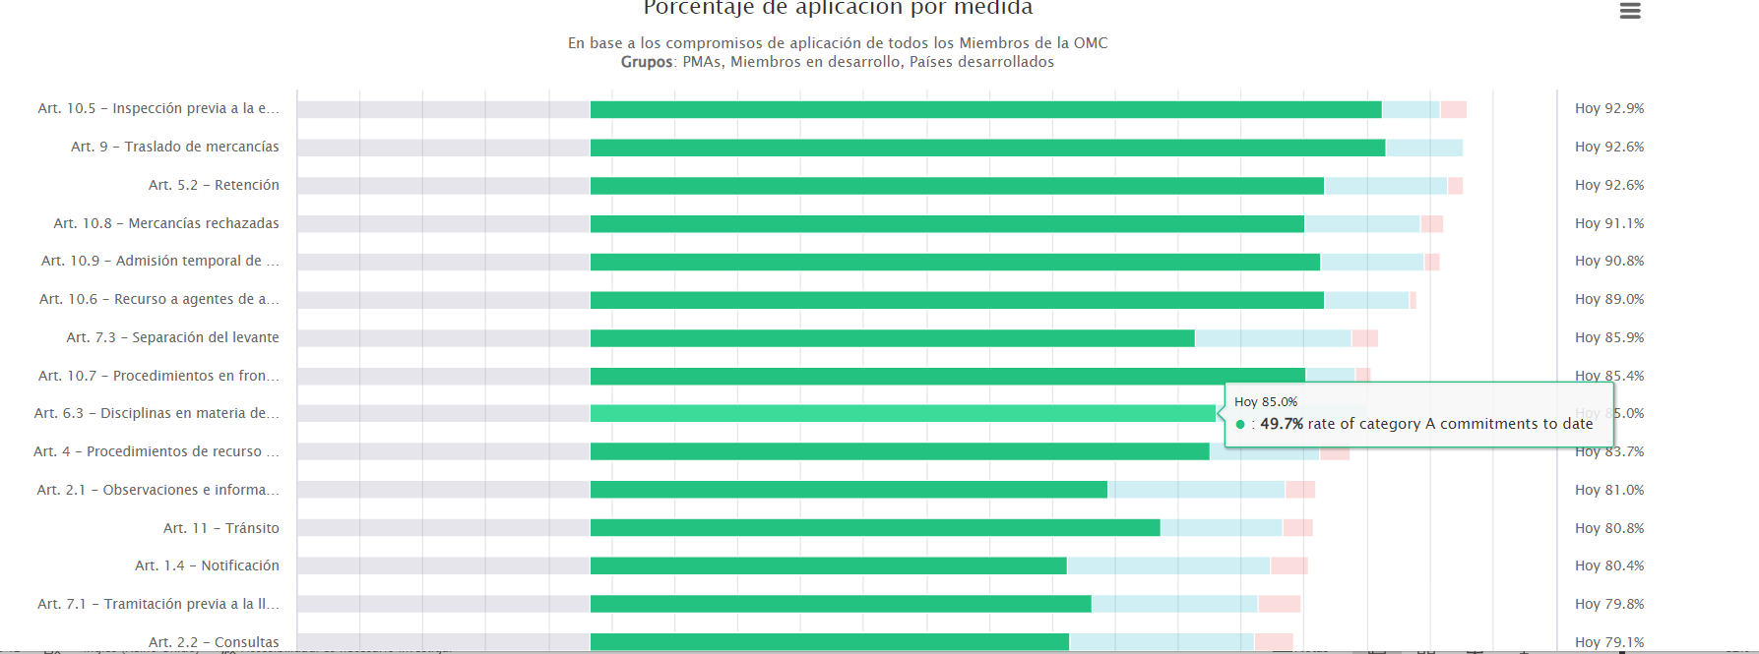
IMPLEMENTATION OF THE TFA (Source: tfadatabase.org)

Slide 16
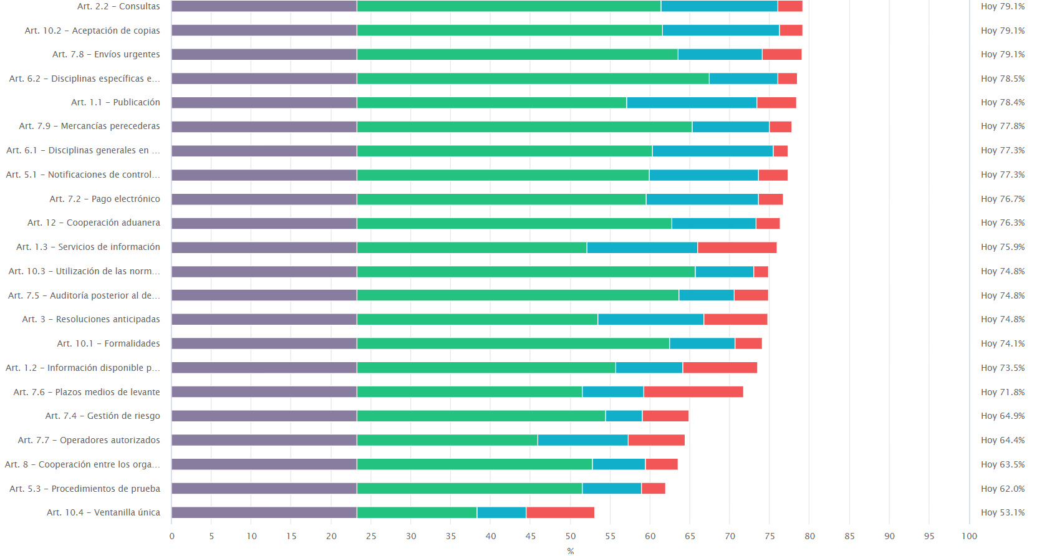
IMPLEMENTATION OF THE TFA (Source: tfadatabase.org)

Slide 17
Tools to boost the implementation commitments of developing and Least developed countries
The WTO Committee on TF:
  Experience sharing, best practices, thematic discussions, crosscutting issues, transit procedures (since May 2018 a stand-alone issue)
  Exchange of experiences on COVID customs related procedures
  Dedicated sessions on TA and Capacity building (art. 21.4):
    Problems in applying the TFA,
    progress in the provision of TA + CB
    Exchange of experiences
    Review of the TA notifications submitted by developed Members
    Art. 23.1.6 (quadrennial reviews: 1st in 2022 (see report in G/TFA/2), next in 2026
    Specific trade concerns (Kyrgyz Rep vs Kazakhstan and Ukraine vs Russian Federation on transit procedures)

Slide 18
Tools to boost the implementation commitments of developing and Least developed countries
TECHNICAL ASSISTANCE
IOs technical assistance: WTO TA Plan + TFAFacility, WCO, UNCTAD, ITC, UPU, OCDE, SELA, SIECA, ALADI, COMESA, FAO, Int Atomic Energy Agency, IMF, OEA, etc
Donors and agencies: African and Asian Development Banks, IADB, WBG, USAID, US Dept. of Commerce, EU, SECO, Danish International Development Agency, Swedish Int. Coop. Agency, German International Development Agency, Japan Int Coop. Agency, Ottawa Group, Australia, Canada, Senegal, Côte d’Ivoire, UK, etc
Others: Commercial Law Development Program, GFA, Médecins sans Frontières, Global Alliance for TF, etc
    For a total of 53 donors or agencies providing TA

Slide 19
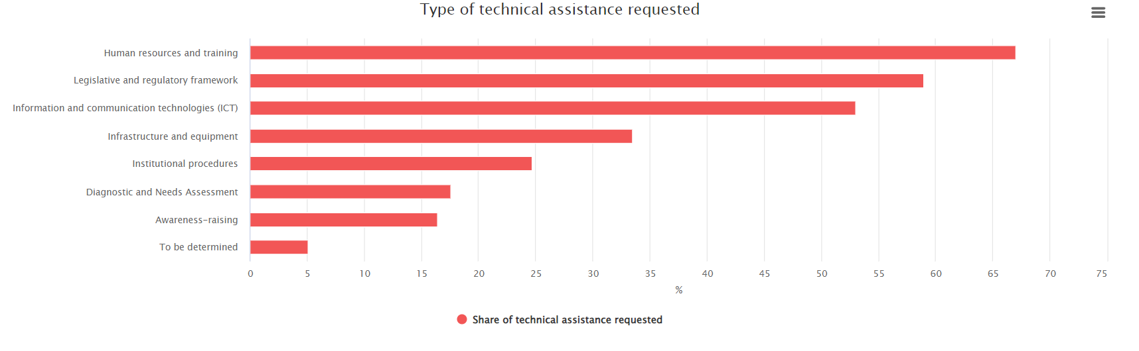
Technical Assistance requested (source tfadatabase.org)

Slide 20
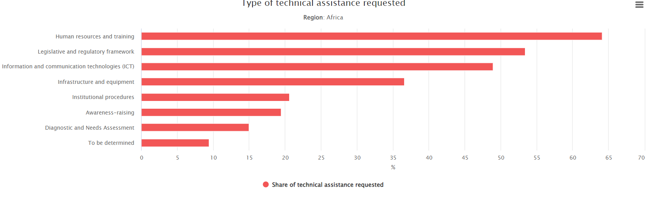
Technical Assistance requested (source tfadatabase.org)

Slide 21
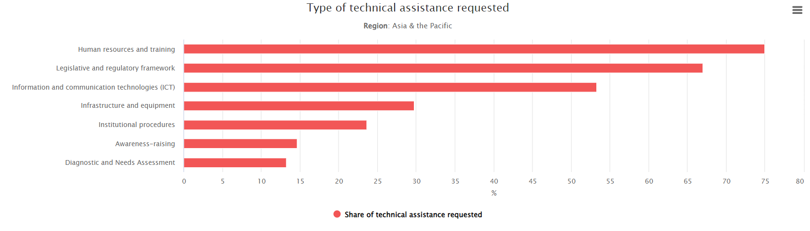
Technical Assistance requested (source tfadatabase.org)

Slide 22
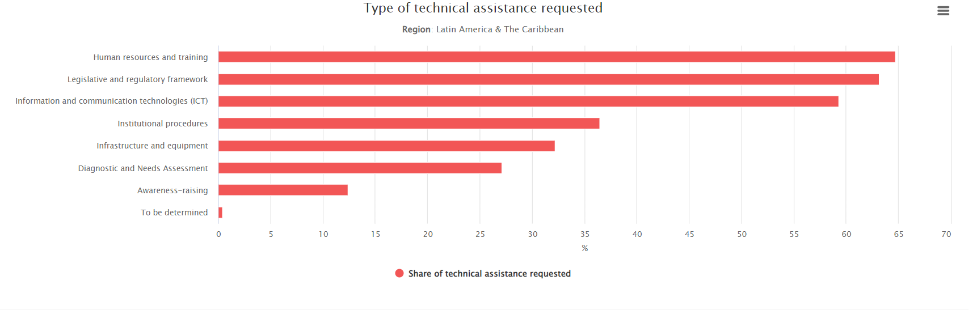
Technical Assistance requested (source tfadatabase.org)

Slide 23
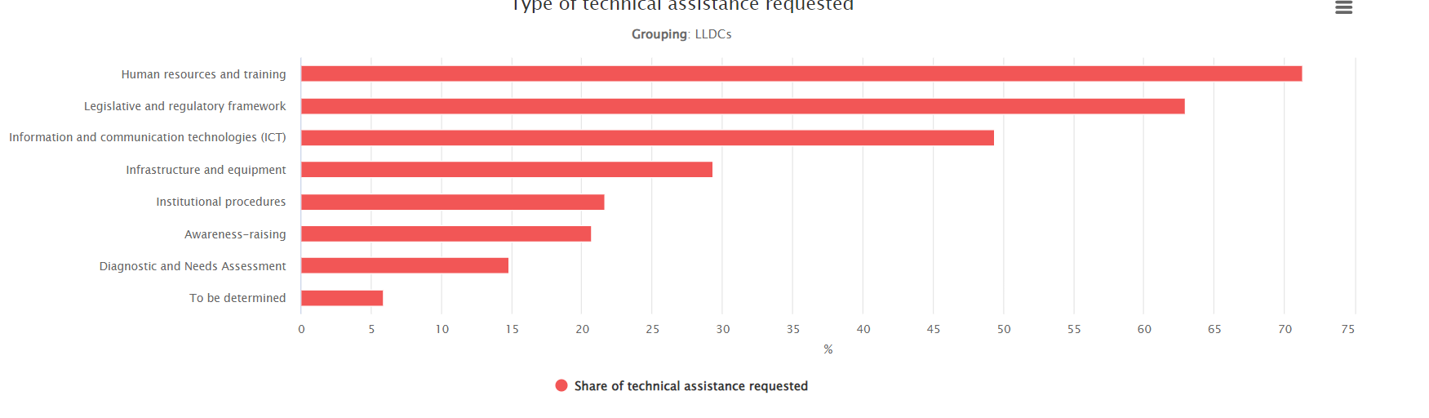
Technical Assistance requested (source tfadatabase.org)

Slide 24
Challenges and difficulties faced by donors, Developing and Least developed countries to provide/receive TA
Gap between donors and beneficiaries of TA
Lack of clarity as regards the identification of the specific measures notified under category C
Wide offer of TA and multiple agencies offering same kind of TA with funds from IOs and other agencies
Lack of coordination among the national authorities when requesting TA
Offers subjected to the priorities of the donors
Lack of political and administrative continuity and leadership
Ensure the sustainability of the project
Lack of clarity as regards who will implement what and lack of identification of the national counterparts
Lack of involvement of the private sector
(Source: Third LA meeting of the NCTF – Report)

Slide 25
NCTF: the best engine to boost, apply and make effective the implementation of the substantive provisions of the WTO TFA
Most Members have established and implemented their NCTF or are implementing them in accordance with Art. 23.2 of the TFA
Different structures, composition and functioning
Some involved the private sector with diverse functions. Others not.
Some have established “local NCTF” at the border
Some have designed working methods, road maps and measurement and monitoring systems
Some have a limited legal structure that not allow them to adapt to different circumstances
Some have not yet identified all the border agencies and import/export and transit procedures
Some coordinate all the TA requests and monitor these TA activities
Some have the full support of the upper administrative authorities

Slide 26
Evaluation of the implementation of the TFA:
Conclusions reached at the Third Meeting of LATAM’s NCTF, Montevideo, Uruguay May 2023
  Although there are many measurement tools (WCO, UNCTAD, GEA, OEDC), it’s not always easy to identify the various aspects to be measured
  Focus in measuring the improvements of compliance with the TFA, rather than in the in the measurement of the impact of the implementation
  Lack of clarity as to what and how to measure, apart from the customs issues
  Lack of clarity about the type of information available and its use to see whether the TFA obligations are being fulfilled
  Movement of HRs, and officers in charge of many areas
  Lack of support and resources to improve and promote digitalization in different institutions and use of non-compatible technologies
  Reluctancy to changes and difficulties to fully engage the private sector

Slide 27
Digitalization of the import, export and transit procedures:
Conclusions reached at the Third Meeting of LATAM’s NCTF, Montevideo, Uruguay May 2023
  Significant investments to put in place IT tools for import, export and transit procedures, including AI
  Positive results when implemented in parallel with a re-engineering of the import, export and transit procedures to eliminate or reduce unnecessary aspects, including the reduction of the intervention of officers
  However, not all of the areas and institutions advance at the same pace
  Some automation processes are old, and it has not been easy to replace or modernize them or to allow them to inter-operate with other systems
  Not all the processes are revised and improved at the same pace
  Lack of a legislative framework to adapt and adopt new technologies
  Lack of continuity in the digitalization processes
  Lack of identification as to the leadership in the process of digital transformation
  E-commerce processes, activities and stakeholders not included in the discussion nor in the NCTF

Slide 28
Risk management and treatment of expedited shipments:
Conclusions reached at the Third Meeting of LATAM’s NCTF, Montevideo, Uruguay May 2023
  Some countries have introduced pre-arrival processes to facilitate risk management, and simplified and automated procedures for expedited shipments
  Important investments in non-intrusive inspection such as scanners, software, methodologies and training of HRs
  However, there is a lack of advanced, clear and complete electronic information
  Many processes still being manual
  Increase of non-expert senders (sellers) using incomplete or erroneous data
  Lack of a good scheme for authorized operators
  Difficulties to deal with the new business models which consolidate various packages in a single container, being delivered later as expedited shipments without having received pre-arrival documentation
  Under valuation practices to benefit from the de minimis threshold and circumvention of other non-tariff barriers
  Lack of coordination among the different authorities at the border
  Complexity and lack of information about the different fees and charges
  Difficulties in acknowledging thar risk management and trade facilitation are complementary but not opposite.

Slide 29
CONCLUSION
ONE THING IS ONE THING, BUT ANOTHER THING IS ANOTHER THING:
TO MONITOR THE COMPLIANCE WITH AN OBLIGATION
IS NOT
TO MEASURE THE EFFICACY OR THE DEVELOPMENT OF THE ACTIONS AND INITIATIVES ADOPTED TO ATTEND SUCH OBLIGATION

Slide 30
MANY THANKS
MUCHAS GRACIAS
Alejandro Gamboa-Alder
E-mail: alejandro.gamboa-alder@hotmail.com

