Slide 1

AEO and Trust & Check: why do we want both of them?
XVII World Customs Law Meeting
Dr Anna Jerzewska
September 2025
.

Slide 2

The UCC Reform
  UCC entered into force in 2016
  Need to modernise and future-proof the legislation
  2022, the EU Customs Union Wise Persons Group (WPG) report included a recommendation for a new approach to the Authorised Economic Operator (AEO) status: Build a new framework of Responsibility and Trust
  May 2023, Proposal for a REGULATION OF THE EUROPEAN PARLIAMENT AND OF THE COUNCIL establishing the Union Customs Code and the European Union Customs Authority, and repealing Regulation (EU) No 952/2013
  Key aspects of the customs reform: creation of the new, centralised EU Customs Authority, new approach to data sharing via a Customs Data Hub and modernising provisions for e-commerce
  Includes far-reaching changes to the EU AEO status

Slide 3
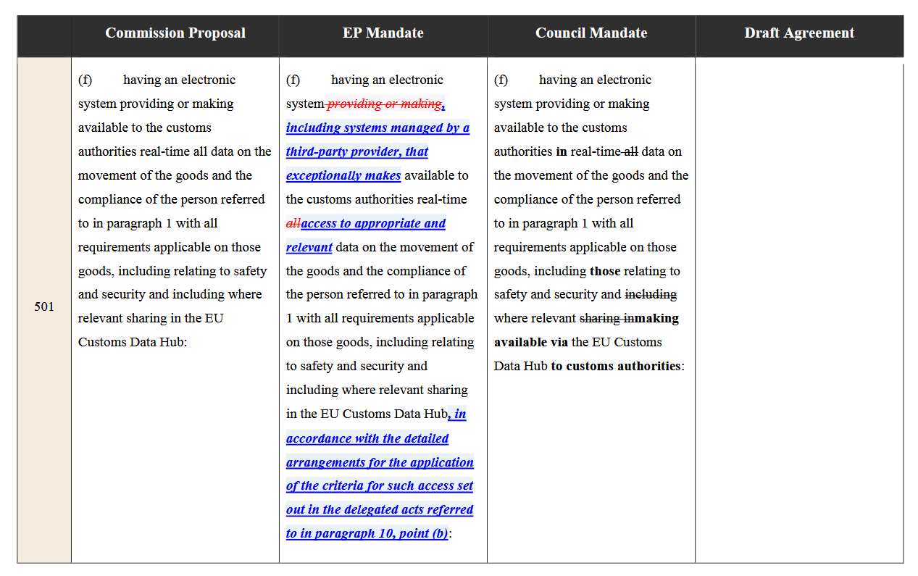
Summer of 2025: we are in a trilogue

Slide 4
Trust & Check
“The changes in the customs processes and the way of operating the customs authorities requires a new partnership with economic operators, that is the Trust and Check traders scheme.
The criteria and conditions to become a Trust and Check trader should build on the AEO criteria but should also ensure that the trader is considered transparent for the customs authorities.
It is therefore appropriate to require Trust and Check operators to grant the customs authorities access to their electronic systems keeping record of their compliance and the movement of their goods.
The transparency should be accompanied by certain benefits, notably the possibility to release the goods on behalf of customs without the necessity for their active intervention, (…) and to defer the payment of the customs debt.”
Recital 16 of the proposal
  AEO S, AEO C, AEO F (S+C)
  Trust and Check
  New way of working with the authorities
  New requirements: making available to the customs authorities in real-time all data on the movement of the goods
  Includes customs but also transport and logistics data
  Additional benefits: the possibility to give part of the data on the goods after the release, self-assessment, self-release, deferred payment

Slide 5

Trust and Check for freight forwarders and customs brokers?
“CLECAT doubts most SME importers will invest in their IT and other systems to obtain the status of T&C trader as they may prefer to outsource their customs affairs to intermediaries, given that they often neither possess the necessary expertise, nor inhouse human resources. CLECAT foresees that many SME’s will not become T&C, and as such will not benefit from any of the current facilitations when they make use of a customs intermediary.
CLECAT calls on the EU policy makers to allow customs representatives acting under direct or indirect representation to extend their facilitations, including their T&C status, to non-T&C economic operators. Especially in cases where the importer occasionally imports goods or due to the size of his organization is incapable of fulfilling the demands of T&C, the importer should be able to rely on and benefit from the T&C facilitations granted to his representative.”
CLECAT Position Paper on the Customs Reform 2023
https://www.clecat.org/media/clecat-pp-customs-reform-2023-.pdf

Slide 6

The debate continued…
Commission Impact Assessment p 6.7
  It is expected that current AEO can qualify for this model to benefit from simpler procedures. They may have a transition advantage as they already comply with strict requirements. In that respect, it is worth noting that 60 to 70% of current AEO are micro, small or medium sized companies and that on average 75% of international trade is handled through AEOs.
  https://eur-lex.europa.eu/legal-content/EN/TXT/?uri=CELEX%3A52023SC0140&qid=1684913437758
CLECAT Position Paper
  Whilst the Impact Assessment (section 6.7) claims that 60-70 % of current AEOs are SME’s and that an average 75% of international trade is handled through AEOs, a number which CLECAT considers to be overestimated, it should be noted that even 25% of the number of importers, who do not become T&C traders represents a considerably large group
  https://www.clecat.org/media/clecat-pp-customs-reform-2023-.pdf
Michael Lux Replacement of the AEO by T&C
  The lifeline for these importers could be the use of customs broker operating under indirect representation. However, the majority of customs brokers will not be interested to offer their services under indirect representation, in view of the increased responsibilities for non-fiscal legislation
  https://www.clecat.org/media/replacement-of-the-aeo-by-the-tc.pdf

Slide 7
What customs brokers say:
“Many of our clients, especially SMEs, would not be able to obtain AEO status on their own. By working with an AEO-certified broker, they still benefit from simplified procedures and fewer controls.
Faster handling and reduced risk of delays are essential for our transport and logistics services. In case of a customs control, we can arrange for the inspection to take place at a designated location, which means that only the affected shipment is held back – not the entire consolidation. This makes a significant difference for both our operations and for clients relying on timely deliveries.
For us, AEO C is therefore not only an internal compliance tool, but also a way to extend tangible benefits to our customers and to strengthen the resilience of European trade.”
DSV Denmark
  "For DSV as a transport company, the ability to use the AEO-C authorisation within the framework of direct representation is of central importance.
  Our customers – especially small and medium-sized enterprises – depend on this service because they often do not have the resources and expertise to meet the complex customs requirements on their own.
  By using our AEO-C privileges on behalf of our customers, we help to ensure that supply chains run smoothly and that the benefits of simplification are enjoyed not only by large corporations but also by small and medium-sized enterprises.“
  DSV Germany

Slide 8
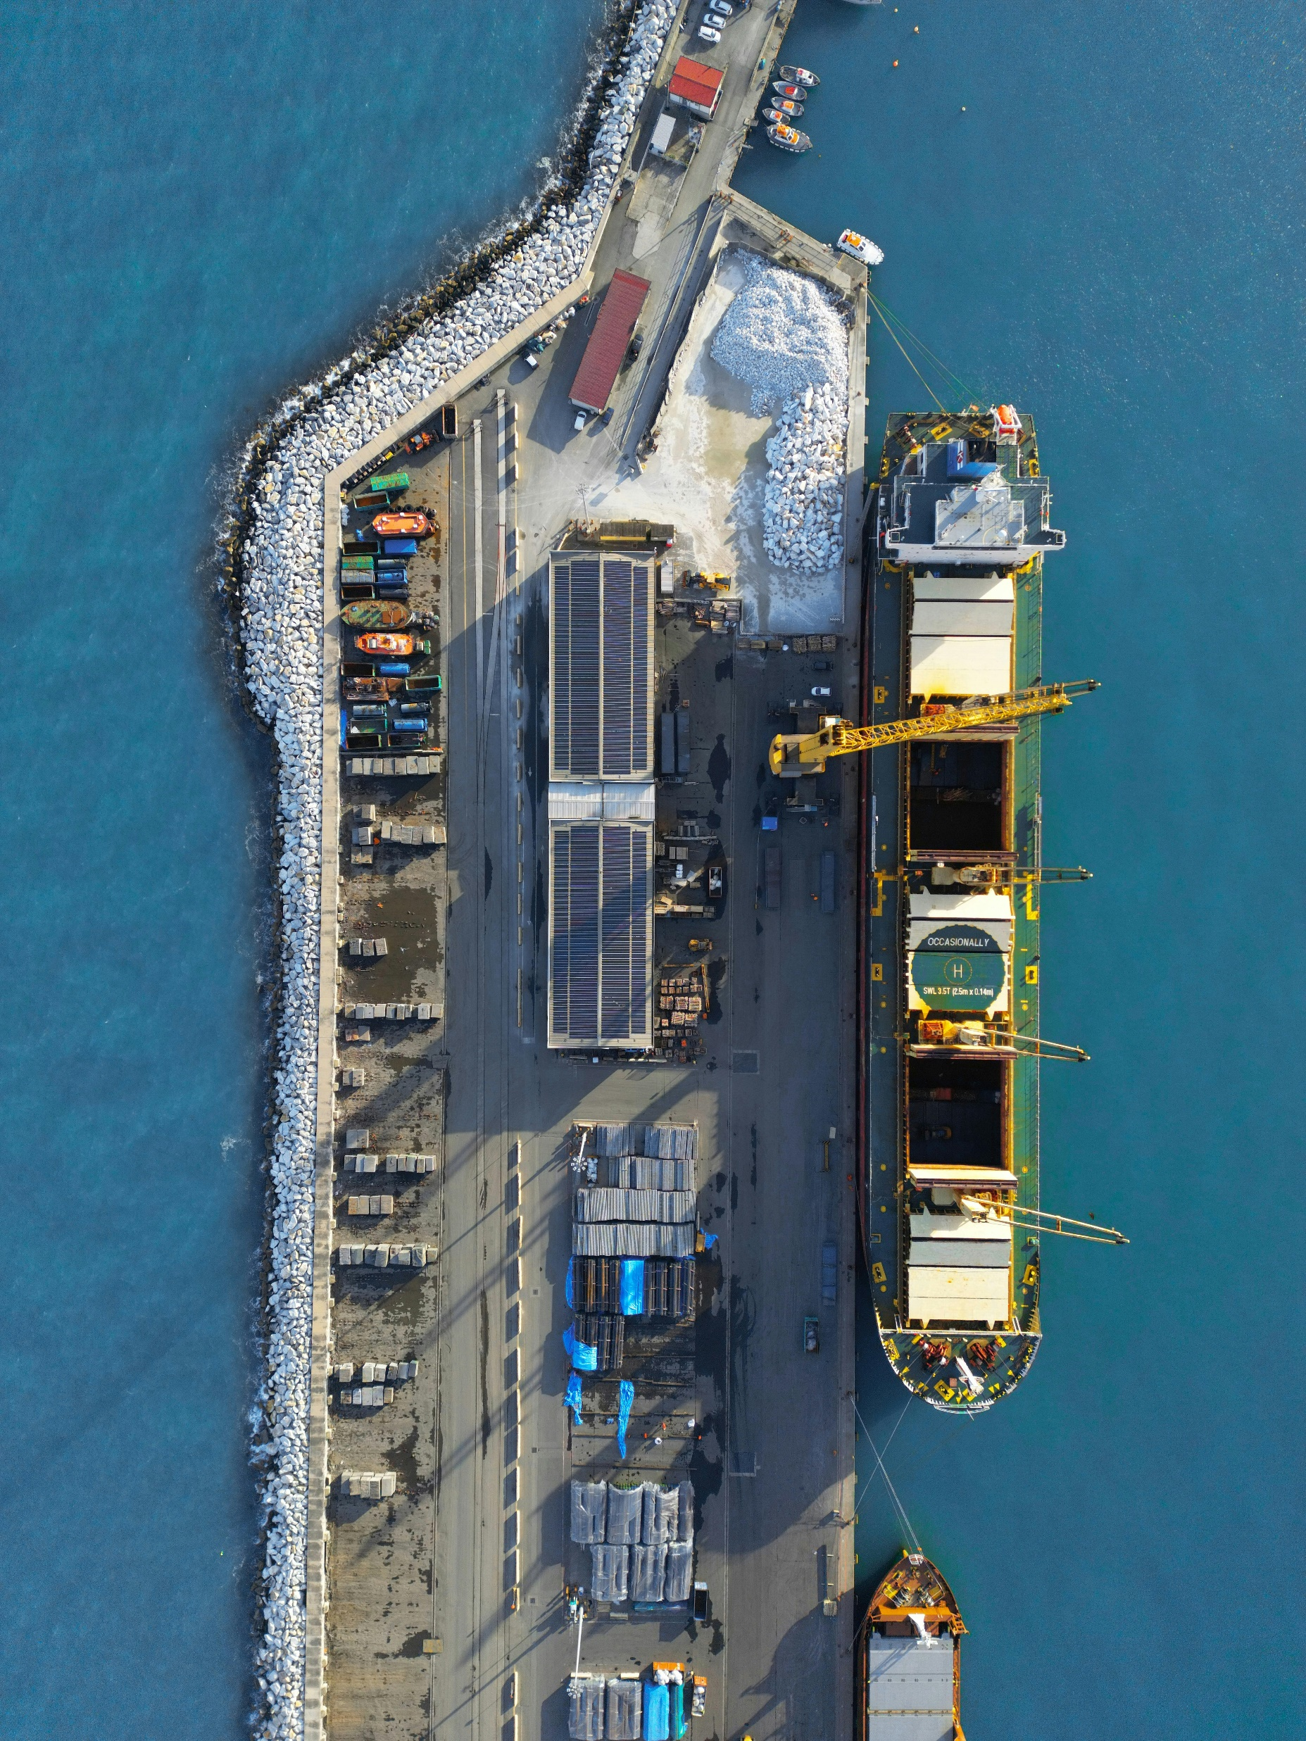
AEO C stays (most likely)
What we know for now:
AEO C and T&C to co-exist
AEO C and T&C CANNOT be hold together
AEO C can be used by direct representatives
T&C benefits can only be used by broker if acting as indirect representative or if the client also has T&C
AEO or T&C need to provide services in a different MS
You need T&C to get simplifications under certain e-commerce movements with a new distance sale warehouse
Non-EU companies need an AEO indirect representative
Questions
What are the differences? Is it the current AEO?
How will this by applied by MS?
Will customs brokers be caught in the middle?

Slide 9
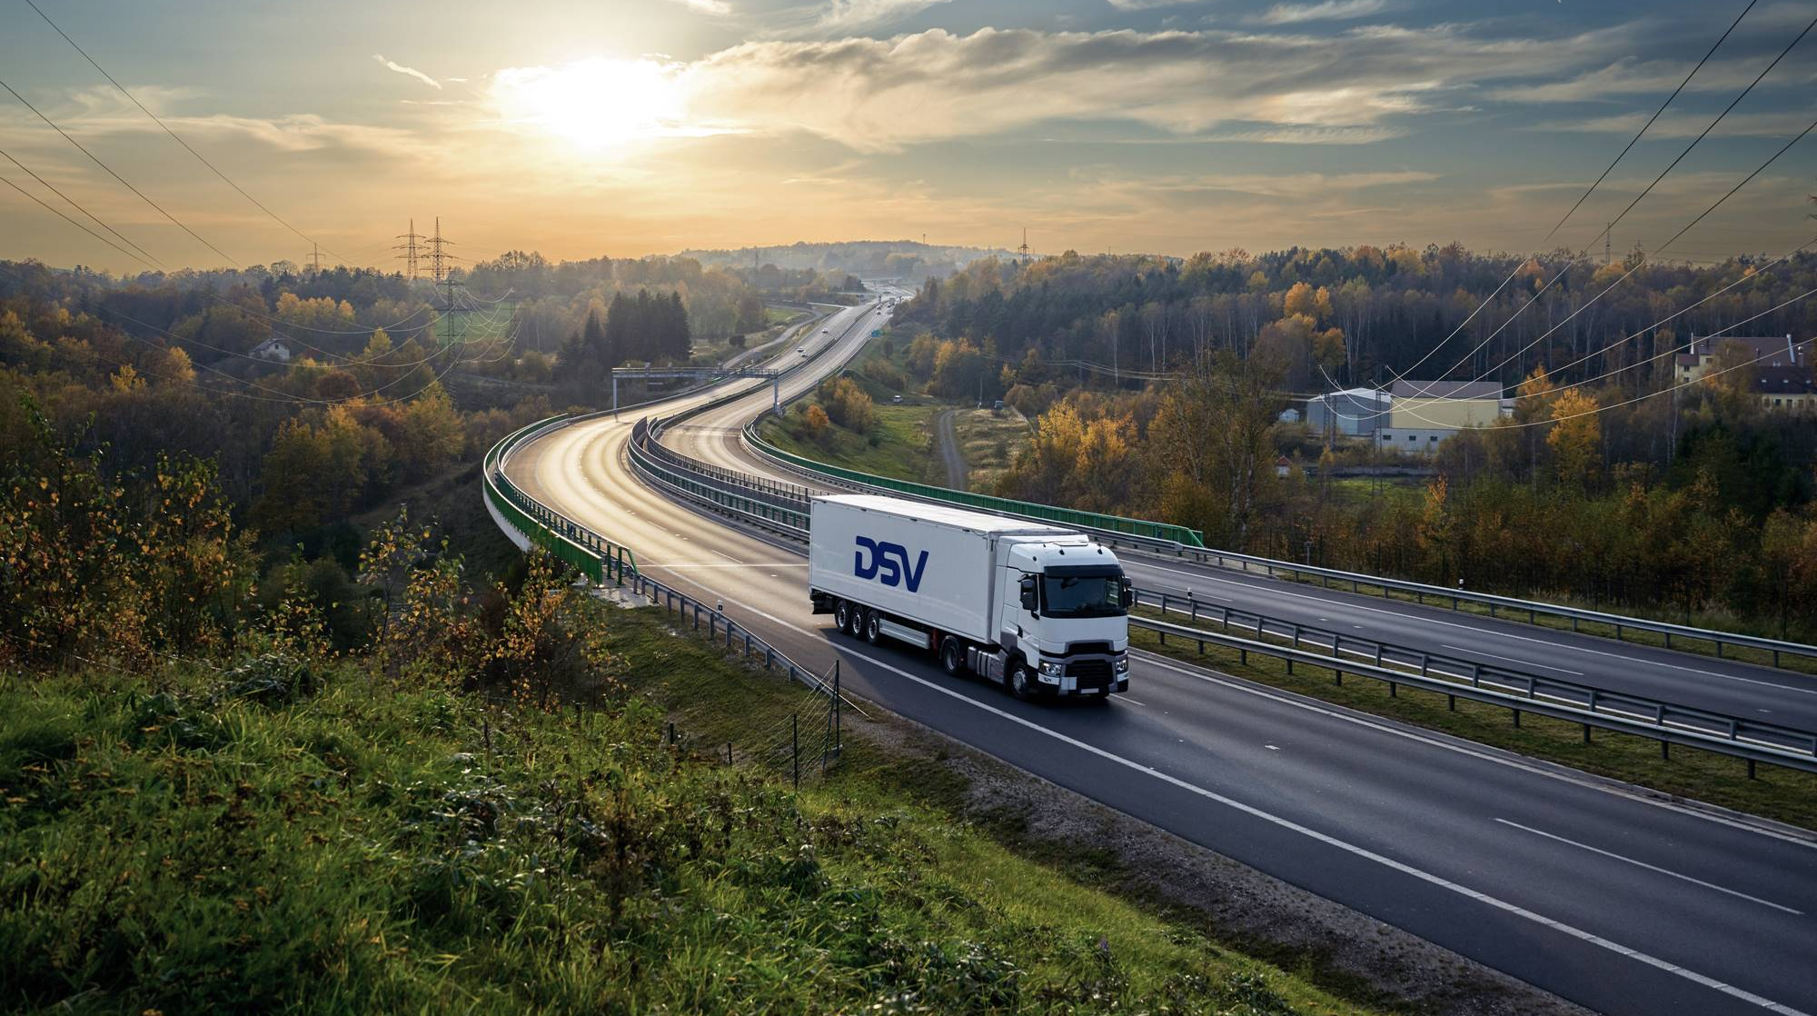
Thank you
DSV – Your Customs Experts

