Slide 1
XVI World Customs Law Meeting
Berlin – September 27-29 2023
PREFERENTIAL
TRADE AGREEMENTS (PTAs)
in ASIA-PACIFIC
Mr. Yann Duval
Chief, Trade Policy and Facilitation
United Nations ESCAP

Slide 2
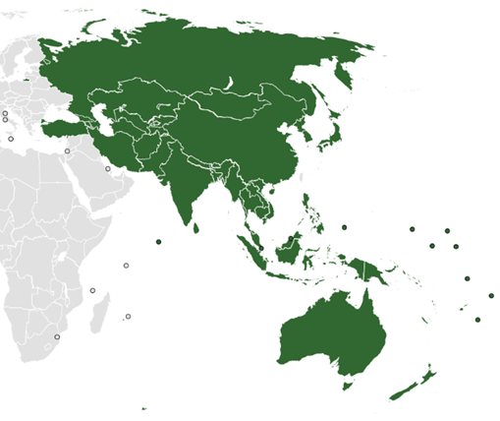
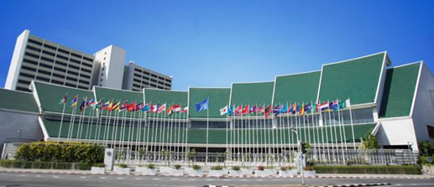
What is ESCAP?
One of the 5 UN Regional Commissions
53 Member States
Support regional cooperation and implementation of the Sustainable Development Goals
Research /Capacity Building
Intergovernmental cooperation
Long-standing programme on trade (as a key mean of implementing the SDGs)
HQ in Bangkok

Slide 3
Current trends in PTAs in Asia-Pacific… How many agreements are there?

Slide 4
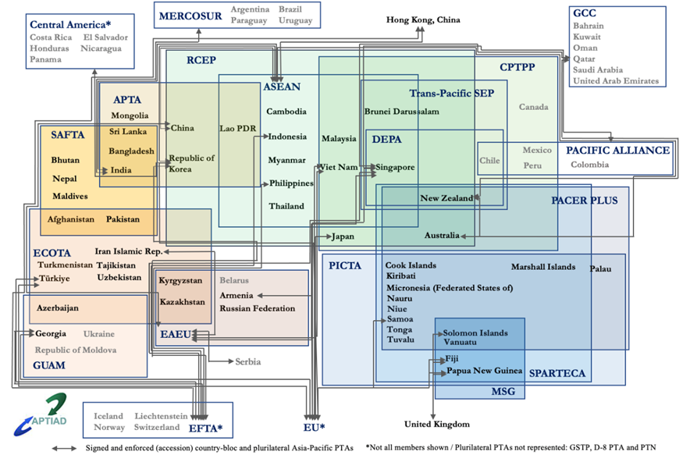
Asia-Pacific PTAs: Largest contributor to the worldwide build-up of PTAs
347 PTAs (including 95 under negotiations) involve at least one AP economy, as of July 2023
Plurilateral PTAs signed and/or in force
Source: Asia-Pacific Trade and Investment Agreement Database (APTIAD), Available at https://www.unescap.org/content/aptiad
Notes:
Background: Overall trend as of August 2022
The Asia-Pacific region continues to be the largest contributor to the worldwide build-up of preferential trade agreements (PTAs). As of August 2022, there are 333 PTAs with at least one party of the Asia-Pacific, of which 202 are in force, 21 are signed and pending ratification, and 95 are still under negotiation.
Notably, the region consists of the mega trade agreements (RCEP, CPTPP) and the standalone digital trade agreements (DEPA).
From January 2020 until the present, the region has signed 23 new PTAs in total. Of these, 7 agreements were signed in 2022. The 6 newly signed agreements: (1) Australia-India; (2) India-United Arab Emirates; (3) New Zealand-United Kingdom; (4) Singapore-Pacific Alliance; (5) Turkiye-Ukraine; and (6) Turkiye-Pakistan, and another digital-only agreement: (7) Singapore-United Kingdom Digital Economy agreement. [WHAT ABOUT TURKEY-PAKISTAN agreement?]
Regarding the new initiatives, 6 PTAs have begun negotiation in 2022: (1) Australia-United Arab Emirates (UAE); (2) China-Ecuador; (3) China-Nicaragua; (4) China-Uruguay; (5) India-UK; (6) Indonesia-United Arab Emirates.
In 2021-2022, several suspended negotiations have been resumed, especially India (renegotiating agreements with Australia, Canada, EU, and Gulf Cooperation Council (GCC). Additionally, ROK-Mexico; Thailand-EFTA and Thailand-EU also resumed after a pause, in some cases linked to the COVID-19 crisis.
Development after 2000
After 2000, the Asia-Pacific PTAs have significantly developed, especially type and geographical coverage. More PTAs have been signed since such period, approximately three times increase.
1.) Regarding the type, ‘FTA and EIA’ is the main type after 2000, accounting for 50% of the enforced PTAs (previously, FTA was the main type (81% of the enforced PTAs)).
Also, new type of ‘Digital’ has been emerged in 2019 after the sign of the “Japan-United States Digital Trade Agreement” considering as the first stand-alone digital-only agreement (enforced 2020).
The depth and the scope of the PTAs have become deeper and wider. Accordingly, 53% of the enforced PTAs beyond liberalization of trade in goods.
2.) After 2000 54% of all Asia-Pacific region, PTAs are with economies outside the region. While before this period most of the enforced agreements partnered with the economies within the subregion (53%). Therefore, this phenomenon reinforces the claim about the Asia-Pacific economies are actively participating as dialogue partners within as well as from outside the region.

Slide 5
Asia-Pacific PTAs: Bigger, Farther and Deeper!
Mega trade agreements
CPTPP (2018), EU-Japan (2019), RCEP (2020)
More PTAs with “non-(sub)regional” partners
EU-Japan (2019); Singapore-Pacific Alliance (2022)
From trade to comprehensive agreements
‘Competition policy’ and ‘Intellectual property’ most common “new” areas in Asia-Pacific PTAs beyond traditional trade in goods liberalization provisions (incl. ‘Custom cooperation and trade facilitation’, ‘SPS/TBT’)
E-commerce / digital economy
Sustainable development
(new areas sometimes added by updating / upgrading existing PTAs)
Notes:
Trade agreements tend to embrace extensive scope beyond the traditional area of trade in goods and tariff liberalization.
Apart from trade in goods:
The most common policy areas in the AP PTAs are ‘Custom cooperation and trade facilitation’, followed by ‘Competition policy’ and ‘Intellectual property’ (found in more than 50% of the signed and enforced PTAs)
The least common policy areas in the AP PTAs are ‘Human rights’, ‘Gender’, and ‘Labor protection’ (found in less than 20% of the signed and enforced PTAs).
The evolution is evidenced by various forms:
Deepening PTAs
1.) Comprehensive agreement:
The coverage of PTAs has begun to cover a wide range of areas not directly to trade, such as government procurement, movement of people, labor standards, intellectual property rights, and environmental standards.
New areas relevant to sustainable development (namely, human rights, gender, SMEs, education, etc.) and digital (data protection, cross-border data flows, online consumer protection, location of computer facilities, etc.) have become more prominent and a greater number of these areas can establish in substantive chapter/provision
Plurilateral, for example, CPTPP, RCEP
Bilateral, for example, Comprehensive Economic Partnership Agreement (CEPA)
2.) Upgrading/Adjusting existing agreement:
Several PTAs have modernized by amending the existing provisions or adding new provisions to increase the dept and widen the scope of trade agreements in response to the evolving global economic architecture (Sign/ratify to replace the original context of the Agreement with the text set out in the Appendix of the Protocol).
The key amendment areas are often found to enhance market access for ‘trade in services’ and incorporate an emerging issue, such as ‘e-commerce’.
In particular, regarding e-commerce, the parties add new chapter of e-commerce or add more comprehensive provisions to their existing chapter. For example, the upgraded Australia-Singapore PTA (signed 2016, enforced 2017) includes data flow commitment to meet better need of a modern business. The upgraded China-Chile PTA (signed 2017 enforced 2019) incorporates the e-commerce chapter for the first time.
The revision can be found in the forms of “upgraded agreement”, “second phase agreement” or “supplementary agreement”.
Upgraded Protocol, for example: China-Singapore PTA upgraded; New Zealand-Singapore CEPA upgraded
Second phrase, for example: China-Pakistan PTA second phase, China-ROK PTA second phase
Supplementary agreement, for example: China-Chile: Supplementary Agreement on trade in services; China-Hong Kong, China Supplementary Agreement I-VI; and China-China, Macao Supplementary Agreement I-IV
3.) Stand-alone digital trade agreements
New type of trade agreement which focuses on one specific area of ‘Digital’ has been emerged in 2019 after the sign of the “Japan-United States Digital Trade Agreement” considering as the first stand-alone digital-only agreement (enforced 2020).
(Specific detail, please see in slide 5 ‘Digital’ section)
4.) Crisis responses
Some of the new PTAs signed after 2021 has more focused on health cooperation. For example, New Zealand-United Kingdom PTA explicitly mention COVID-19 and the right to promote access to medicines (signed 2022).
The PTAs can be a tool to facilitate trade during the time of crisis. In line with the current development of deep trade integration, the deeper PTA is found to be more resilient and has relatively better stability against the effect of COVID-19 pandemic (UNCTAD, 2021).
Several PTAs provisions, namely the treatment of essential goods and services, trade facilitation, technical measures, and intellectual property, could play an important role in ensuring essential supplies. These provisions should be binding and incorporate credible enforcement mechanisms to be effective.
The COVID-19 pandemic disrupted international trade flows. It caused some delays in trade negotiations and a slowdown in the number of the new PTAs signed in 2020-2021.
Specifically, there were only 16 PTAs signed in certain periods, while 27 PTAs were signed in the period before the pandemic, 2018-2019. Nevertheless, 2022 shows a positive sign because several agreements and negotiations have been signed and resumed.
ESCAP with UNCTAD and the UNRCs’ Handbook on Provisions and Options for Trade in Times of Crisis and Pandemic provides options of provisions to shape the design of the future agreement to ensure coordination and effective responses under crisis circumstances.
Technical Cooperation through various protocols
At the same time, less formal trade deals are growing. Its characteristic requiring less negotiation time could complement the developing trade environment:
1.) Memorandum of Understanding (MoU):
Several MOUs have been established based on the existing PTAs.
For example, Australia-Indonesia PTA: MOU on Pilot Workplace-Based Training Visa Arrangement; China-Chile PTA: MOU on Labour and Social Security Cooperation
2.) Mini FTA: Recent development is the creation of the MOU by Thailand under the name “Mini FTA” initiated in 2021.
Notably, the “Mini FTA” of Thailand is not about “free trade”, but more about strengthening cooperation (information exchange, organizing trade fairs) of the targeted industries at the city or state level.
As of August 2022, Thailand has signed 5 MOUs with Japan (Kofu : cooperation in gem and jewelry industry), India (Telangana : 1 year, exchange trade information and products such as medicine, IT, furniture, start-up cooperation), China (Hainan: 2 years, exchange trade information, SMEs, food, agricultural and industrial products, e-commerce matching services/ Gansu : cooperation in halal food, agricultural products and logistic services) and the Republic of Korea (Busan: boost trade and accelerate economic partnership).
The first Mini FTA started in July 2021 with Kofu, Japan, and the latest one is Busan, the Republic of Korea in July 2022. Thailand plans to sign more MOUs with other trading partners.

Slide 6
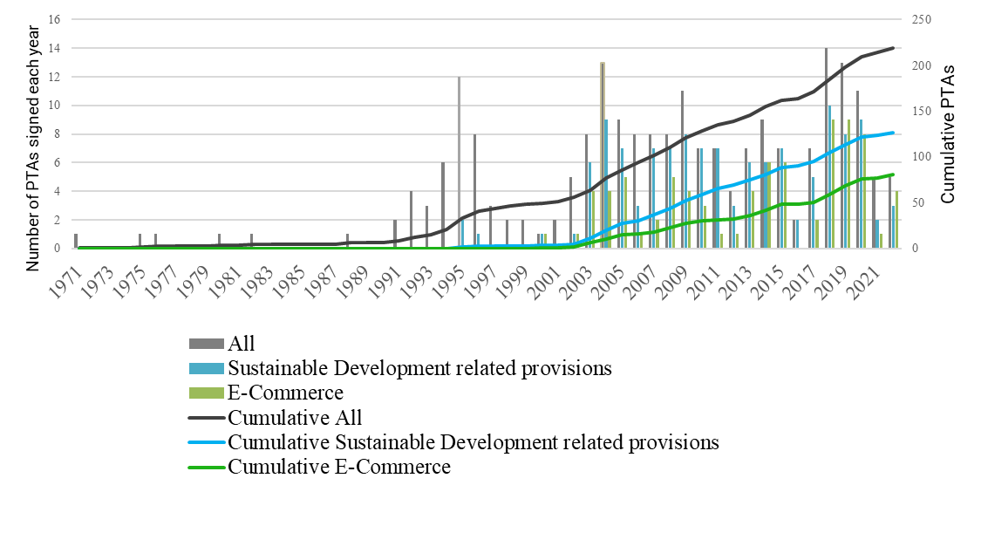
Digital & Sustainable Development provisions are growing
Digital and Sustainable Development-related provisions in PTAs
Notes:
From the proliferation of the agreement scope, “Sustainable Development” and “Digital” are among the prominent agenda items in trade negotiations after 2000. The pandemic also emphasizes the importance of these two areas:
Sustainable Development
“Whist the main objectives of PTAs are to determine market access and business opportunities, this does not guarantee sustainable, inclusive development at the country-level.” Handbook on Negotiating Sustainable Development Provisions in Preferential Trade Agreements
Sustainable development covers a wide scope of the 3 pillars: economic development, social development and environmental protection in a view to promote human wellbeing, and strengthen social progress while preserving the environment.
The Asia-Pacific region has 127 of 224 signed and enforced sustainable development-related provisions, and 56 signed and enforced agreements with the dedicated provisions on sustainable development as a concept later in 2003 (Singapore-United States signed 2003).
The SD provision can be found under various provisions, namely sustainable development as a concept, labour protection, human rights, environment, SMEs, health and gender. The coverage and level of commitment of the sustainability provisions are varied.
Health and environment provisions are found to be the most common area due to the proliferation of the SPS provisions and the concern of climate change, respectively.
The first PTA with a substantive SD provision (in the world) is North American Free Trade Agreement (1994) (NAFTA), which includes specific environmental provisions.
Challenges: The inclusion of the sustainability clause is not universal. Most PTAs lack comprehensive commitment or omit sustainability provisions. Most sustainability provisions are insufficient due to their unenforceable nature.
Lack of dispute settlement mechanisms to resolve conflicts arising in the implementation of those provision
Include dispute settlement mechanisms, however, decisions are usually non-binding.
Lack of framework to monitor the performance of RTA or its contribution to sustainable development.
Digital
E-commerce provisions/chapter:
The inclusion of the digital (‘e-commerce’) provision has begun since 2000 after the sustainability provisions.
The region is actively engaged in electronic commerce, 81 out of 224 signed and enforced agreements have included e-commerce chapters or provisions. The first PTA with a substantive e-commerce provision (in the world/region): New Zealand-Singapore Closer Economic Partnership Agreement (CEPA) (signed November 2000).
Digital (standalone PTAs):
In line with the rising of e-commerce agreements, the digital-only agreement was initiated in 2019. It is noteworthy that digital trade aspects address the emerging digital economy issues (such as AI, Fintech, Regtech, and digital inclusion) that go beyond the provisions found in the e-commerce agreement.
Asia-Pacific region, especially Singapore, is the main player in digital trade agreements. The 5 digital trade agreements involve the economies in the Asia-Pacific. All of them have entered into force, except the Republic of Korea-Singapore Digital Partnership Agreement which is still under negotiations.
The latest update for the digital trade agreement in 2022 is the signatory of the Singapore-United Kingdom Digital Economy Agreement (DEA) in February and later enforced in June. (Substantially concluded in December 2021).
Among the total digital trade agreements, there is one standalone plurilateral agreement dedicated to digital trade – “Digital Economy Partnership Agreement (DEPA)” (signed 2020 and enforced 2021, only between New Zealand and Singapore).
The agreement is based on the e-commerce chapter of the CPTPP and is designed to complement the WTO JSI negotiations on e-commerce. Thereby, the group is opened to eligible WTO members. Recently, China (2021), the Republic of Korea (2021) and Canada (2022) have formally submitted their request to join the agreement.
DEPA consists of 12 modules, covering various aspects of the digital economy. This modular approach, which is separable, provides options to member States to adopt the entire or a part of certain modules. This flexibility regards as a potential building block for future interoperable digital trade rules.
Additionally, the existence of the digital trade agreement or digital economy agreement could help shaping the harmonization of the digital trade regulations.
(Note: the 5 digital-only agreements: The 4 enforced agreements are Japan-US DTA, Australia-Singapore DEA, Digital Economy Partnership Agreement (DEPA), Singapore-United Kingdom DEA. The 1 under negotiation agreement is the Republic of Korea-Singapore Digital Partnership Agreement.)

Slide 7
Potential benefits of mega-regional trade agreements
Common trade rules across larger group of economies
Simplify the “spaghetti bowl” of rules associated with smaller (mostly bilateral and subregional) trade agreements
Address new issues not covered by WTO agreements
But…
Benefits not automatic
e.g., if rules under bilateral agreements remain preferable
Some (smaller) economies excluded

Slide 8
As of July 2023

Slide 9
Comparative coverage of USMCA/CPTPP/RCEP
TPP USMCA CPTPP RCEP
Source: Kim (2021)
Notes:
https://www.eria.org/uploads/media/discussion-papers/FY22/Comparison-of-the-Regional-Comprehensive-Economic-Partnership-(RCEP)-and-Other-Free-Trade-Agreements-(FTAs).pdf

Slide 10
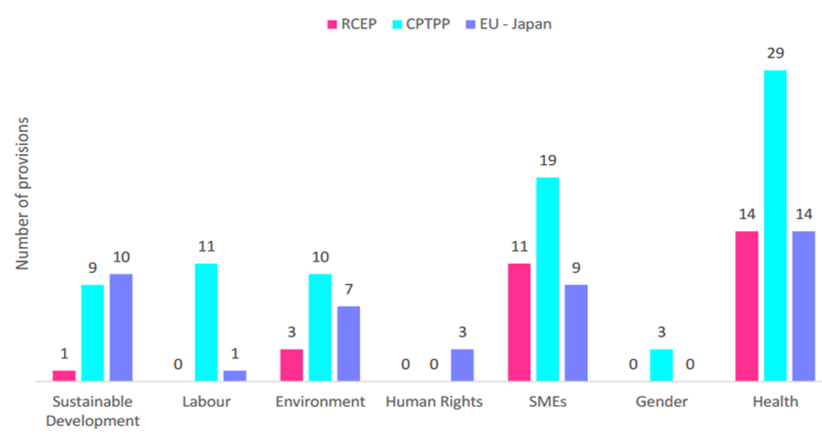
Sustainable Development provisions
in Asia-Pacific Mega RTAs
Source: Malingrey and Duval (2022), Mainstreaming Sustainable Development Provisions in RTAs: Comparative Analysis and Way Forward for RCEP.

Slide 11
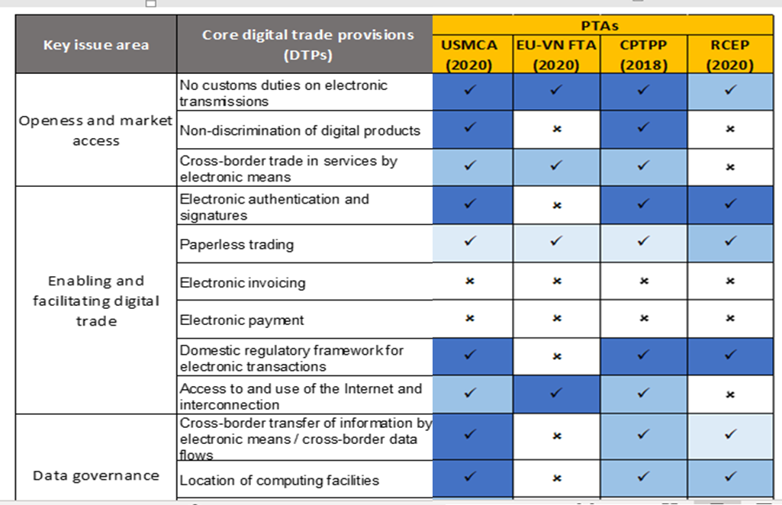
Digital trade provisions in CPTPP and RCEP

Slide 12
On trade facilitation provisions in mega-regional trade agreements
WTO TFA+; General push for digitalization of procedures / paperless trading and related cooperation
But
Often lack specificity 🡪 typically found in separate agreements, e.g.
(regional) Single Window Agreements, e.g. ASEAN SW
Mutual Recognition Agreements of Authorized Economic Operators (or of NTM conformance procedures)
Transit/transport facilitation agreements

Slide 13
Besides & beyond mega-regional trade agreements…

Slide 14
Asia-Pacific PTAs: More digital, focused and resilient?
Digital Trade/Economy Agreements
Japan-USA DTA (2019); DEPA (2020); Singapore-UK DEA (2022)
“Mini FTAs”
Less formal technical cooperation deals
MoUs based on existing PTAs
China-Chile MoU on labor and social security cooperation
Thailand mini-FTAs focusing on cooperation with specific regions / industries
Thailand - Kofu, Japan (2021) on cooperation in gem and jewelry
Provisions for trade in times of crisis
New Zealand- UK (2022)
See UN Handbook on provisions for trade in times of crisis and pandemic (2021) / Model RTA chapter on trade in crisis situations
Notes:
Trade agreements tend to embrace extensive scope beyond the traditional area of trade in goods and tariff liberalization.
Apart from trade in goods:
The most common policy areas in the AP PTAs are ‘Custom cooperation and trade facilitation’, followed by ‘Competition policy’ and ‘Intellectual property’ (found in more than 50% of the signed and enforced PTAs)
The least common policy areas in the AP PTAs are ‘Human rights’, ‘Gender’, and ‘Labor protection’ (found in less than 20% of the signed and enforced PTAs).
The evolution is evidenced by various forms:
Deepening PTAs
1.) Comprehensive agreement:
The coverage of PTAs has begun to cover a wide range of areas not directly to trade, such as government procurement, movement of people, labor standards, intellectual property rights, and environmental standards.
New areas relevant to sustainable development (namely, human rights, gender, SMEs, education, etc.) and digital (data protection, cross-border data flows, online consumer protection, location of computer facilities, etc.) have become more prominent and a greater number of these areas can establish in substantive chapter/provision
Plurilateral, for example, CPTPP, RCEP
Bilateral, for example, Comprehensive Economic Partnership Agreement (CEPA)
2.) Upgrading/Adjusting existing agreement:
Several PTAs have modernized by amending the existing provisions or adding new provisions to increase the dept and widen the scope of trade agreements in response to the evolving global economic architecture (Sign/ratify to replace the original context of the Agreement with the text set out in the Appendix of the Protocol).
The key amendment areas are often found to enhance market access for ‘trade in services’ and incorporate an emerging issue, such as ‘e-commerce’.
In particular, regarding e-commerce, the parties add new chapter of e-commerce or add more comprehensive provisions to their existing chapter. For example, the upgraded Australia-Singapore PTA (signed 2016, enforced 2017) includes data flow commitment to meet better need of a modern business. The upgraded China-Chile PTA (signed 2017 enforced 2019) incorporates the e-commerce chapter for the first time.
The revision can be found in the forms of “upgraded agreement”, “second phase agreement” or “supplementary agreement”.
Upgraded Protocol, for example: China-Singapore PTA upgraded; New Zealand-Singapore CEPA upgraded
Second phrase, for example: China-Pakistan PTA second phase, China-ROK PTA second phase
Supplementary agreement, for example: China-Chile: Supplementary Agreement on trade in services; China-Hong Kong, China Supplementary Agreement I-VI; and China-China, Macao Supplementary Agreement I-IV
3.) Stand-alone digital trade agreements
New type of trade agreement which focuses on one specific area of ‘Digital’ has been emerged in 2019 after the sign of the “Japan-United States Digital Trade Agreement” considering as the first stand-alone digital-only agreement (enforced 2020).
(Specific detail, please see in slide 5 ‘Digital’ section)
4.) Crisis responses
Some of the new PTAs signed after 2021 has more focused on health cooperation. For example, New Zealand-United Kingdom PTA explicitly mention COVID-19 and the right to promote access to medicines (signed 2022).
The PTAs can be a tool to facilitate trade during the time of crisis. In line with the current development of deep trade integration, the deeper PTA is found to be more resilient and has relatively better stability against the effect of COVID-19 pandemic (UNCTAD, 2021).
Several PTAs provisions, namely the treatment of essential goods and services, trade facilitation, technical measures, and intellectual property, could play an important role in ensuring essential supplies. These provisions should be binding and incorporate credible enforcement mechanisms to be effective.
The COVID-19 pandemic disrupted international trade flows. It caused some delays in trade negotiations and a slowdown in the number of the new PTAs signed in 2020-2021.
Specifically, there were only 16 PTAs signed in certain periods, while 27 PTAs were signed in the period before the pandemic, 2018-2019. Nevertheless, 2022 shows a positive sign because several agreements and negotiations have been signed and resumed.
ESCAP with UNCTAD and the UNRCs’ Handbook on Provisions and Options for Trade in Times of Crisis and Pandemic provides options of provisions to shape the design of the future agreement to ensure coordination and effective responses under crisis circumstances.
Technical Cooperation through various protocols
At the same time, less formal trade deals are growing. Its characteristic requiring less negotiation time could complement the developing trade environment:
1.) Memorandum of Understanding (MoU):
Several MOUs have been established based on the existing PTAs.
For example, Australia-Indonesia PTA: MOU on Pilot Workplace-Based Training Visa Arrangement; China-Chile PTA: MOU on Labour and Social Security Cooperation
2.) Mini FTA: Recent development is the creation of the MOU by Thailand under the name “Mini FTA” initiated in 2021.
Notably, the “Mini FTA” of Thailand is not about “free trade”, but more about strengthening cooperation (information exchange, organizing trade fairs) of the targeted industries at the city or state level.
As of August 2022, Thailand has signed 5 MOUs with Japan (Kofu : cooperation in gem and jewelry industry), India (Telangana : 1 year, exchange trade information and products such as medicine, IT, furniture, start-up cooperation), China (Hainan: 2 years, exchange trade information, SMEs, food, agricultural and industrial products, e-commerce matching services/ Gansu : cooperation in halal food, agricultural products and logistic services) and the Republic of Korea (Busan: boost trade and accelerate economic partnership).
The first Mini FTA started in July 2021 with Kofu, Japan, and the latest one is Busan, the Republic of Korea in July 2022. Thailand plans to sign more MOUs with other trading partners.

Slide 15
Implications / Way forward
Bigger and deeper regional trade agreements 🡪
More harmonized / consistent rules across larger group of economies = lower cost
But more rules in more areas (e.g. environment) = higher cost
For non-parties, cost of being “out” potentially very high
/
Prioritize digitalization as key to managing procedural complexity ( based on public-private + intergovernmental collaboration)
Develop issue-specific international agreements and standards (e.g., measuring carbon content)

Slide 16
3 related
UN ESCAP work / initiatives

Slide 17
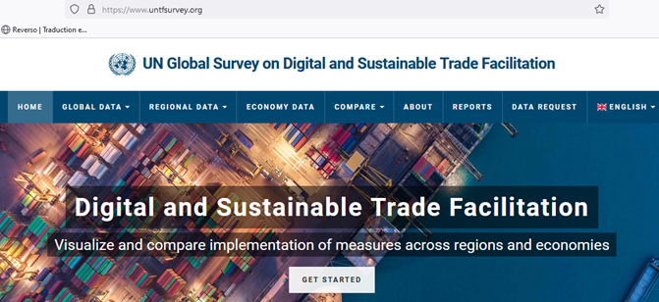
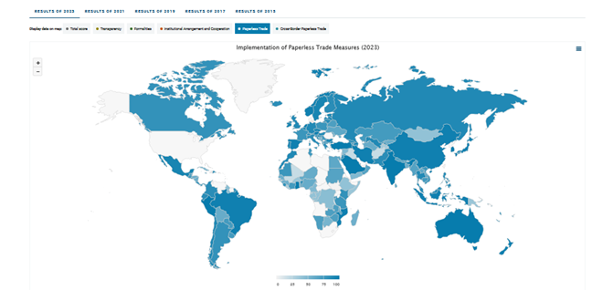
1-UN Global Survey on Digital and Sustainable Trade Facilitation
Overview of implementation of trade facilitation reforms
WTO TFA++
60+ measures
160+ countries
www.untfsurvey.org

Slide 18
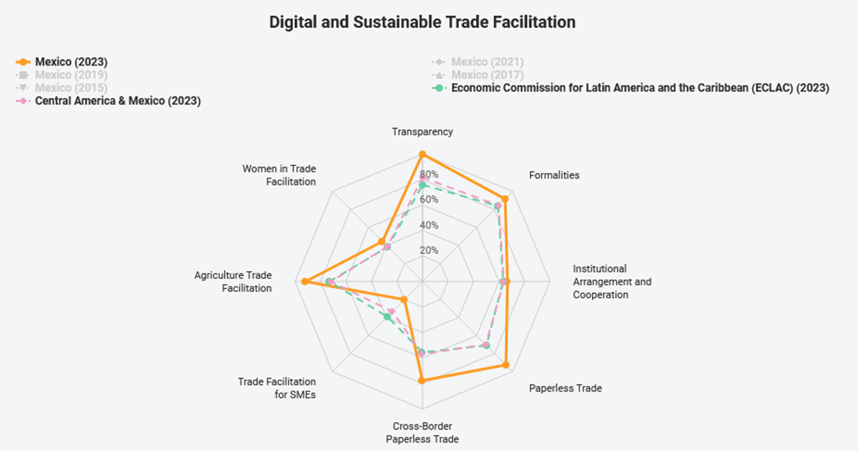
State of play in Digital & Sustainable Trade Facilitation: Mexico
www.untfsurvey.org

Slide 19
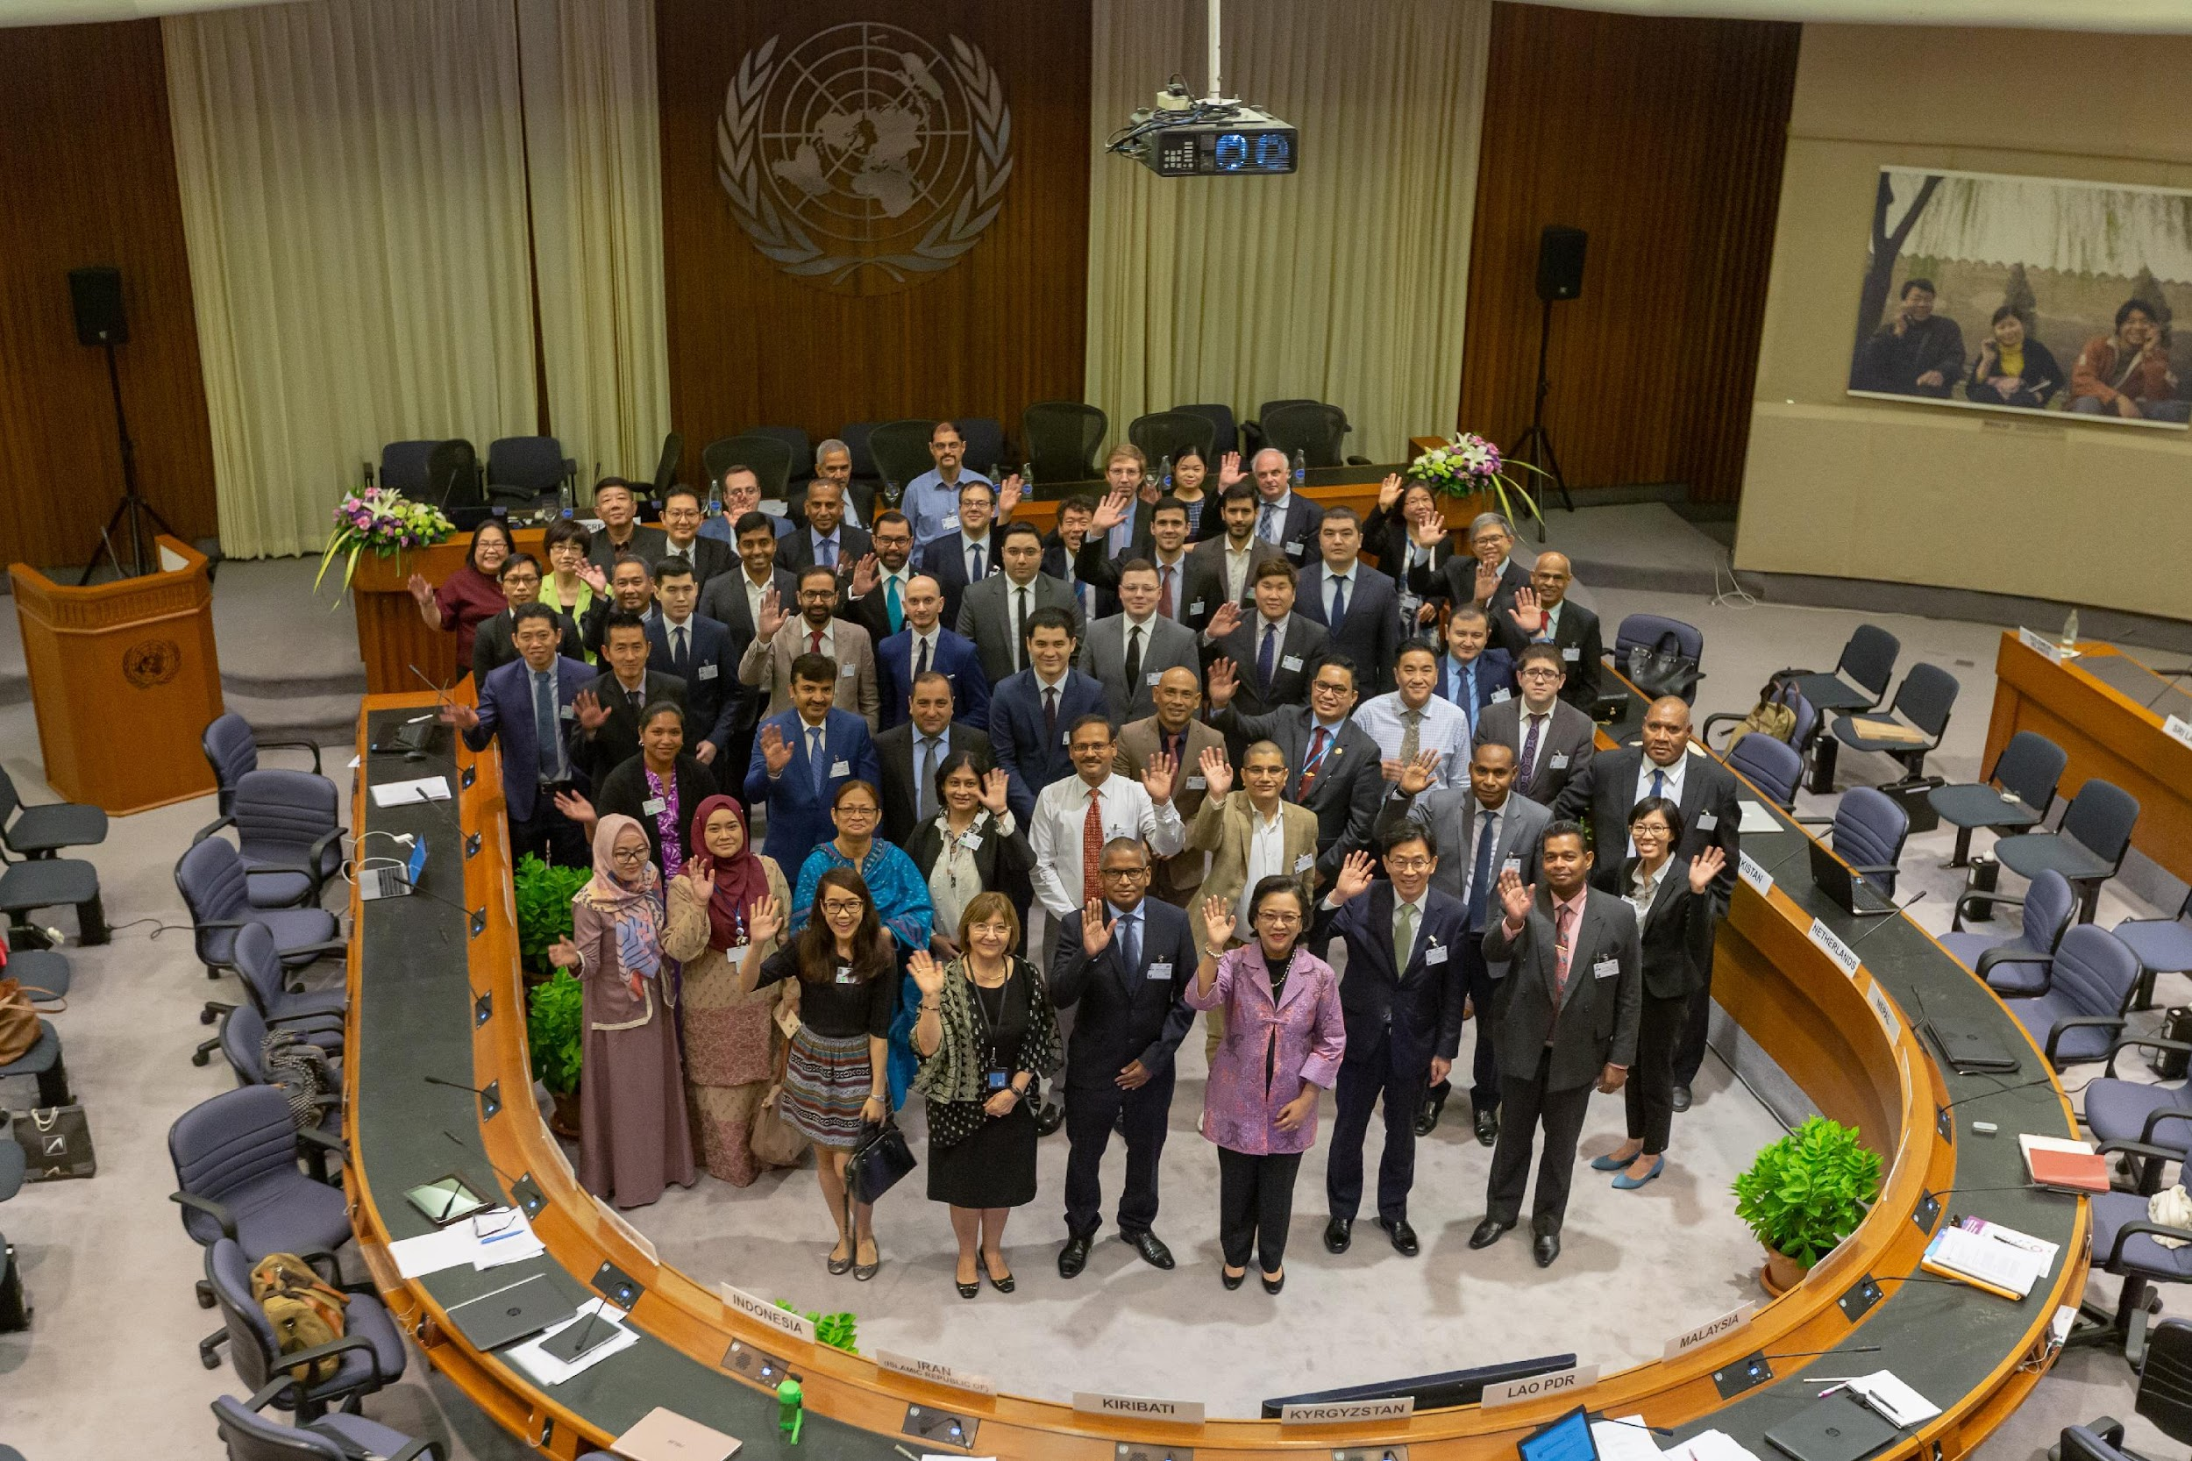
2-The Framework Agreement on the Facilitation of Cross-Border Paperless Trade in Asia and the Pacific (CPTA)
A UN Treaty: enabling and action-oriented
Open to interested (53) ESCAP member states
Entered into force in 2021
Objective
To facilitate cross-border paperless trade (data exchange) among willing ESCAP member states by providing a dedicated intergovernmental framework to develop legal and technical solutions
Complementary to the WTO Trade Facilitation Agreement (TFA) as well as (sub)regional efforts
www.unescap.org/kp/cpta
Notes:
Entry into force of the treaty is a great achievement for our region, confirming the high-level commitment, vision and leadership of Asia and the Pacific on trade digitalization.
However, this does not mean the journey is complete – rather, it is the start of the journey focusing on turning cross-border paperless trade into reality through cooperation, testing, innovation and actual implementation.

Slide 20
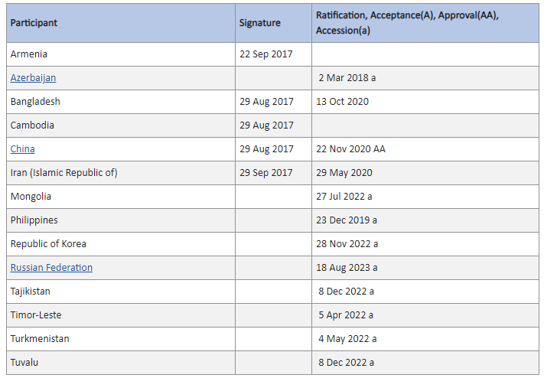
The Framework Agreement on the Facilitation of Cross-Border Paperless Trade in Asia and the Pacific (CPTA)
100% growth in number of parties in 2022 (YoY)
More countries expected to join in 2023/24
Work on-going on model protocols for data exchange and identification of pilot projects
Next session of the Paperless Trade Council: June 2024
https://treaties.un.org/Pages/ViewDetails.aspx?src=TREATY&mtdsg_no=X-20&chapter=10&clang=_en#EndDec
Notes:
I also commend the G20 Presidency of Indonesia for highlighting sustainable global value chains.
Trade facilitation has a vital role in minimizing the negative effects the transportation of goods across borders can have on the environment.
Indeed, accelerating trade digitalization and a move to paperless trade is crucial. In addition to a 13 per cent reduction in trade costs that may be expected from cross-border paperless trade implementation, ESCAP research suggests that achieving paperless trade in Asia and the Pacific would be equivalent to planting 400 million trees.
The Framework Agreement on Facilitation of Cross-Border Paperless Trade in Asia and the Pacific bears great importance in this context.
This United Nations treaty entered into force in 2021, and with eight active Parties, it already accounts for 37 per cent of regional trade. At the moment, this UN treaty is only open to the ESCAP member states. However, we have heard some voices from the development partners and some countries that this treaty should be expanded globally. ESCAP is certainly willing to work with its member states to explore this possibility.

Slide 21
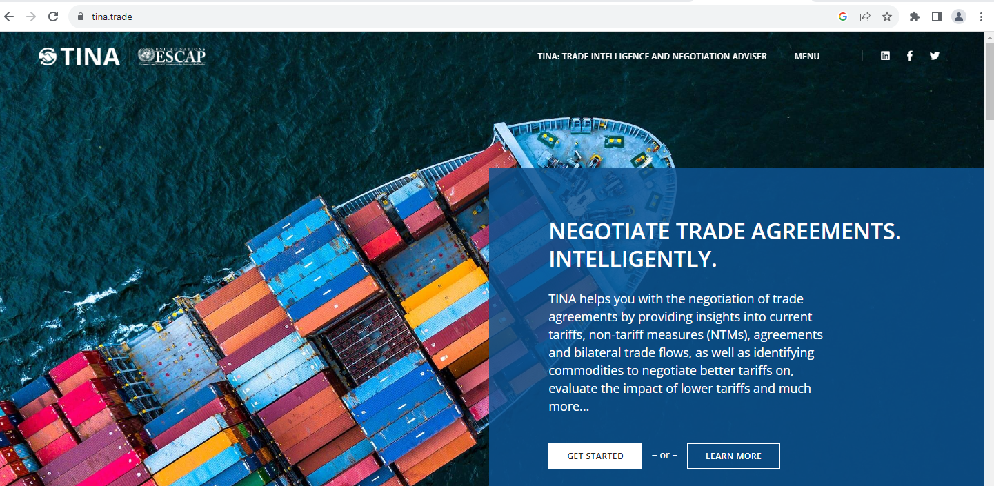
3- Virtual Trade Intelligence and Negotiation Adviser (TINA) www.tina.trade
Courses on trade policy/negotiation
Including self-service online certificate courses

Slide 22
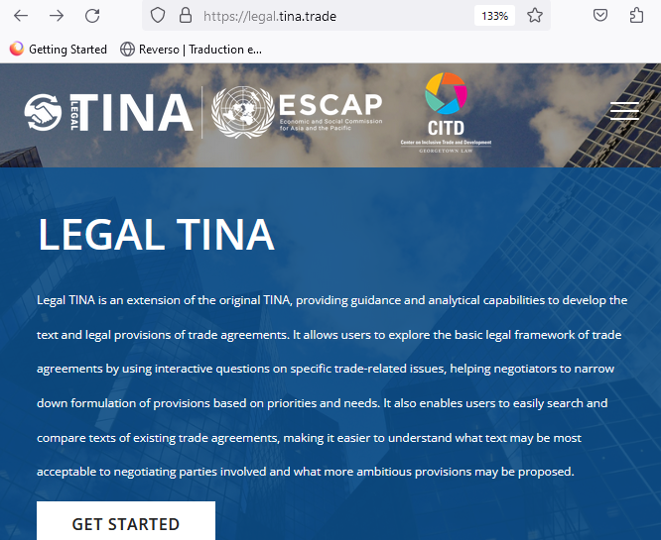
“Legal TINA” – public release, beta version, 27 Sep 2023
Advanced text search of 460+ trade agreements
Guidance on legal provisions in various areas of RTAs
In cooperation with Georgetown Law CITD; other partners welcome!

Slide 23
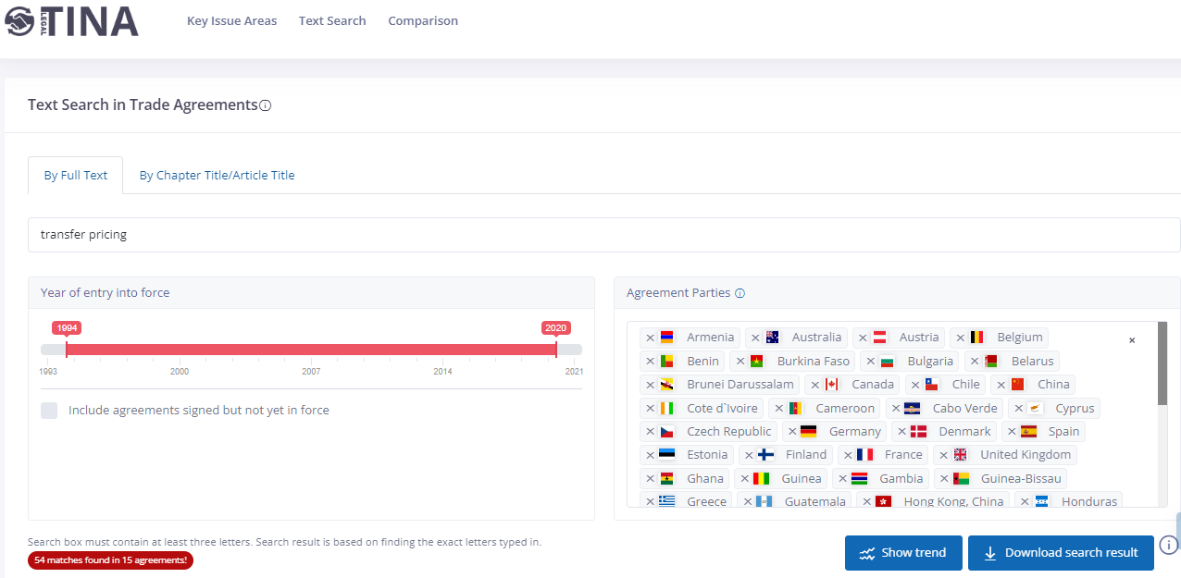

Slide 24
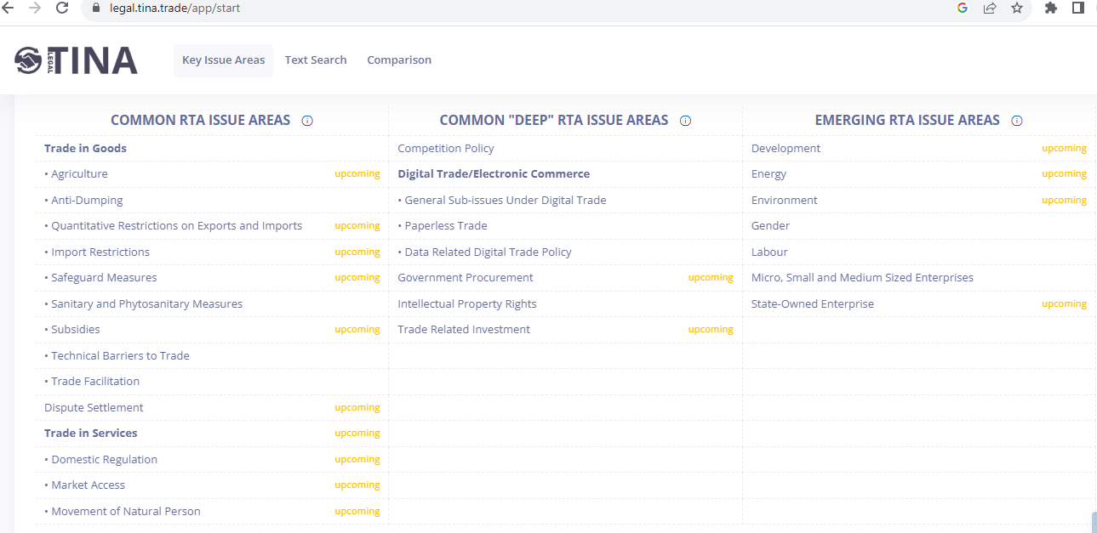
All welcome to explore legal provisions in PTAs using legal.tina.trade
Looking for contributors to develop and maintain content in specific RTA issue areas

Slide 25
THANK YOU
duvaly@un.org
https://www.unescap.org/our-work/trade-investment-innovation/trade-facilitation-digital-trade

Slide 26
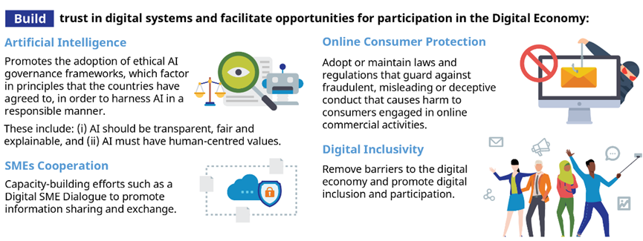
Digital Economy Partnership Agreement (2020)

