Slide 1

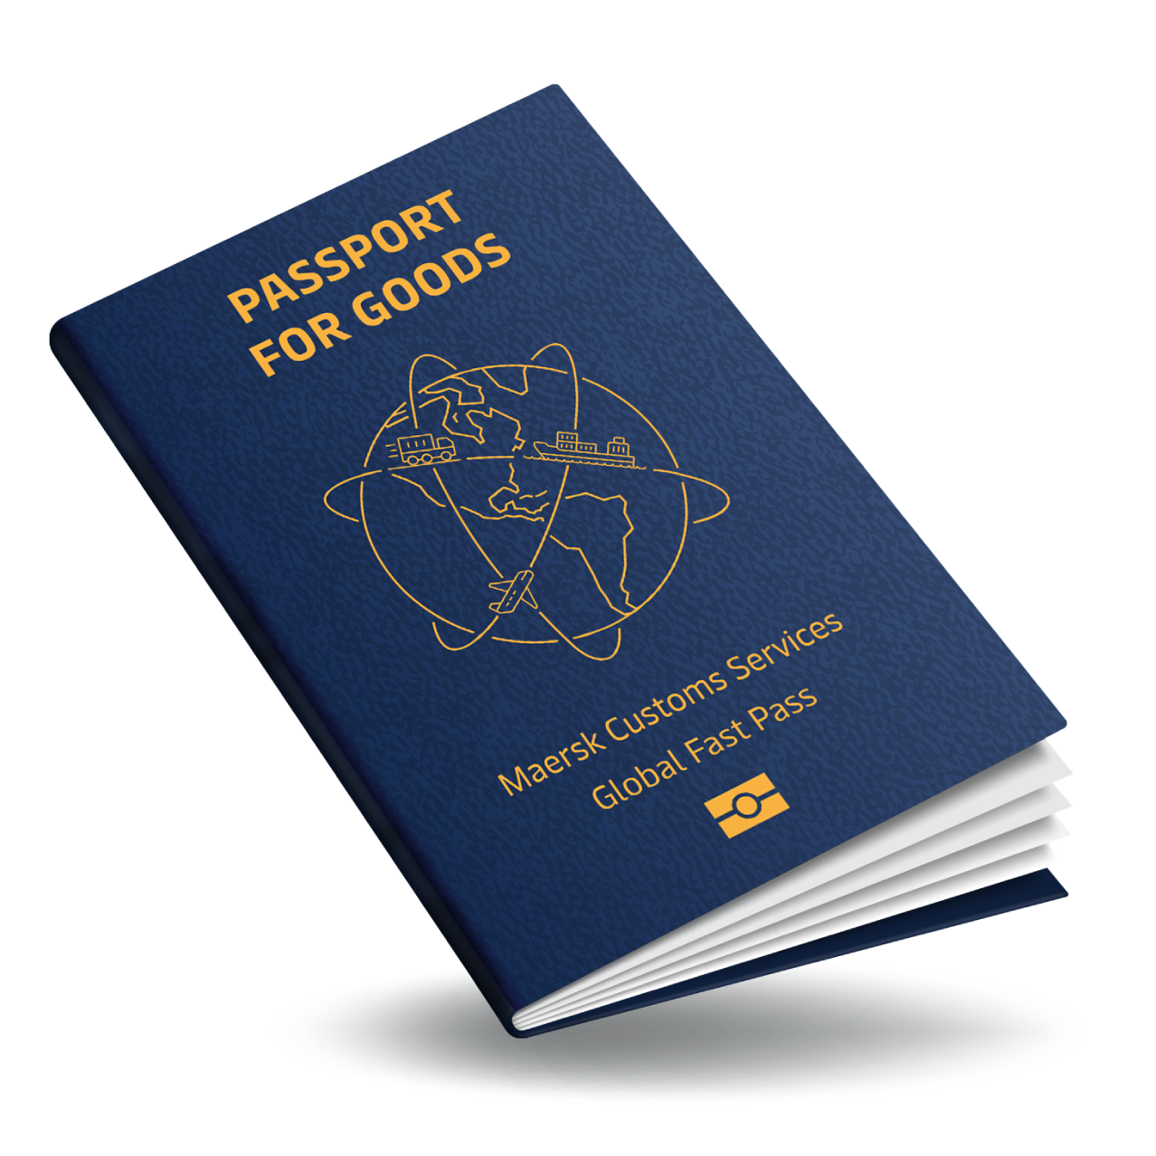

What if?

Slide 2
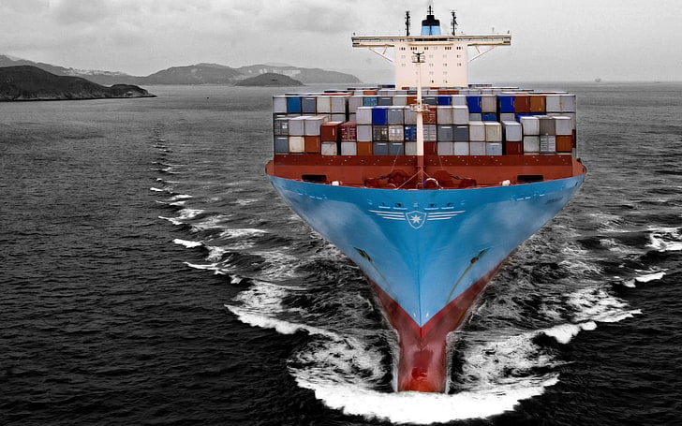
Headline
Global Trade 2.0
The New Paradigm
for International Trade
is Already Here
Smart Customs
Smart Borders
Smarter Trade
XVII WORLD CUSTOMS LAW MEETING
PORTO 3-5 September 2025’
‘CUSTOMS CONTROL IN THE ERA OF SUSTAINABILITY, DIGITALIZATION AND SECURITY IN A TRADE WAR LANDSCAPE’

Slide 3
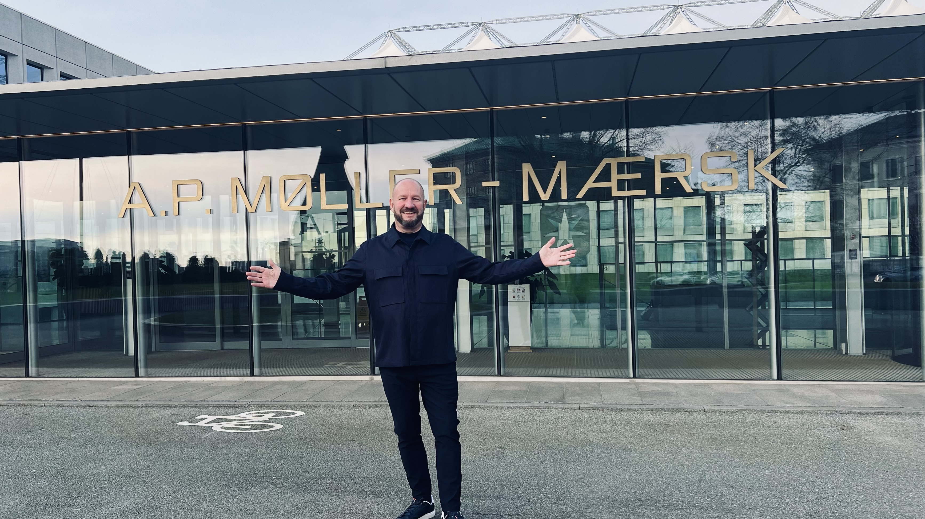
Global Head of Trade and Customs Consulting Maersk
MD KGH Consulting former Director World Customs Organization former Director General Swedish Customs
Doctor of Education (hc)
PhD studies Trade Compliance
Master in International Customs Law
Lars Karlsson

Slide 4
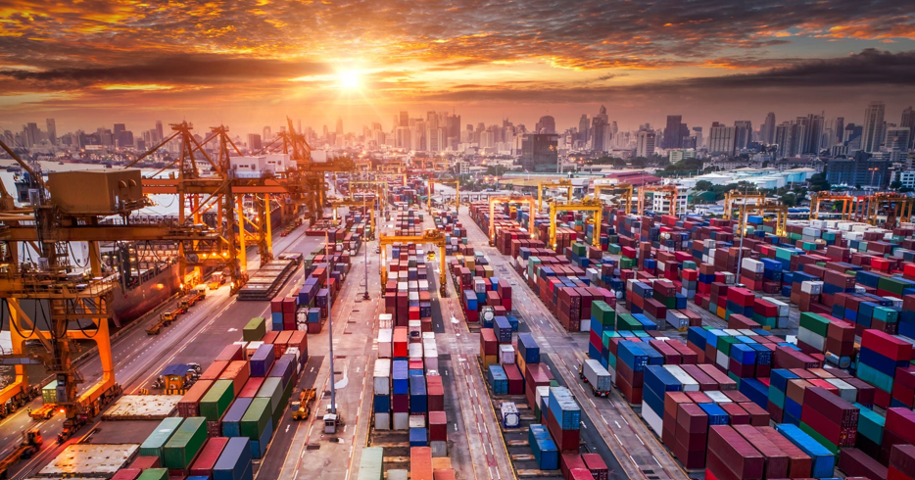
INTERNATIONAL TRADE IS GOOD
BUT WE LIVE IN AN UNPRECEDENTED TIME OF UNCERTAINTY

Slide 5
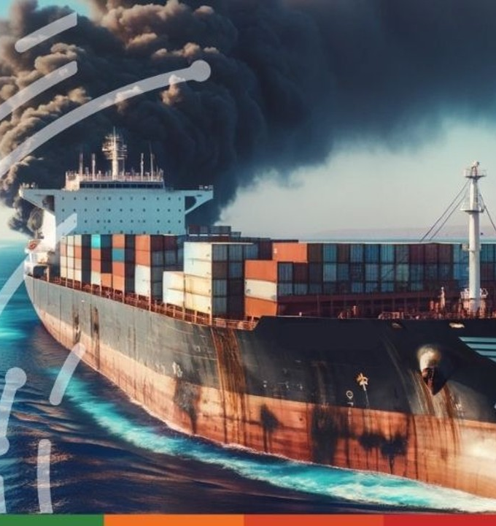
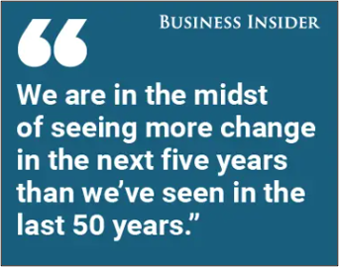
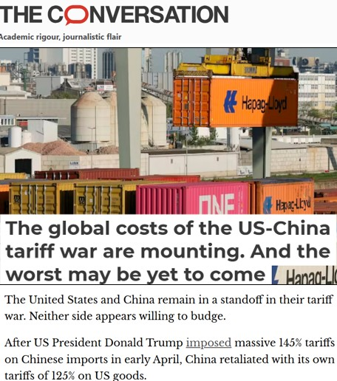
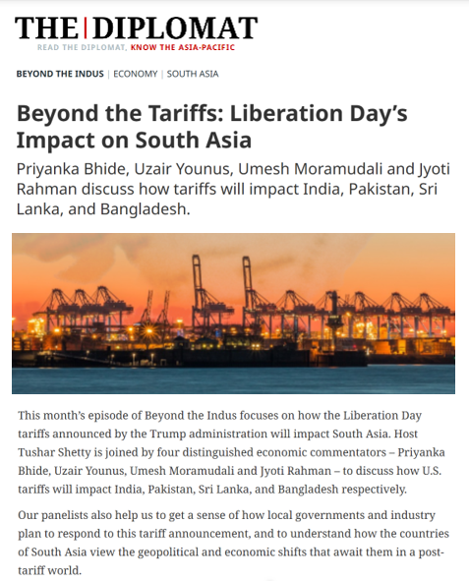
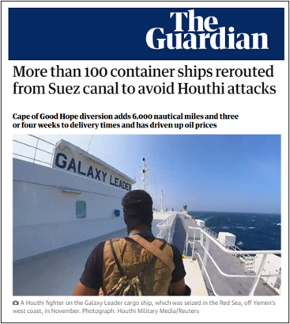
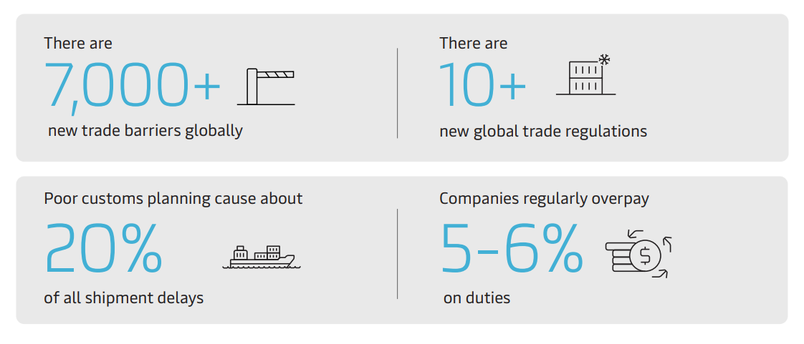
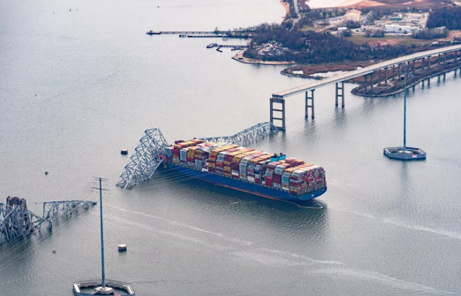
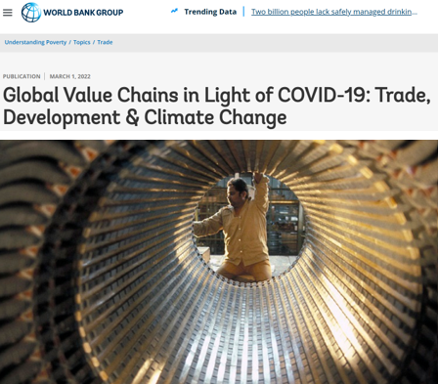
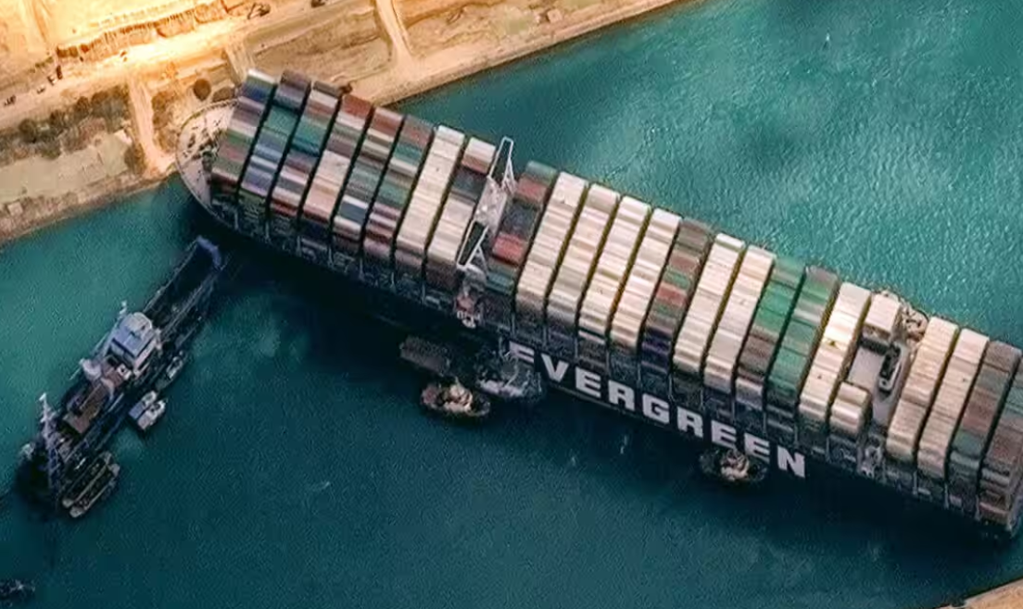
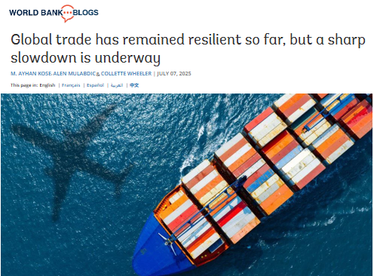
The WORLD
A New Normal is here
Higher tariffs are here to stay
Companies should not leave money on the table

Slide 6
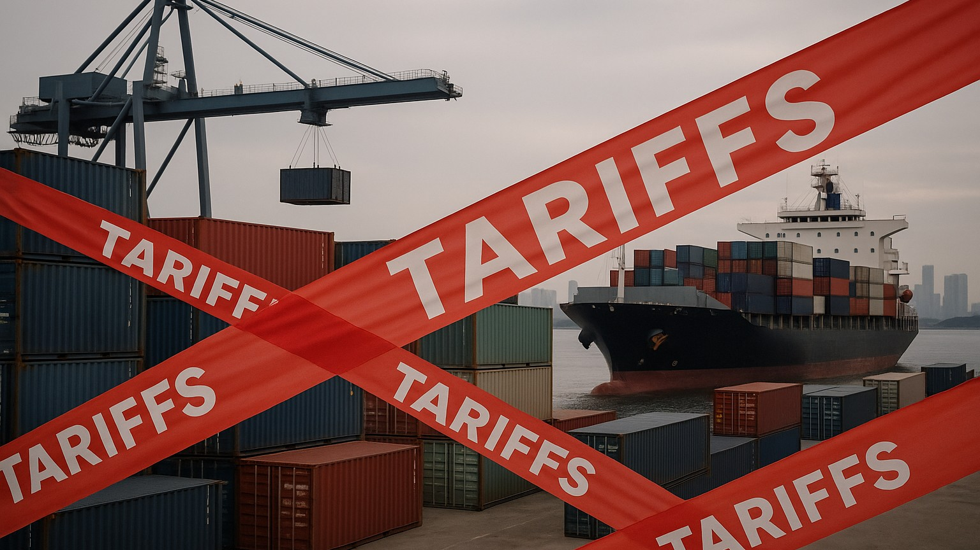
Headline
The new tariff landscape is here to stay
What if?
RULES OF ORIGIN
TRANSHIPMENT

Slide 7
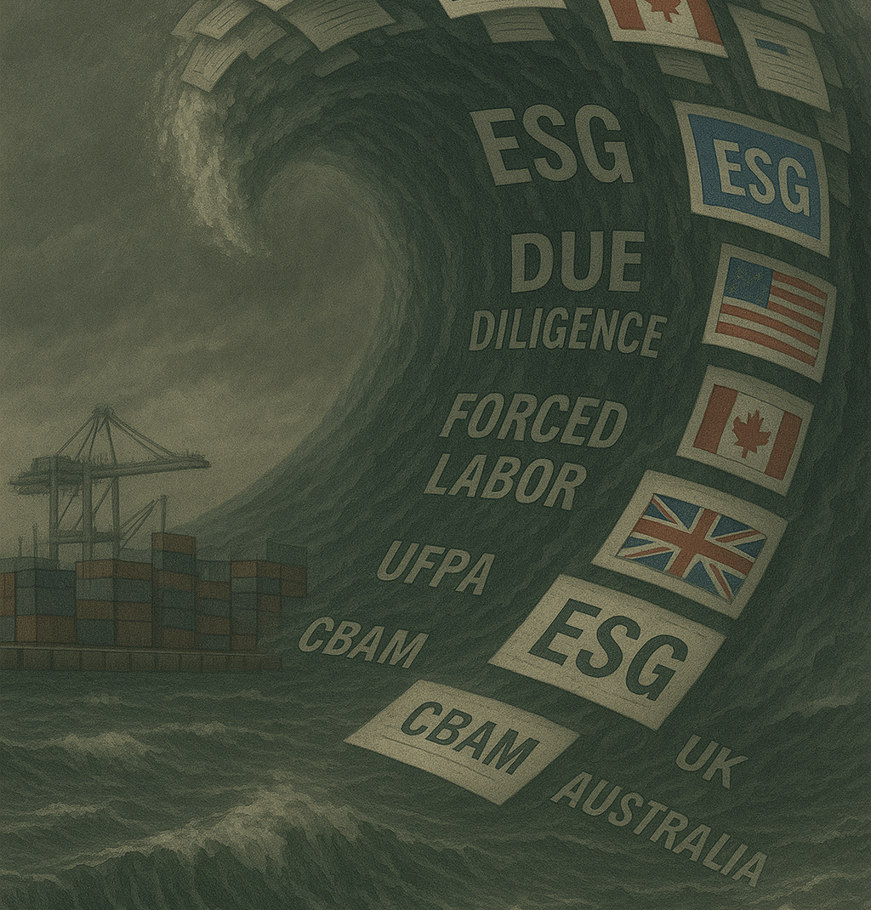
THE ESG TSUNAMI Environment Social Protection & Governance regulations for trade
Four regulations in operations
Legislation passed in a number of countries
10 more regulations on the way
All similar – but different
Multitier Supply Chain application
Draconian penalties / Market Access Mechanisms
10x enforcement levels, powered by AI
A competence challenge for Customs and other Border Agencies

Slide 8

Are you compatible with Global Trade 2.0?
To all companies
Notes:
Keep on-screen words to a minimum throughout

Slide 9

What to do when it is all challenges?
Is there an answer?

Slide 10


DATA
Treat it like gold in the bank
Because it is

Slide 11

AI in customs & trade
’AI and machine-learning need to train on real validated data’
3 examples

Slide 12
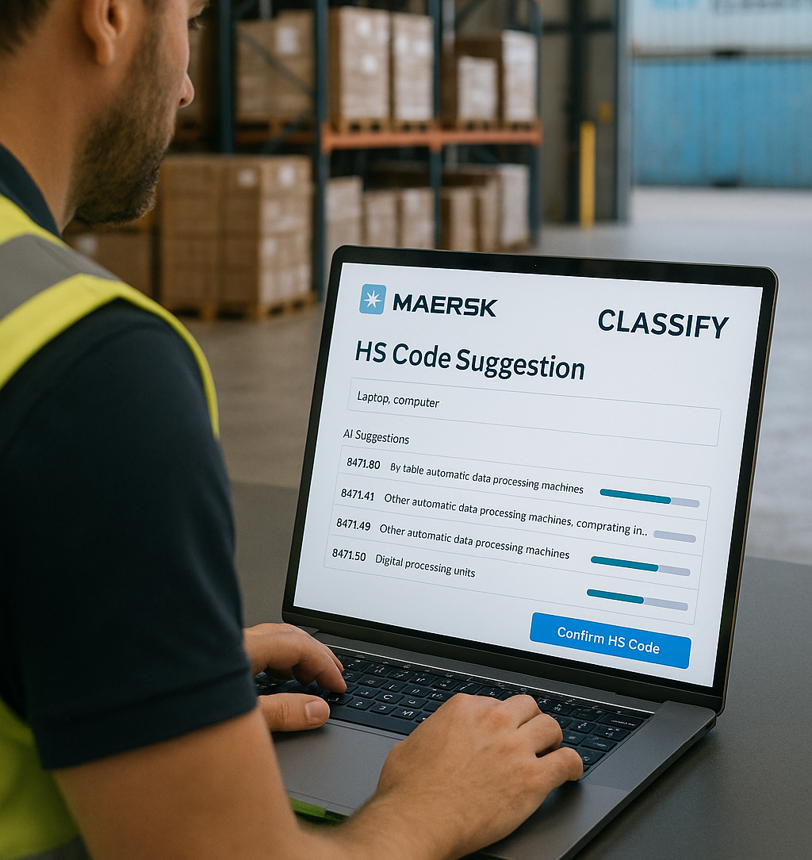


Maersk Classify
AI-powered HS Classification
A managed service
’We do 6 million customs declarations/year.
Maersk Classify is trained on expert classifications from 25 million customs declarations’
Notes:
Keep on-screen words to a minimum throughout

Slide 13
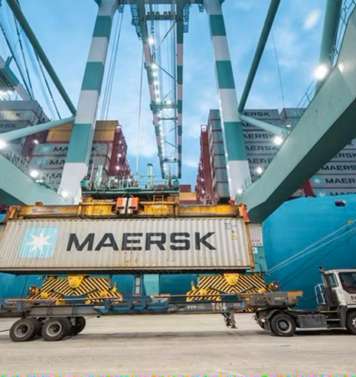

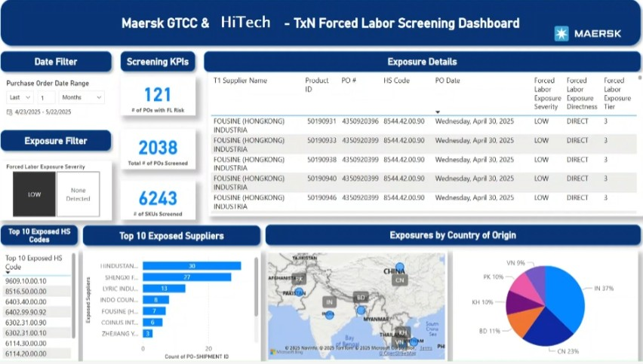
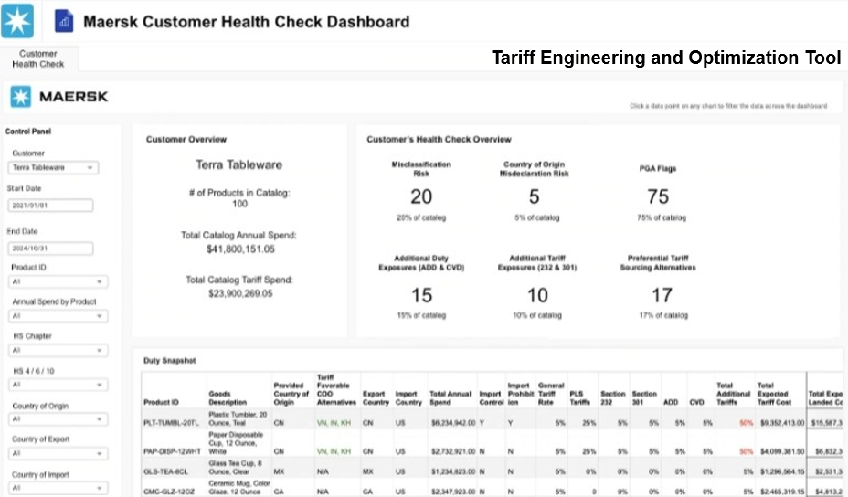
Maersk Trade and Tariff Studio (TTS)
An AI powered one stop shop to manage trade compliance risks and opportunities
Operational Tariff Management on master data
All tariff books combined with Maersk Classify (AI)
Upstream transactional screening for risks using commercial data (ESG risks, tariff risks, sanctions, money laundry, regular compliance risks)
Supply Chain Visibility and Actioning
One modular global platform tool for multiple markets / multiple risks
Notes:
Keep on-screen words to a minimum throughout

Slide 14
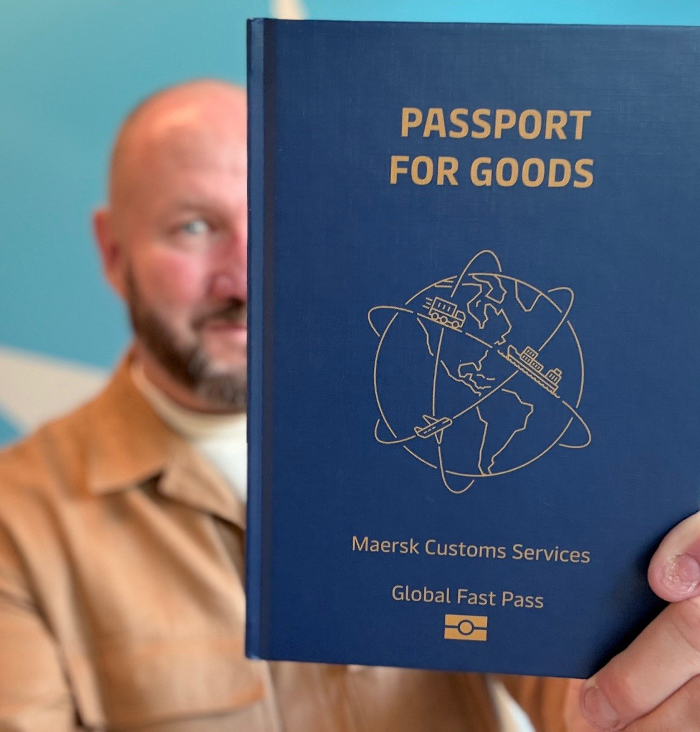


‘Passport for Goods’
A digital ‘Passport for Goods’
A Trust Badge for predictability & speed
  Trade Compliance Data
  Supply Chain Visibility Data
  Customs Data
  Smart Container Data
Upstream screening for compliance risks, sanctions, ESG related risks, tariff risks (ROO/transhipment)
Early warning systems
Accessable for customs and border agencies at source way before goods arrives
Trust the truth!

Slide 15
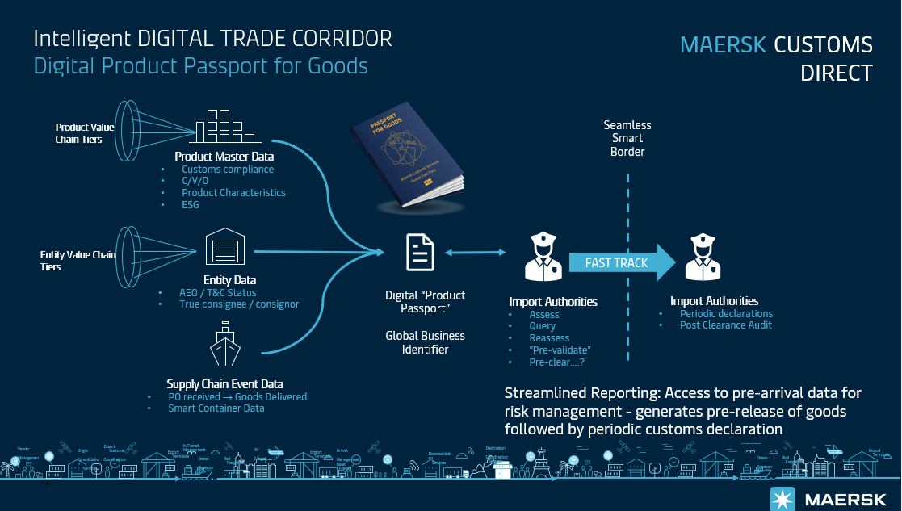
Interconnected /Interoperable

Slide 16
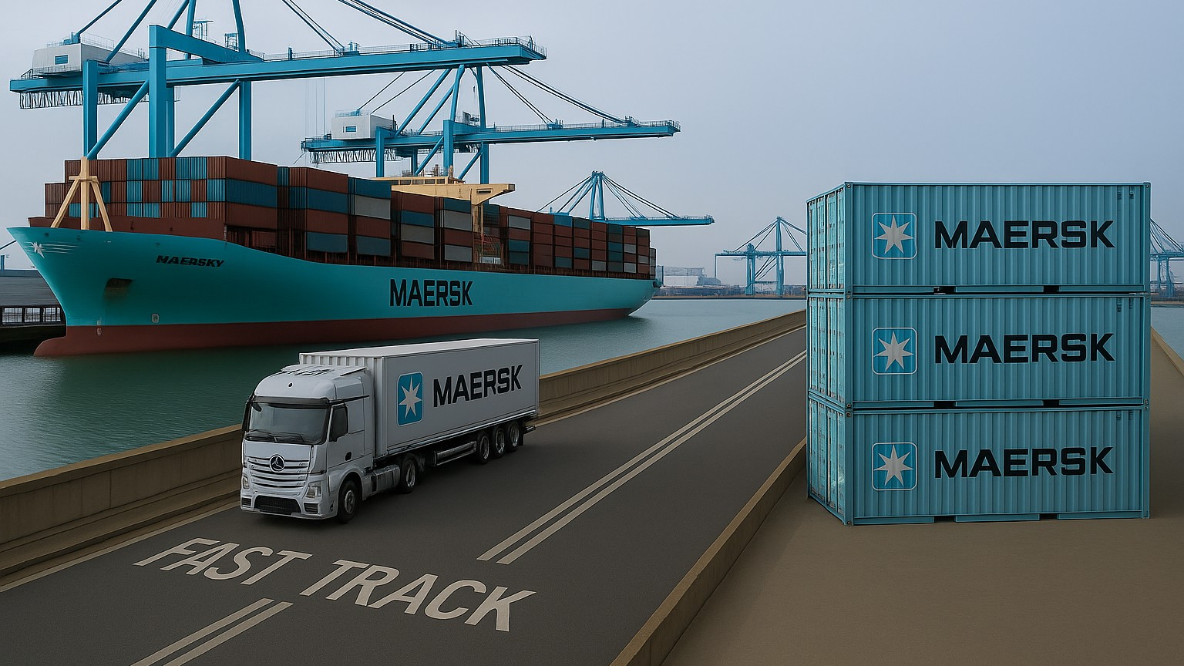

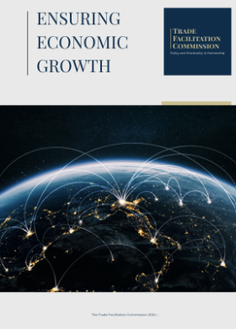
Headline
FAST-TRACK with dedicated lanes
Trust & Check
Pre-release of goods
Streamlined reporting
Centralized Clearance
What if?
‘Improving UK GDP by £40bn or £3,500 per household’
UK Trade Facilitation Commission and UK Growth Commission

Slide 17

Headline
Transforming challenges to an opportunity
Turning a challenge
into an opportunity
Notes:
Make the title as engaging and challenging as possible. We want to capture attention immediately and it could bring passers-by to the booth to watch.

Slide 18

THE WAY FORWARD
What to think about
‘Customs has never been more important than now, but it will be more important tomorrow’
Trade Compliance is a license to play !
Own your customs and trade data !
The answer to uncertainty is agility !
Kill segmentation ! Look end-to–end !
Wait and see is not a strategy - Be ahead of the curve !
Evaluate your partner network, update it !
Framework regulation is faster !
Let’s pilot test together, early !
Make your challenges your differentiator !

Slide 19

ALL PHOTOS USED WITH PERMISSION

