Slide 1
XVI WORLD CUSTOMS
LAW MEETING, BERLÍN 2023
Modernisation of the Revised Kyoto Convention
– General Report –
Prof. Dr. Achim Rogmann LLM (Murdoch), Brunswick European Law School (BELS)
27-29
SEPTEMBER 2023

Slide 2
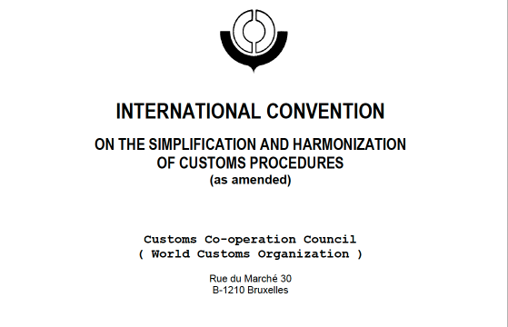
Agenda
Overview: Kyoto Convention/Revised Kyoto Convention
Revision process
General/cross-cutting Issues
Issues related to the Body/General Annex
Issues related to the Specific Annexes
The way ahead

Slide 3
Overview – Kyoto Convention and Revised Kyoto Convention
1973: adoption of the International Convention on the Simplification and Harmonization of Customs Procedures (= Kyoto Convention).
1974: Kyoto Convention entered into force in 1974 with 63 Contracting Parties.
1994: decision to revise the Convention.
1999: adoption of the Revised Kyoto Convention (RKC).
2006: RKC entered into force after 40 CPs acceded to the Protocol of Amendment.
June 2023: Accession by the Republic of The Gambia with effect of 24 September 2023 – making it the 134th Contracting Party to the Convention which is one of the flagship conventions of the World Customs Organization. 2 CPs not WCO Members.

Slide 4
Overview –Revised Kyoto Convention: Structure
The RKC consists of three parts:
- the Body (text of the convention)
- a General Annex (GA) with 10 Chapters
- 10 Specific Annexes (SAs) with 25 Chapters.
The Body and the GA are binding on all CPs and no reservations are possible. Acceptance of SAs or parts of it is only optional and reservation to Recommended Practices can be submitted.

Slide 5
Overview –Revised Kyoto Convention: Structure
Whereas the GA aims at cross-cutting aspects of Customs procedures, the 10 SAs deal in its 25 Chapters with treatment of goods under customs control:
Specific Annex A – Arrival of goods in a Customs territory
Specific Annex B – Importation
Specific Annex C – Exportation
Specific Annex D – Customs warehouses and free zones
Specific Annex E – Transit
Specific Annex F – Processing
Specific Annex G – Temporary admission
Specific Annex H – Offences
Specific Annex J – Special Procedures (Travelers, Postal Traffic, Means of Transport…)
Specific Annex K – Origin

Slide 6
Overview –Revised Kyoto Convention: Structure
Even with 134 CPs no part of the SAs could attract more than 50 acceptances. The EU and its 27 Member States did not accept any parts of the SAs yet.
Source: WCO Secretariat
PG0327Ea

Slide 7
Revision Process –Review Approach and Aim
In 2016 an iniative has been launched to review the current RKC
Main reasons for the current review:
rapid changes of international trading landscape,
desire to keep the RKC as WCO flagship convention and a blueprint for modern and efficient customs procedures in the 21st century.
Trade challenges
global value chains, free trade agreements, international supply chains,
enactment of the WTO Trade Facilitation Agreement,
technological developments, digitalization (e-commerce),
socio-economic developments...

Slide 8
Revision Process – Review Approach and Aim
Objectives of the review
enhance RKC’s role in trade facilitation,
future proofing of the convention while considering the time-consuming procedure (negotiations/ratifications) for essential modifications.
Method and goals:
comprehensive review covering all the content and provisions of RKC,
ensure an overall analysis of gaps and identify need to accommodate updated or new concepts in WCO instruments and tools.

Slide 9
Revision Process – Review Approach and Aim
June 2018: RKC/MC set up the Working Group on the comprehensive review of the Revised Kyoto Convention (WGRKC),
Sept. 2018 until October 2021: 8 meetings of the WGRKC,
3 Sub-Groups:
Sub-Group I – The RKC Body and relevant horizontal issues,
Sub-Group II – The RKC General Annex (GA) and its Guidelines,
Sub-Group III – The RKC Specific Annexes (SAs) and their Guidelines,
From 5th meeting: involvement of external stakeholders and academia,
Work during the intersession regarding the received proposals and concepts (WCO Secretariat).

Slide 10
Revision Process – Review Approach and Aim
Issues raised at the 1st Meeting of the WGRKC:
achieving the balance between trade facilitation and security,
significance and strengths of the binding nature of RKC and its different parts (soft law vs. hard law),
periodic review mechanisms/monitoring,
need for implementation mechanisms, technical assistance and capacity building,
enhanced use of electronic data submission.

Slide 11
Revision Process – Concepts and Proposals
A total of 186 proposals regarding the Body, General Annex (GA) and Specific Annexes (SAs) of RKC covering 37 concepts have been presented and discussed.
140 proposals from Members and 46 from external stakeholders:
Source: Final Report of WGRCK, PR0041E

Slide 12
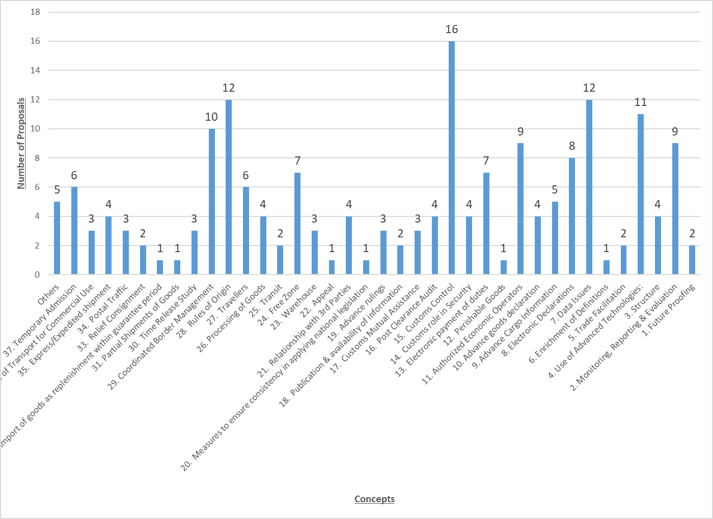
Revision Process – Concepts and Proposals
Source: Final Report of WGRCK, PR0041E

Slide 13
Revision Process – Concepts and Proposals
Concepts with largest number of proposals:
Customs control (16)
rules of origin (12)
data issues (12)
use of Advanced Technologies (11)
Coordinated Border Management (10)
Authorized Economic Operator – AEO (9)
monitoring, reporting and evaluation (9)
electronic declaration (8)
electronic payment of duties (7)

Slide 14
Revision Process – Concepts and Proposals
Proposals from academia:
Comprehensive rules on liability to duties and taxes
by Wolffgang/Harden/Rogmann => presented under the headline “electronic payment of duties”. See our publication ‘Why the Future Revised Kyoto Convention Should Contain Comprehensive Rules of Customs Debt’ in 14(2) World Customs Journal 29 (2020).
Option to combine inward processing and processing for home use (by M. Lux).

Slide 15
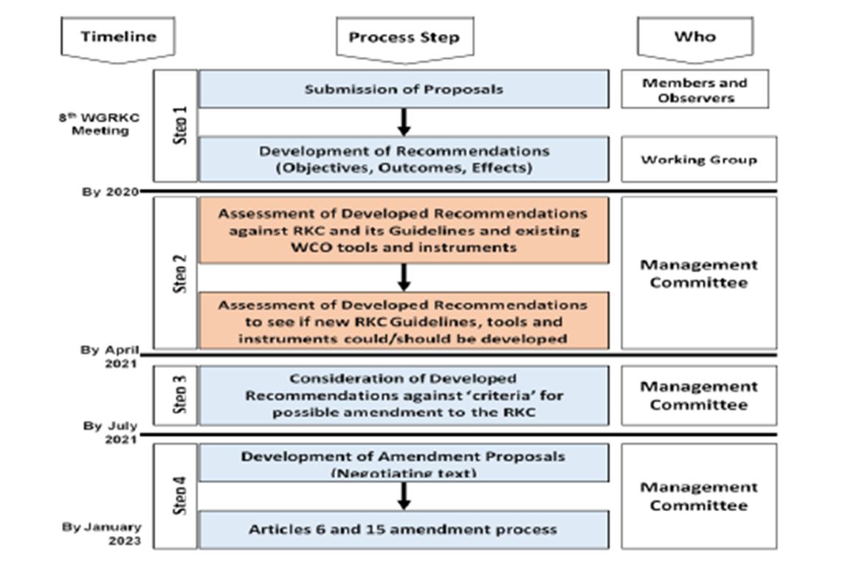
Revision Process – Way forward – Four Step Framework of the RKC Management Committee
Around 70% of the proposals “survived” the four-step filtering system decided by the RKC/MC.
Source: Final Report of WGRCK, PR0041E

Slide 16
General/Cross-cutting Issues
new/revised provisions stipulating the “what” or the “how”?
future proofing (periodical update mechanism/flexibility in adapting to new developments),
monitoring, reporting and evaluation,
Customs legislation to be consistently implemented and applied in a predictable and transparent manner throughout Customs territories,
structure: reduction in the number of SAs, but no fundamental changes to the structure, especially the non-binding nature of the SAs

Slide 17
Issues related to Body/GA – Customs Declarations
goods declaration by electronic means as standard,
information required to be based on WCO Data Model,
permit lodgment of supporting documents in a non-editable format or scanned copies thereof by electronic means,
permit the lodgment of electronic declarations at any time,
utilisation of central customs clearance,
(no) amendment of declaration after the release of the goods,
declarant shall (not) be allowed to withdraw declaration before the goods exit the Customs territory.

Slide 18
Issues related to Body/GA – Risk Management
a definition of the central term “risk” is to be added,
in general: customs control shall be interlinked with risk management,
also selection of persons/consignments for post clearance audit shall be conducted in a risk-based manner,
risk management shall also be used as tool to expedite the release of goods.

Slide 19
Issues related to Body/GA – AEO Programmes
AEO under the SAFE Framework to be implemented into the future RKC as transitional Standard,
Customs shall provide benefits to AEOs, including those arising from mutual recognition agreements/arrangements among partner Customs administrations,
at issue: AEO criteria to be met specified either in
national legislation,
WCO AEO Guidelines.

Slide 20
Issues related to Body/GA – Customs Procedures
Warehousing procedure
enhance the efficiency of manufacturing and supportive operations,
extend the area of responsibility for warehouse operators,
enhance the role of Customs, including enforcement of rules.
Free Zones
revision of current definition to avoid existing ambiguity (proposal finally failed in the last meeting).

Slide 21
Issues related to Body/GA – Rules of Origin
RoO not part of the revision of the KC in the 1990’s due to negotiations in the WTO harmonization failed,
establish a clear distinction between preferential and non-preferential origin,
amend the definition that only refers to “country” as origin of goods,
establish standardised typology and terminology for different forms of cumulation.

Slide 22
Issues related to Body/GA – Time is Money
Customs shall carry out performance measurements of its processes and procedures (Time Release Studies),
to be conducted periodically, no special tool to be used,
when necessary, publish a report/findings in line with relevant international guidelines (at issue),
benchmarking should be applied,
→ Where to integrate it into the future RKC? (inserting it into the GA as new Transitional Standard?).

Slide 23
Way Ahead
current drafts show:
partial alignments to the TFA,
integrating of some other WCO instruments into the RKC,
enhanced inclusion of GATT-related aspects,
existing structure of the Convention (body/GA/SAs) will be kept unchanged,
work still in progress and not yet completed,
WCO Secretariat will compile by December 2023 a list of the potential draft texts to the RKC/MC for its consideration,
formal amendment process to be commenced in spring 2024 at the earliest.

Slide 24
Thank you for your attention!
Prof. Dr. iur. Achim Rogmann LLM
a.rogmann@ostfalia.de
http://bit.ly/BELS-Customs

