Slide 1
PERSPECTIVES OF THE MULTILATERAL TRADING SYSTEM
FERNANDO DE MATEO
ASSOCIATE PROFESSSOR-RESEARCHER AT EL COLEGIO DE MÉXICO
FORMER AMBASSADOR TO THE WTO

Slide 2
% OF WORLD GDP (1700-2022)

Slide 3
GDP GROWTH FORECAST (2023 & 2024)

Slide 4
HEADLINE INFLATION RATE

Slide 5
THE END OF THE GLOBALIZATION PROCESS?

Slide 6
ECONOMIC CONVERGENCE BETWEEN DEVELOPING AND ADVANCED ECONOMIES

Slide 7
EVOLUTION OF WORLD MERCHANDISE TRADE VOLUME, 1950=100

Slide 8
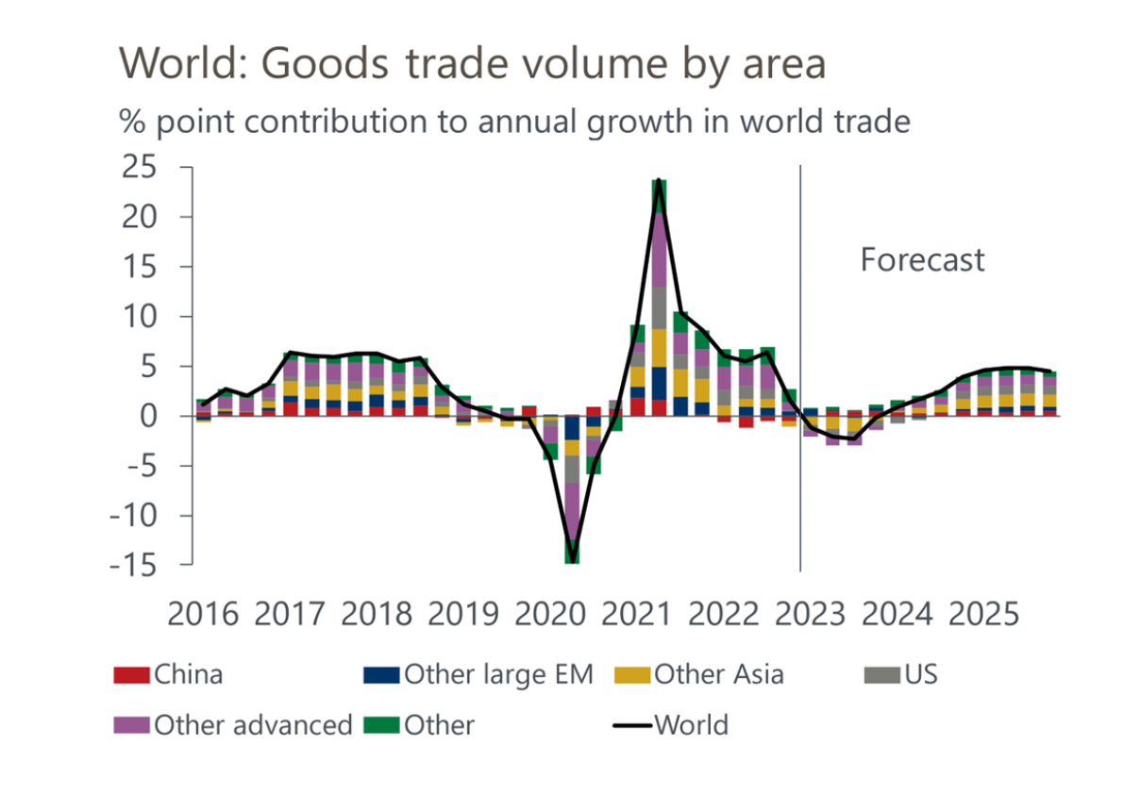

Slide 9
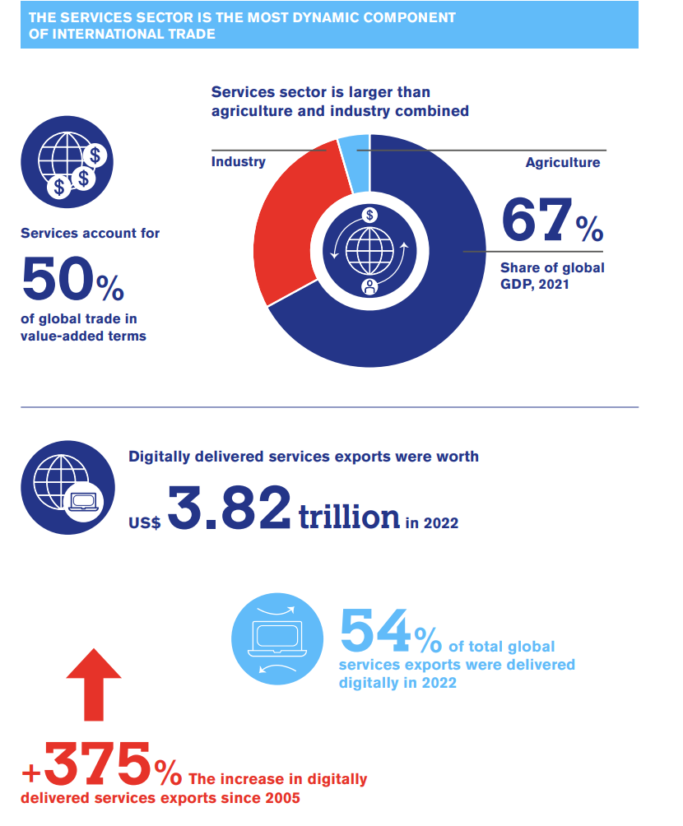

Slide 10
TOP EXPORTERS AND IMPORTERS OF INTERMEDIARY PRODUCTS (4Q 2022)

Slide 11
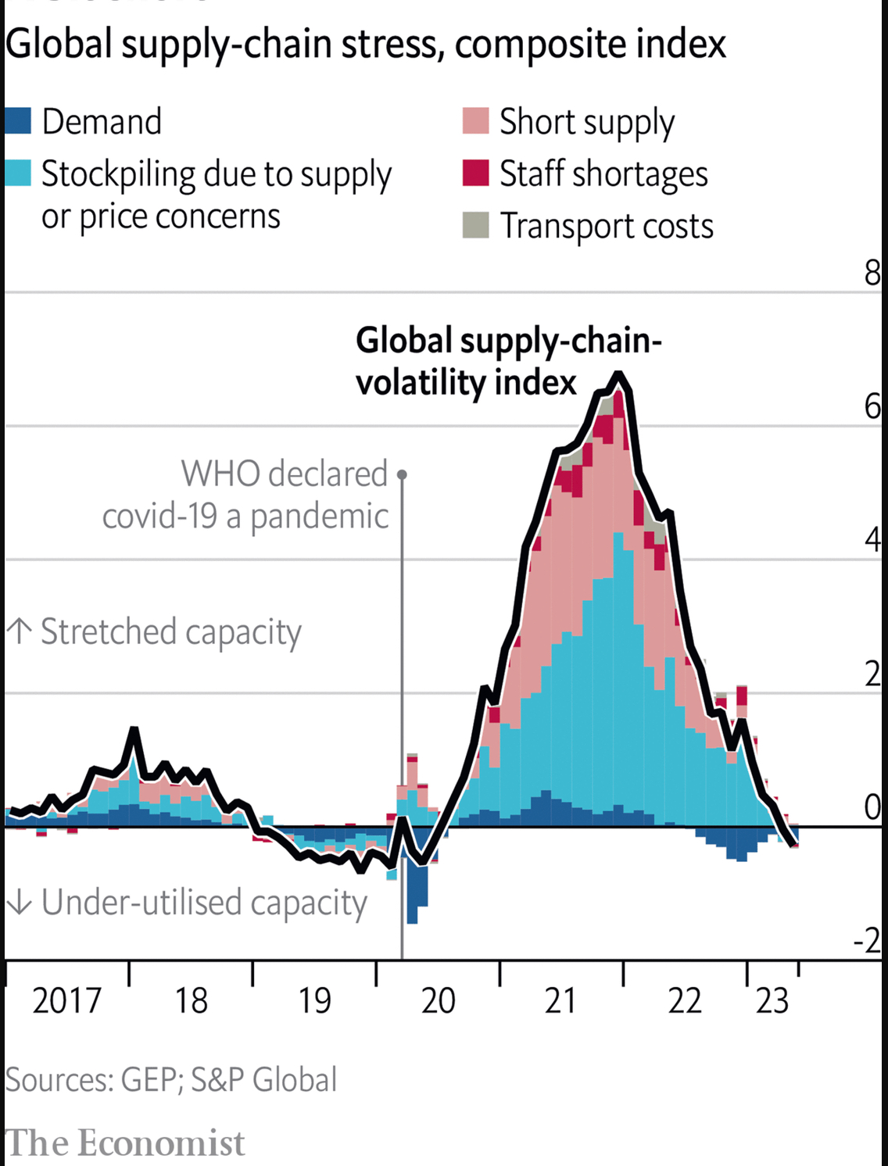

Slide 12
TRADE WAR U.S-CHINA

Slide 13
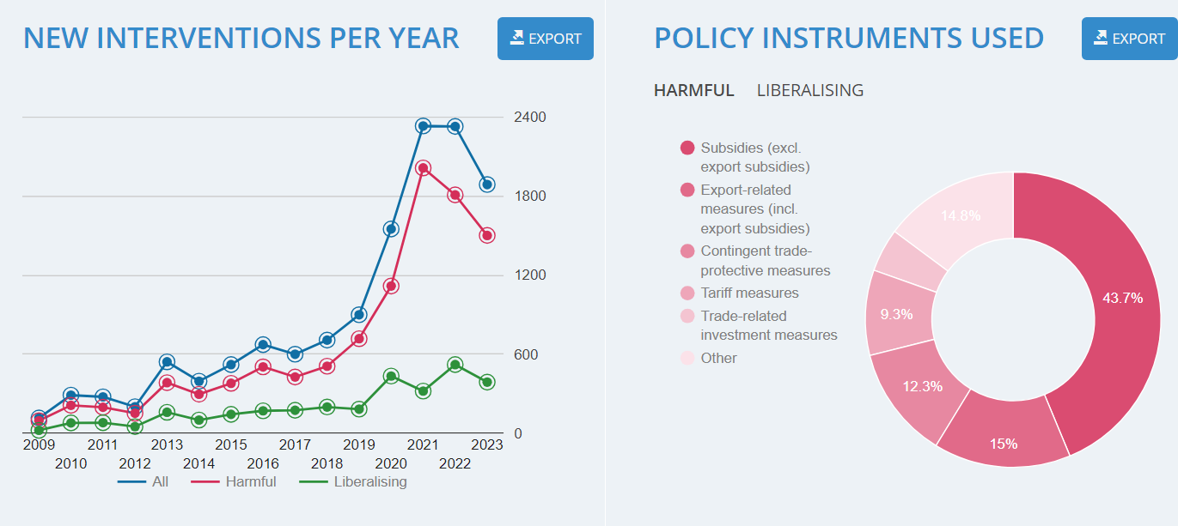

Slide 14
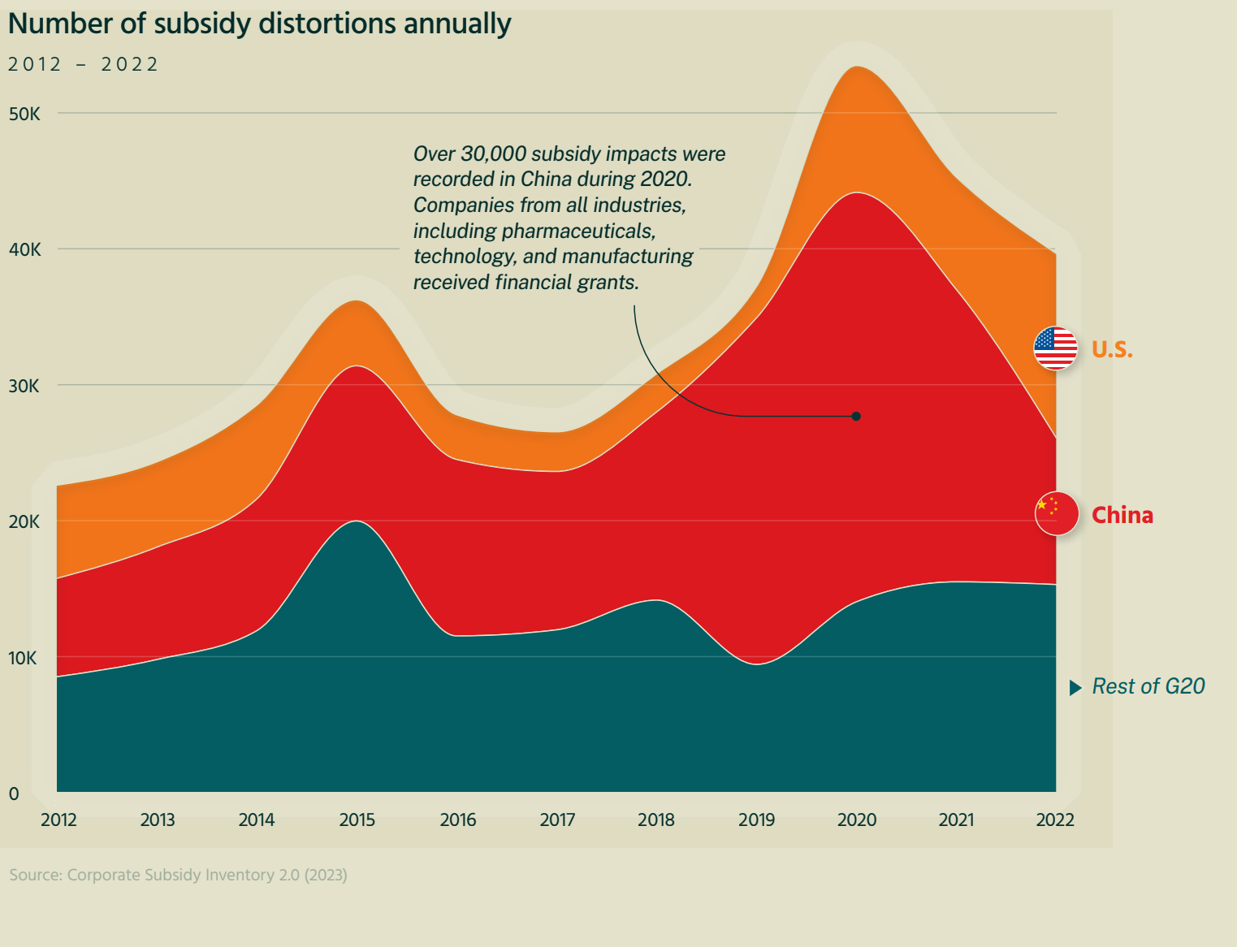

Slide 15
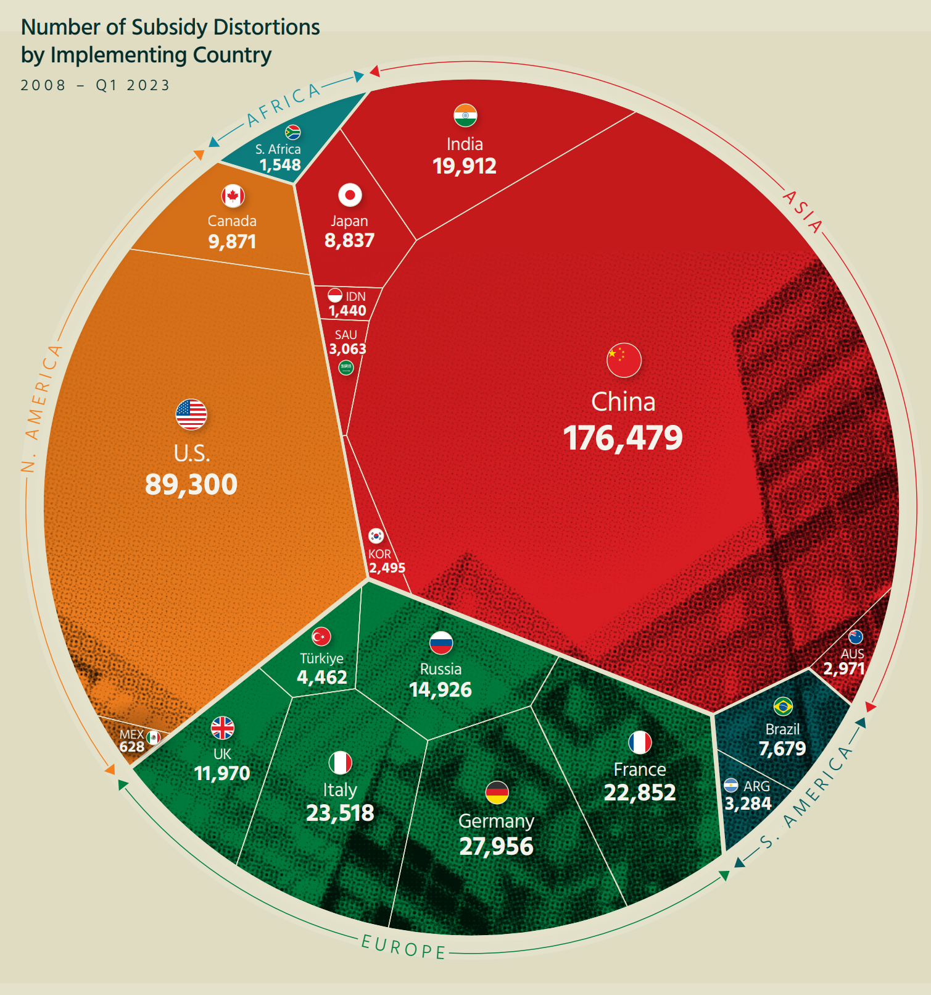

Slide 16
THE FIGHT FOR SEMICONDUCTORS
Notes:
Estados Unidos se especializa en diseño. Taiwan en chips lógicos avanzados. Corea del Sur en chips de memoria. japón en sensores ópticos y en materiales y equipo para construir semiconductores. China en chips lógicos de baja tecnología

Slide 17
Since the Bali Summit large shares of intermediate goods imports by the G20 were covered by new measures that discouraged cross-border sourcing

Slide 18
THE WTO UPSIDE-DOWN

Slide 19
RTAs IN FORCE, BY REGION

Slide 20
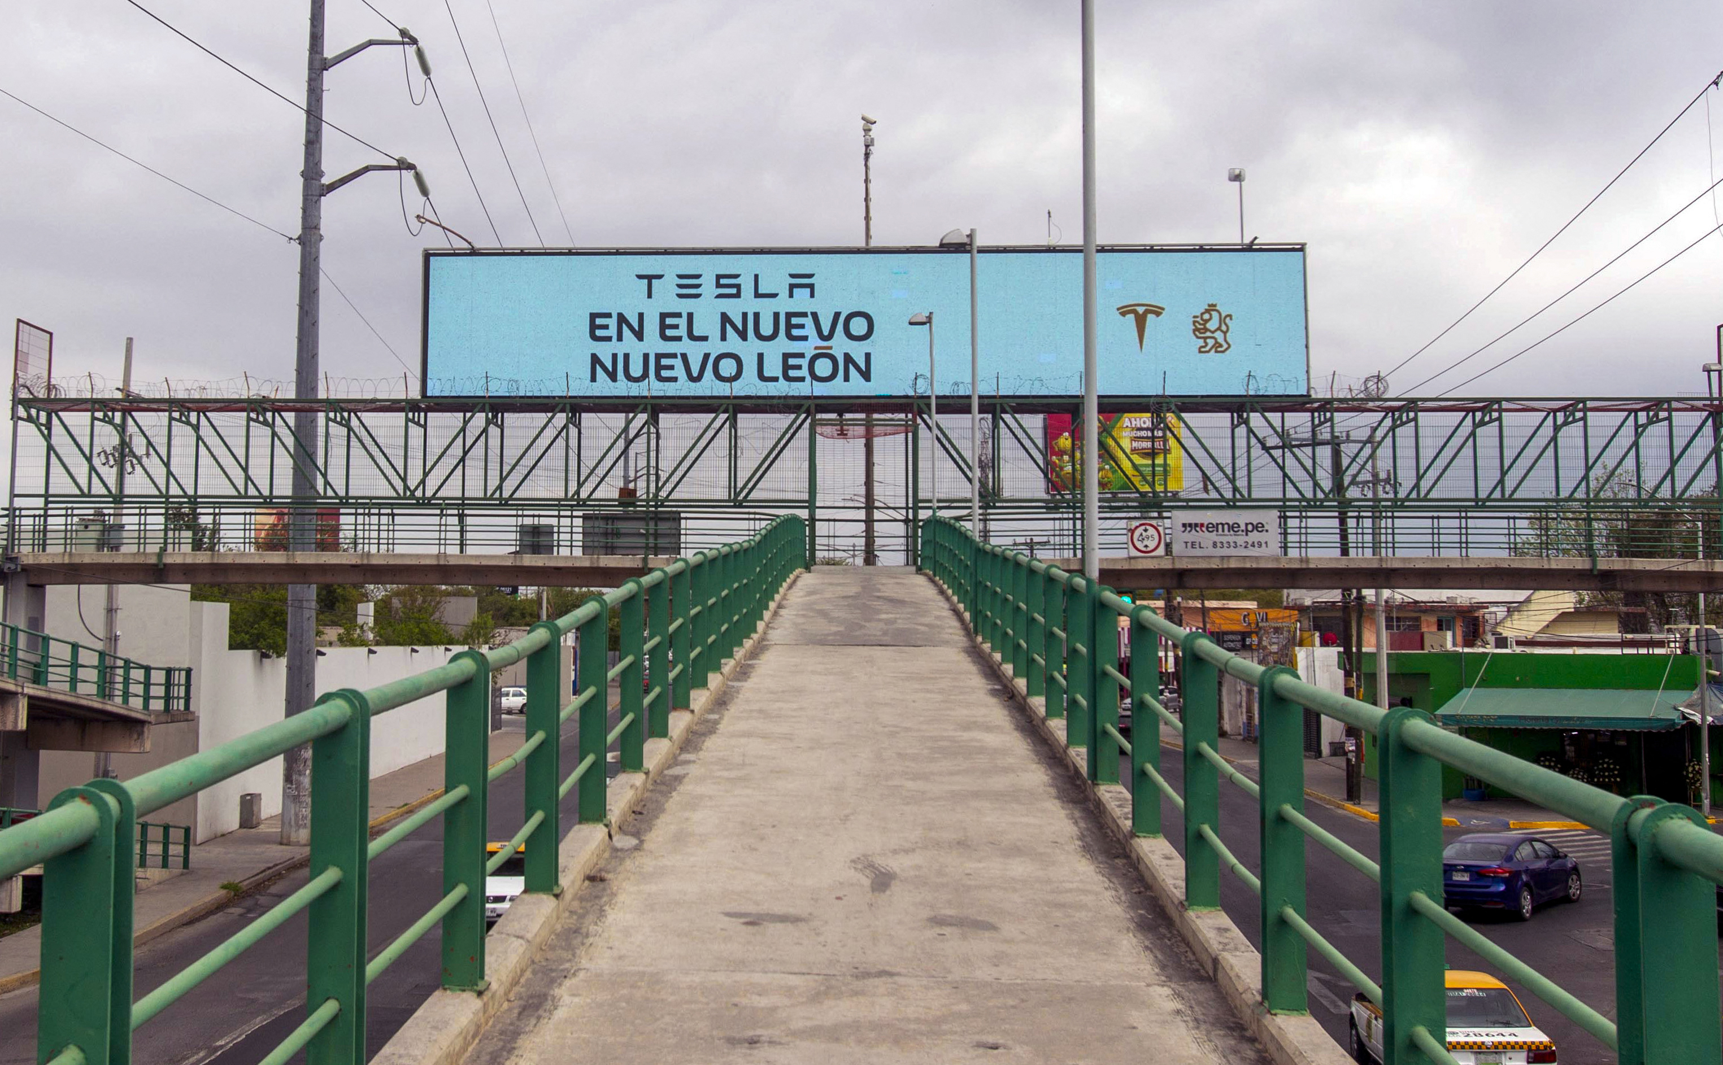

Slide 21
CHANGE IN US IMPORTS BY COUNTRY (2017-2022)

Slide 22
AVERAGE ANNUAL GROWTH IN GVC PARTICIPATION (2010-20)

Slide 23
SHARE IN IMPORTS BY TRADE PARTNER (2017-2022)

