Slide 1
XVII WORLD CUSTOMS LAW MEETING PORTO, PORTUGAL
Tariff increases, the use of anti-dumping duties, the application of sanctions and export controls as factors in "trade wars"

Slide 2
Legality of Trump’s tariffs
According to WTO Law
Article II:1 GATT 1994
Article II, GATT
Schedules of Concessions
1. (a) Each contracting party shall accord to the commerce of the other contracting parties treatment no less favourable than that provided for in the appropriate Part of the appropriate Schedule annexed to this Agreement.

Slide 3
Legality of Trump’s tariffs
Trump’s tariffs exceed the bound tariff rates located in the US’s schedule of commitments
  Average level of US bound tariff rates:
  3,4%
  Average level of applied tariffs (Sep42025, Yale Budget Lab):
  17,4%

Slide 4
Legality of Trump’s tariffs
Article I, GATT 1994
Most favoured nation principle
  Non-discrimination according to origin of goods
  Regarding each category of goods, the US has to apply exactly the same tariff rate irrespective of the country of origin

Slide 5
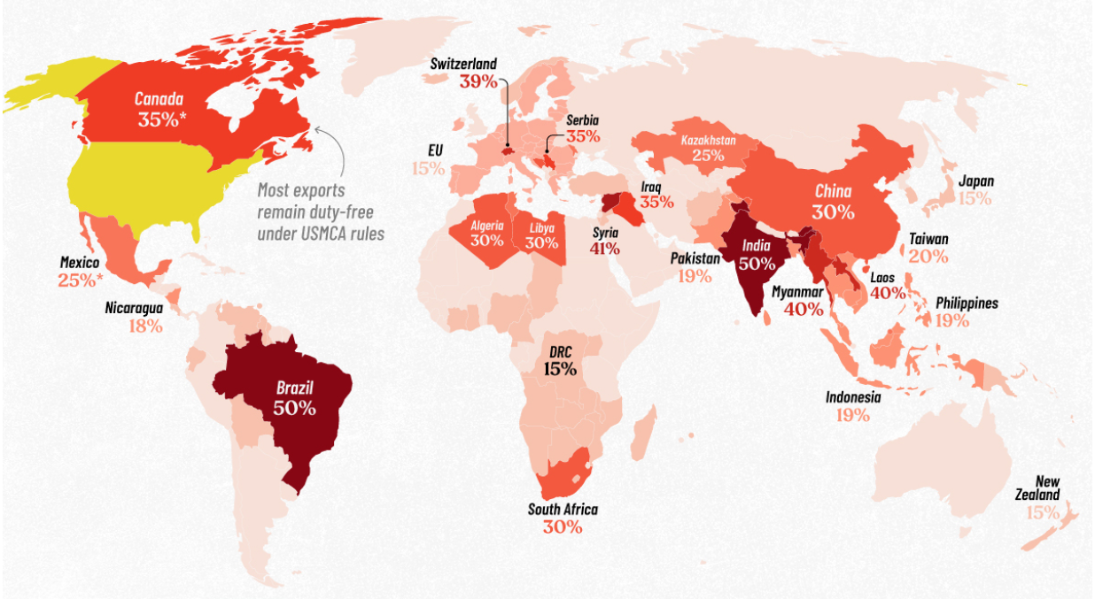

Slide 6
Legality of Trump’s tariffs
WTO-legal exceptions:
  Preferential trade agreements
  GSP schemes
  Trade defence measures (subsidies, dumping, safeguards)
  Article XX General Exceptions
  …National security

Slide 7
Requests of consultations – WTO dispute settlement
DS633 United States — Additional Tariff Measures on Goods from China
DS634 United States — Additional Import Duties on Goods from Canada
DS635 United States — Additional Import Duties on Steel and Aluminium Articles from Canada
DS637 United States — Additional Duties on Imports of Automobiles and Automobile Parts from Canada
DS638 United States — Universal and Country-specific Additional Duties on Imports from China
DS640 United States — Tariff Measures on Certain Products from Brazil

Slide 8
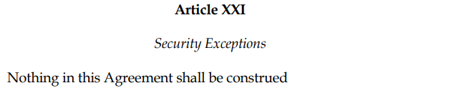

US invokes national security
US: “Issues of national security are political matters not susceptible to review or capable of resolution by WTO dispute settlement”

Slide 9
Russia – Traffic in Transit (Ukraine) (2019)
Panel rejected that art. XXI was non-justiciable and self-judging
WTO panels may determine if there is an “emergency in international relations”
WTO panels may review,
    (i) whether the Member's designation of its essential security interests is not made in good faith, and
    (ii) whether the challenged measures are “not implausible” as measures to protect those essential security interests
Report was adopted by DSB

Slide 10
US — Steel and Aluminium Products (Turkey) (2022)
Panel: US measures at issue were not “taken in time of war or other emergency in international relations”
  US could not invoke national security exception
Panel report appealed by the US to the Appellate Body
Appellate body appointments blocked by US, not functioning since 2020…

Slide 11
Thank you!

