Slide 1
The Impact of Mega Free Trade Agreements on International Trade and Customs Administrations

Slide 2
Outline
WTO and FTA: Multilaterism ./. Regionalism
Mega FTA
European Union
USMCA
RCEP
CPTPP
Mercosur
New Trade Initiatives
IPEF
BRICS
Trade Policies and Protectionism
Impact on Business and Customs

Slide 3
World Trade Organization and Free Trade Agreements

Slide 4
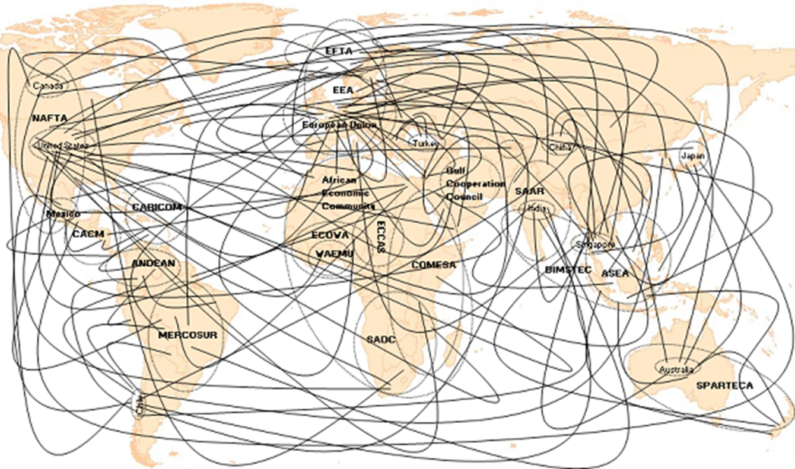
Free Trade Agreements
Since the 2000s, more regional FTAs have been concluded
“Spaghetti bowl” (more than 600 FTAs – bilateral or regional are notified to WTO; 356 are in force)

Slide 5
Free-Trade Areas
Free-Trade Areas (FTA) are formed by international agreements of at least two countries.
FTAs are critical from WTO perspective.
WTO (GATT) based on multilateralism; FTAs based on regionalism
Art XXIV GATT contains an exception clause for FTAs
Vision of WTO: FTAs lead to multilateral free trade
Reality: FTAs only benefit members; risk of protectionism against non-members grows.

Slide 6
Free-Trade Areas
Standard rules in FTAs:
Tariff dismantling for originating products (partially)
Uniform rules of origin for the entire zone (partially with regional accumulation)
Uniform simplified customs procedures
Harmonisation of technical standards
Investor protection
Opening of services markets
Consumer protections rights
Special rules in some FTAs:
Environmental protection standards
Protection of labor rights

Slide 7
Mega Free Trade Agreements
Mega FTAs span several countries or even continents

Slide 8
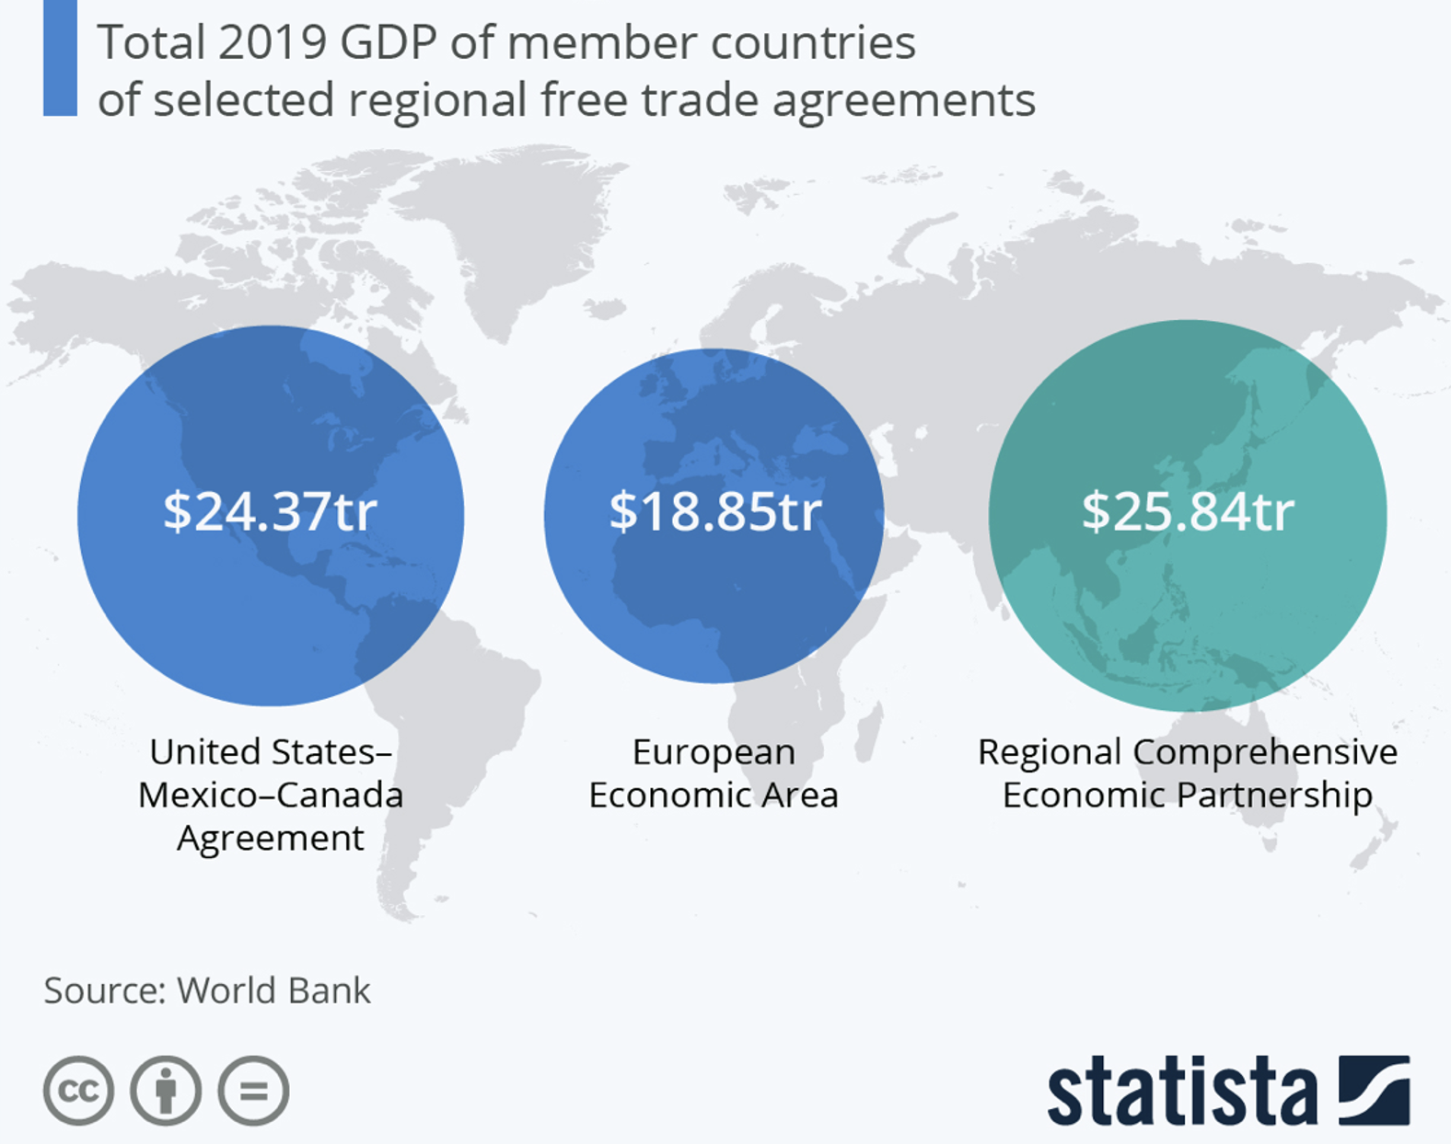
Ranking of Mega FTA
RCEP
30% of world´s population
USMCA
500 million people
EEA
470 million people
CPTPP
480 million people
Mercosur
300 million people
2.
3.
1.
$3.4tr
4.
$11.26tr
5.
Mercosur
Comprehensive and Progressive
Agreement for Trans-Pacific Partnership

Slide 9
Europe

Slide 10
European Union
Customs Union
Single Market
450 million people
Free movement of
Goods
Services
People
Capital
Protection of human and labour rights
Protection of environment

Slide 11
North America

Slide 12
United States – Mexico – Canada
– Agreement
500 Mio population
16% of world trade

Slide 13
United States – Mexico – Canada
– Agreement
Successor Agreement to NAFTA (1994 - 2020)
In force since 1 July 2020
Content:
Elimination of customs duties for originating goods
Regional Accumulation possible
Consideration of labour costs with minimum wage
Elimination of technical barriers to trade (equivalence of standards)
Access to public procurement
Opening of the services market
Protection of intellectual property
Protection for foreign investment
Guarantee of labour protection rights
Compliance with environmental standards

Slide 14
Asia - Pacific

Slide 16
RCEP
Effective since 2022
Largest trade bloc in history
Ca. 30 % of world trade
Ca. 30 % of world population (2.2 Billion people)
India took part in the early negotiations, but dropped out

Slide 17
RCEP
Tariff dismantling for originating products (partially)
Uniform rules of origin for the entire zone with regional accumulation
Uniform simplified customs procedures
Harmonisation of technical standards
Investor protection
Opening of services markets
Consumer protections rights
Not:
Environmental protection standards
Protection of labor rights

Slide 18
CPTPP
CPTPP is the evolution of the TPP, after the US leaving
Several further countries have applied, such as the UK or China
UK is accepted
Came into force December 2018
Deeper economic integration than RCEP
480 Mio. population
14 % of world trade

Slide 19
CPTPP
Elimination of customs duties for originating goods
Promotion of the circular economy through rules of origin
Regional accumulation possible
Elimination of technical barriers to trade
Access to public procurement
Opening of the services market
Protection of intellectual property
Protection for foreign investment
Guarantee of workers' protection rights
Compliance with environmental standards

Slide 20
South America

Slide 21
MERCOSUR
Founded in 1991
Free-trade area and customs union
300 million people
3 percent of global trade

Slide 22
MERCOSUR
Aim: Customs union and single market
Liberalisation of markets and boost in intra-Mercosur trade achieved
Single market and customs union only partly achieved so far
No free movement of people
Low integration in global value chains
Member states were allowed to exclude sensitive products from tariff reduction

Slide 23
New Trade Initiatives

Slide 24
IPEF Indo-Pacific Economic Framework for Prosperity

Slide 25
IPEF Indo-Pacific Economic Framework for Prosperity
Economic initiative launched by the US in 2022
Not a trade agreement (= soft law)
IPEF partners ➔ 40 % of global GDP and 28 % of global goods and services trade
Part of the US – China conflict
Strong reactions of China against the IPEF

Slide 26
IPEF Indo-Pacific Economic Framework for Prosperity
Four pillars of the IPEF
Connected economy: higher standards and rules for digital trade, such as cross-border data flows.
Resilient economy: resilient supply chains that can withstand unexpected disruptions like the pandemic.
Clean economy: targeted green energy commitments and projects.
Fair economy: implementation of fair trade, including rules to fight corruption and effective taxation.
IPEF partners are not required to support all four points

Slide 27
BRICS
©James Eagle

Slide 28
BRICS
Informal intergovernmental bloc
Coordinating multilateral trade policies
Initiatives
New Development Bank
BRICS Contingent Reserve Arrangement
BRICS payment system
BRICS Joint Statistical Publication
BRICS basket reserve currency
Geopolitical rival to G7

Slide 29
BRICS
©James Eagle

Slide 30
BRICS
©James Eagle

Slide 31
BRICS

Slide 32
BRICS
Status after expansion

Slide 33
Trade Policies and Protectionism

Slide 36
Impact on Business and Customs

Slide 37
Summary
The WTO-centred multilateral trade order is visibly eroding.
Globalisation is in an uncertain transformation.
On the one hand: Number of Free Trade Areas is increasing.
➔ Economic benefit for members of FTA only
On the other hand: Protectionism is on the rise worldwide.
➔ Less economic freedom for all
New trade initiatives
➔ International trade is increasingly being instrumentalised for geopolitical influence.

Slide 38
Impact
Complexity of international trade is increasing (e.g. different rules of origin and different technical standards)
More trade regulations and restricitions
More duties, trade remedies, sanctions etc.
➔ International trade law and customs law will become more important both for multinational companies and customs administrations

