Slide 1
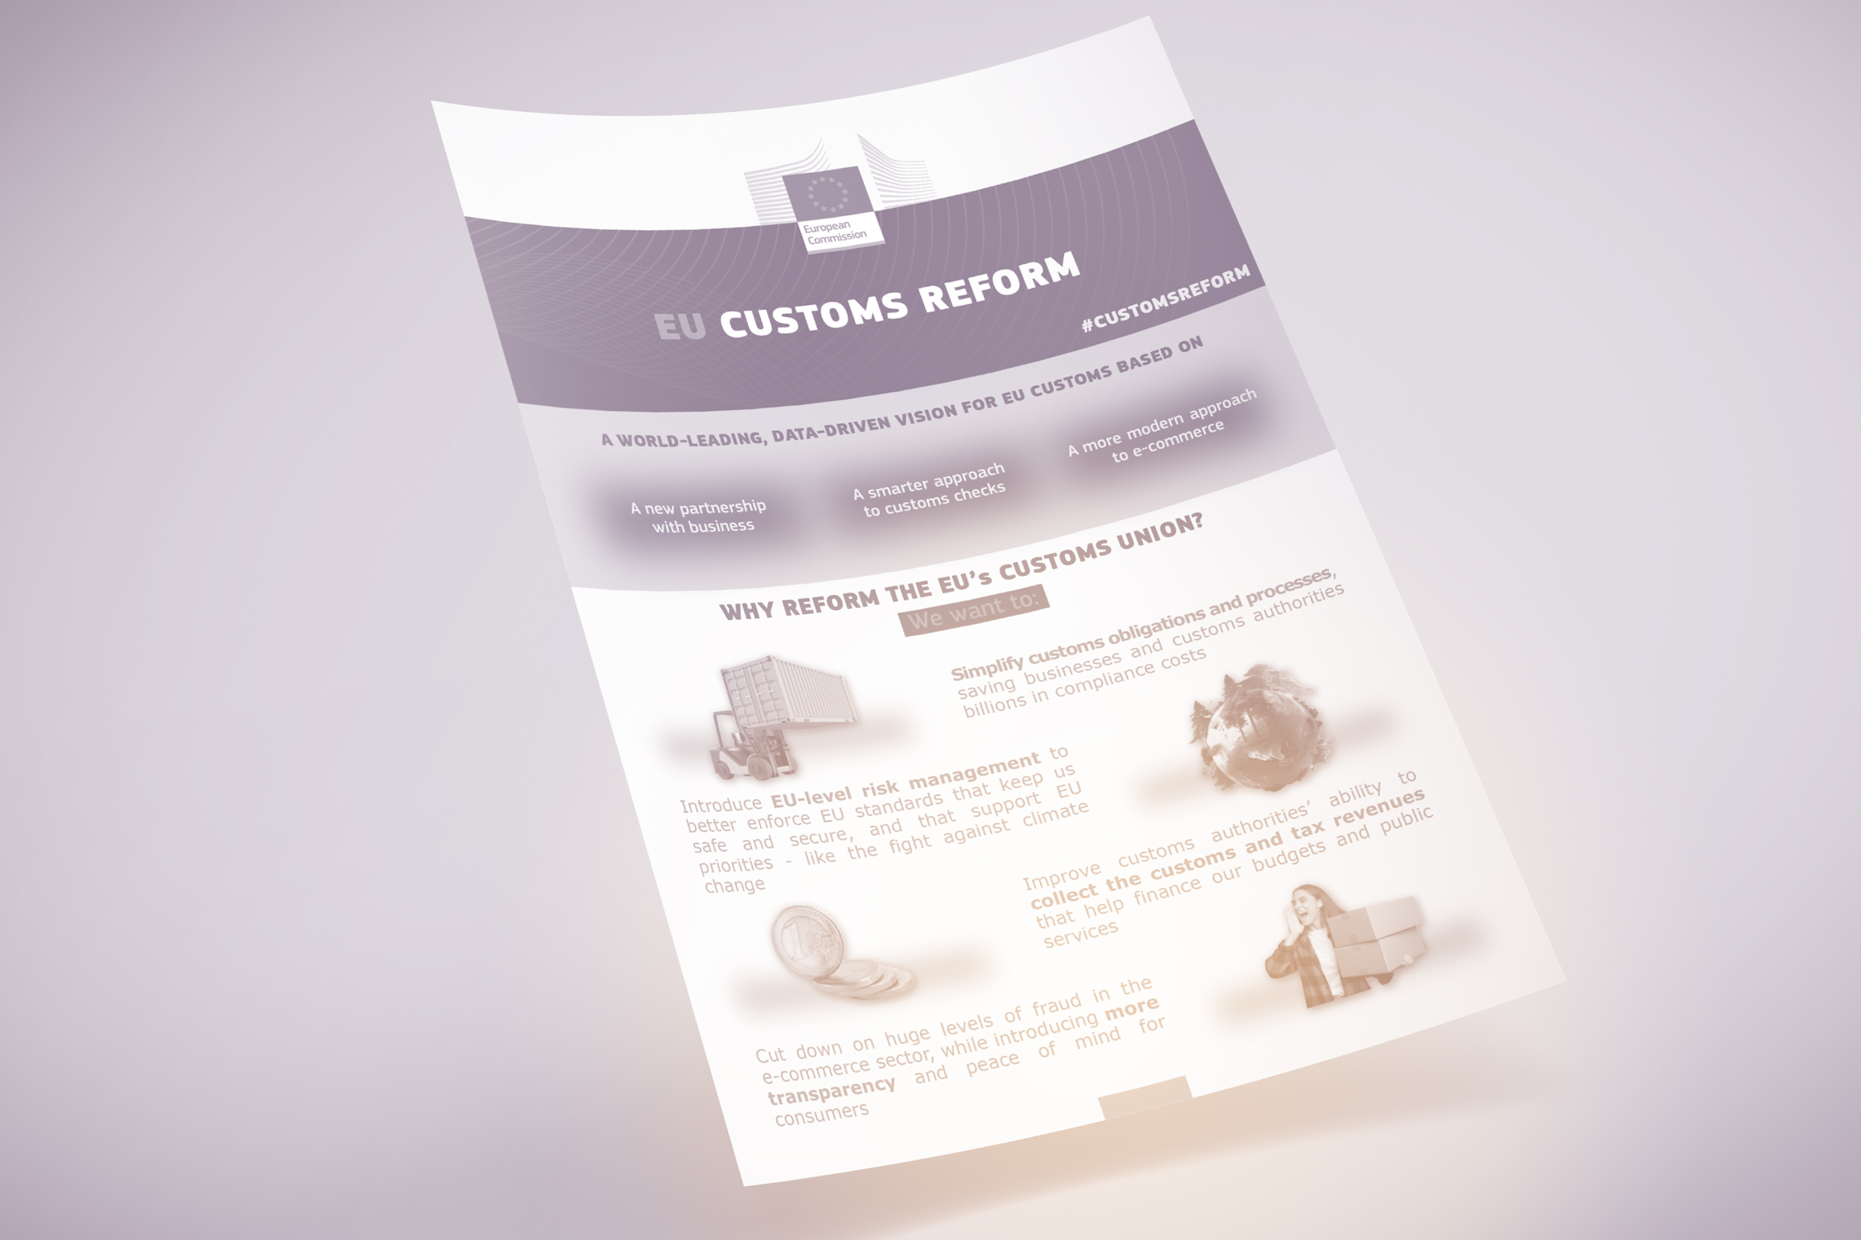
Redefinition of Authorized Economic Operator
Trust and Check Traders (T&C)
Union Customs Code Reform
XVII World Customs Law Meeting, Porto
5th September 2025

Slide 2
UCC Reform - New Paradigm on the EU Customs Union
Increase in the EU Standards + Complexity
Environmental Protection
Unfair Competition (Non-EU Traders)
1968
EU Customs Union Establishment
2023
EU Customs Union Reform (Proposals)
2016
Union Customs Code
1994
Community Customs Code
Geopolitical Changes
EU Sanctions and Prohibitions
E-Commerce
Fast Changing World….
International Trade Facilitation (Intra EU level + Worldwide)
Entered into force in 1992 and applicable since 1994
Substantive Provisions of UCC became applicable
International Trade Facilitation + “Smarter” Customs Risk Management

Slide 3
2023
EU Customs Union Reform (Proposals)
New Partnership with Businesses
Smarter Approach to Customs Checks
Three Pilars
More Modern Approach to E-Commerce

Slide 4
EU Customs Union Reform
Additional level of Partnership between traders and customs authorities
Positive discrimination of the traders qualified as “most trusted and transparent” – the ones:
  Granting real-time information to the customs authorities on their records of compliance and movement of goods
  With robust and reliable internal controls systems
But, will it be, in practice, accessible to all the “trustable and compliant” traders, including the SME (more than 90% of the companies in the EU….)?
New Partnership with Businesses
Trust and Check traders
New STATUS
Notes:
Small and Medium Enterprise, Criteria in the EU:
Micro Enterprise: Fewer than 10 employees and an annual turnover or balance sheet below €2 million.
Small Enterprise: Fewer than 50 employees and an annual turnover or balance sheet below €10 million.
Medium Enterprise: Fewer than 250 employees and an annual turnover below €50 million or balance sheet below €43 million.

Slide 5
What will be (potentially) better for businesses?
EU Customs Union Reform
Progressive change of paradigm:
  From customs declarations and goods release by the customs authorities to “self- release” by the importers/exporters
  From a “declaration-based to a “data-led system:
    EU Customs Data Hub: of voluntary use by economic operators as per 2023 but targeted as of mandatory use by the end of 2037
  Reduction of paperwork and formalities
Pilar 1
Trust and Check traders
New STATUS

Slide 6
EU Customs Union Reform
What will be (potentially) better for businesses?
“Trust and Check” traders transparency criteria will allow additional privileges:
  Possibility of releasing the goods without active intervention from the customs authorities (release on behalf)
  Defer payment of the customs debt
  Avoid transit formalities (replaced by “customs supervision”)
  Possible to comply with the customs obligations with the customs authorities of the Member State of establishment, independently the EU Member State of entrance/exit of the goods in/from the EU.
Pilar 1
Trust and Check traders
New STATUS

Slide 7
What will be the “price” for businesses?
EU Customs Union Reform
“Today” the decision to obtain Authorized Economic Operator certification lies (more) with a “voluntary” cost- benefit analysis by traders
The customs facilitations/simplifications resulting from the Authorized Economic Operator status are not unanimously perceived and experienced by traders, particularly SMEs, as being worth the granting and maintenance costs
The “costs and constraints” that a trader may face when not holding Trust and Check certification may potentially be higher (when compared with the AEO status)
Pilar 1
Trust and Check traders
New STATUS

Slide 8
EU Customs Union Reform
What will have to be “considered and wheighed” by businesses?
  Trust and Check traders’ criteria and conditions build on the AEO criteria but with additional requirements:
    IT/systems and interfaces
    Internal customs controls and procedures (resources required)
  Traders with AEO certification will not become automatically Trust and Check traders.
Pilar 1
Trust and Check traders
New STATUS

Slide 9
EU Customs Union Reform
What will have to be “considered and weighed” by businesses?
Until 2037: AEO certifications and related “customs simplification authorizations” will be reviewed and revoked if their holders cannot be granted the Trust and Check status
New standards (systems, processes, interaction with customs authorities, as well as real-time data sharing via the EU Customs Data Hub) will directly affect traders,
Even those outsourcing the customs compliance obligations to external service providers)
Pilar 1
Trust and Check traders
New STATUS

Slide 10
EU Customs Union Reform
What will have to be “considered and weighed” by businesses?
Traders not AEO certified: Advised to reassess the rational behind eventual “cost and benefit analysis” performed in the past, bearing in mind the following:
    Customs “costs and inefficiencies” for traders not certified as “Trust and Check traders”, including
      The impact of not being able to benefit indirectly from the AEO status of external service providers (e.g., customs brokers, freight forwarders)
      Competitive disadvantages compared to Trust and Check traders
    Mandatory requirement to use the EU Customs HUB as of 2038 (even for non-T&C certified traders): relevant to consider in the Trust and Check trader “cost benefit” analysis
Pilar 1
Trust and Check traders
New STATUS

Slide 11
EU Customs Union Reform
What will have to be “considered and weighed” by businesses?
Traders AEO certified:
  Identify:
    Gaps for the Trust and Check trader certification (systems and processes)
    Impacts of loosing the AEO certification (AEO existing authorizations will be reassessed until 2037)
  Cost and benefit analysis of the Trust and Check certification scenario
  Roadmap establishment and preparation for Trust and Check certification (if the scenario to implement)
Pilar 1
Trust and Check traders
New STATUS

Slide 12
Challenges
Direct Impacts (and responsibilities) for traders
Investment requirements (IT, Qualified Resources, Internal Control and Procedures)
Advantages
Commercial and Financial competitive advantages
Self-Release of goods and less controls “at border” (trusted trader)
(Higher) Customs Facilitations (Simplifications)
Centralized Clearance
Real-time data sharing + EU Customs HUB
Impacts for non- Trust and Check traders – less competitive in international trade?
Pilar 1
Trust and Check traders
New STATUS
Where does the balance lie? That is for each trader to assess and decide…

Slide 13

Gabriela Sousa
www.linkedin.com/in/gabrielalsousa
https://gabrielasousa.eu

