Slide 1

Artificial Intelligence:
An effective, accurate and secure tool for determining and verifying tariff classification, origin and customs valuation of goods?
XVII World Customs Law Meeting
4 September 2025 | Porto
Valerie Picard, Head of Trade, ICC

Slide 2
XVII WORLD CUSTOMS LAW MEETING PORTO, PORTUGAL 2025
XVII WORLD CUSTOMS LAW MEETING PORTO, PORTUGAL 2025
State of play
Key trends and challenges
01
Digitalisation The foundational Imperative
02
Cross-border data flows
Enabling AI in Supply Chains
03
Public-private partnerships
Driving effective rulemaking
04
Q&A
05

Slide 3

Global AI Landscape
What chambers are saying
80% of chambers view AI positively—but adoption is uneven.
Only 22% report AI is widespread across industries.
Asia leads in preparedness; other regions, such as Latin America and Sub-Saharan Africa, lag behind.
Barriers like talent shortages, data challenges, and security concerns remain widespread.
Source: ICC WCF Chamber Pulse: Global Markets, Local Landscapes (2025)

Slide 4


Using AI in Trade
What businesses are saying and doing
91%
of firms
Report efficiency gains, better decision-making, diversification
75%
of firms
Use AI for customs tasks – HS classification, rules of origin, declarations, and compliance risk analysis
Source: ICC-WTO Adopting AI for Trade (2025) – draft findings

Slide 5

Firm Size Matters
Large firms drive advanced use cases
Large firms
  Use AI for compliance and regulatory checks
  Lead in predictive analytics for valuation and compliance risks
  Invest in in-house or subscription-based tools.
MSMEs
  Use AI more for market intelligence and communications
  Use free or open-source tools to support customs tasks like HS classification, origin checks and declarations
Source: ICC-WTO Adopting AI for Trade (2025) – draft findings

Slide 6
Timing is right
Turning compliance challenges into advantages
Volume and complexity of data
Regulatory pressure and opportunies
Advances in AI technology
Private sector initiatives

Slide 7

Key benefits of AI in Customs Compliance
AI is transforming trade compliance
Efficiency & speed – automates labor-intensive tasks
Accuracy & consistency – reduces human error and subjectivity
Compliance & risk reduction – is a second set of eyes
Cost savings & revenue – cuts down on consulting fees, increases use of FTAs and helps identify correct tariff rates
Scalability & agility – can absorb new products and rules

Slide 8
But on the flip side…
Challenges and practical steps for companies
Data quality
Invest in good data governance
Integration
Connect AI engines to ERP or customs filing systems
Human oversight & explainability
Keep experts in the loop & have AI explain its reasoning
Change management
Staff training and information sessions
Regulatory compliance & documentation
Maintain solid documentation of how classification / origin determinations were made
Security & privacy
Ensure vendors follow data protection standards, don’t violate privacy laws or agreements
Continuous improvement
Monitor performance and feed new examples back into training

Slide 9
Closer look: regulatory challenges
Fragmentation –adds compliance costs (~60% report moderate-to-critical impact).
Uncertainty lack of coordination slowing adoption
Data privacy –overlapping privacy regimes create compliance challenges
Source: ICC-WTO Adopting AI for Trade (2025) – draft findings

Slide 10
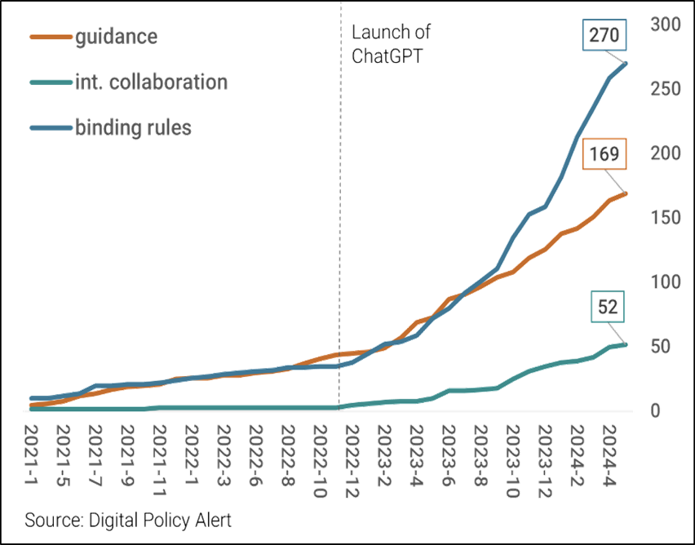
Acceleration of digital policymaking - AI
Rapid AI rulemaking: Binding regulations are increasing at the fastest pace, signalling a growing emphasis on AI governance across G20 countries, Europe, and Southeast Asia.
Diverse regulatory approaches: Alongside binding rules, non-binding guidance and international collaboration on AI policy are gaining momentum, reflecting broader efforts to manage digital technologies.
Broader digital regulation trend: AI regulation exemplifies the overall acceleration of digital policy similar patterns are seen in data governance, competition law, consumer protection, and content moderation.

Slide 11
Core enablers
XVII WORLD CUSTOMS LAW MEETING PORTO, PORTUGAL 2025
Digitalisation unlocks AI’s full potential
Data flows drive AI integration in global supply chains
Public-private partnerships are key to effective rulemaking and scaling AI solutions for both sectors

Slide 12
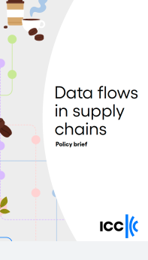
Recommendations
Cross-border data flows
1 | Pursue multilateral rules to enable trusted, secure, and predictable cross-border data flows
2 | Promote risk and evidence-based approaches to determine when there should be an exception to the default position of allowing data to flow across borders.
3 | Ensure open and interoperable data frameworks by avoiding blanket data localisation and supporting mutual recognition of standards.
4 | Safeguard Confidential Business Information (CBI) in trade and data policies through enforceable protections
5 | Support a digital trade enabling environment, including harmonised documentation standards and trusted trader certifications to reduce friction and increase participation, especially for MSMEs
ICC (2025), Data flows in supply chains, www.iccwbo.org/news-publications/policies-reports/data-flows-in-supply-chains/

Slide 13
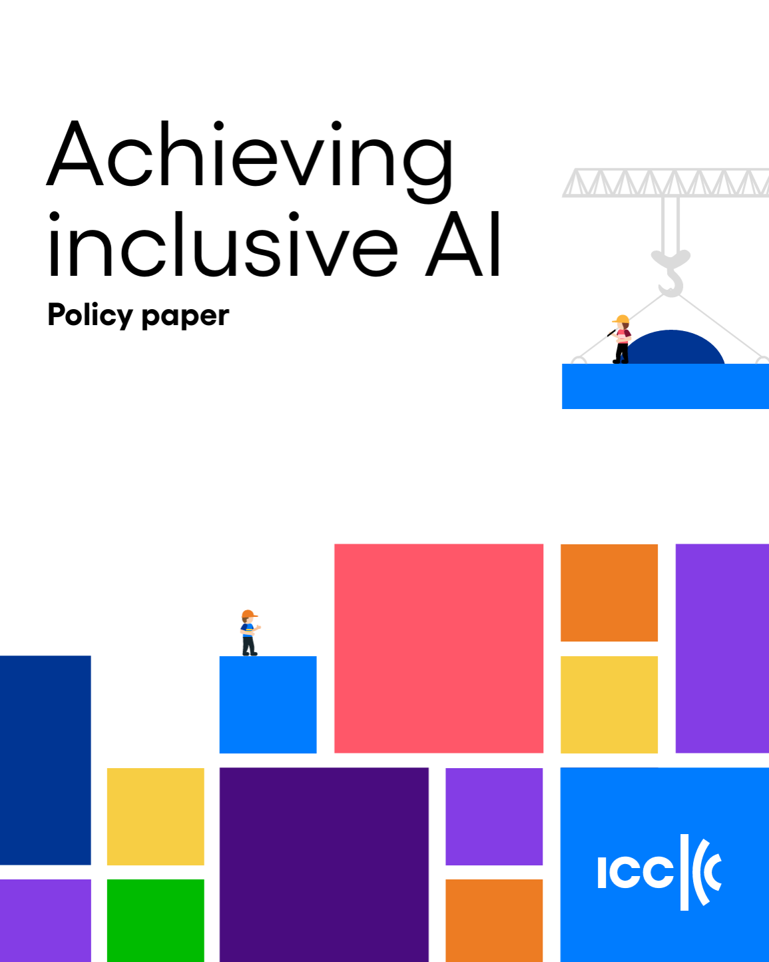

Additional resources
Digitalising Global Trade
Achieving inclusive AI

Slide 14
THANK YOU
Valerie Picard
Head of Trade
Valerie.Picard@iccwbo.org

