Slide 1

SUSTAINABILIT AND GREEN TRADE
The impact of environmental regulations on international trade and the role of business in cross-border environmental compliance
Axel Marx
University of Leuven
Porto, 4-5 September 2025

Slide 2
Focus
The impact of environmental regulations on international trade and the role of business in cross-border environmental compliance.
Focus on a new set of regulations => Sustainability Due Diligence (DD) => direct obligations on firms to govern for sustainability across borders (own operations and suppliers) BUT compliance benchmarks are not clear. When do you comply or not?
How to manage? Engage with existing tools such as Voluntary Sustainability Standards (VSS) which allow for cross-border verification.

Slide 3
Outline
Sustainability Due Diligence
  What and How
  Impact on Trade
Voluntary Sustainability Standards
  What and How
  Importance of VSS
VSS and DD – comparison and convergence
Conclusion

Slide 4
Sustainability Due Diligence
Risk-based due diligence refers to the steps companies should take to identify and address actual or potential sustainability risks in order to prevent or mitigate adverse impacts associated with their activities or sourcing decisions.

Slide 5
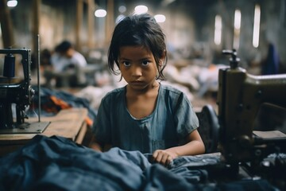

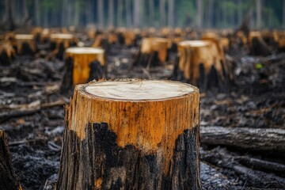
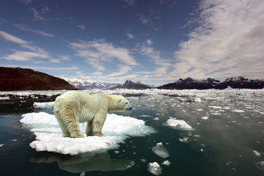

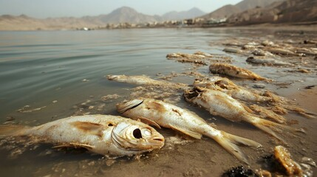

Sustainability Risks

Slide 6
Due Diligence - Origin
Soft Law Instruments
  OECD Guidelines for Multinational Enterprises (1976 – 2023)
  United Nations Guiding Principles on Business and Human Rights (20111)
Companies engaging in Corporate Social Responsibility (CSR)/Responsible Business Conduct (RBC) for a few decades
Due diligence applications in other fields – food safety

Slide 7
Evolution of Sustainability Due Diligence
Variation
  Substantive Scope
  Company Scope
  Reach: entire value chain versus 1-tier suppliers
  Enforcement: sanctions, monitoring

Slide 8
Examples
  Commodity Specific Due Diligence Regulations
  Deforestation Commodities Regulation
  Conflict Minerals Regulation
  New Batteries Regulation
  Substantive Specific Regulations
  Several Forced Labor laws/acts/regulations
  General Due Diligence
  French Duty of Vigilance law
  Directive on Corporate Sustainability Due Diligence
  German Supply Chain Act

Slide 9
Due Diligence Process
Identify and assess adverse impacts along the GVC
2
Embed due diligence in policies and management
1
Cease, prevent and mitigate adverse impacts
Provide remedy and grievance mechanisms
6
3
Communicate how adverse impacts are addressed
5
4
Monitor performance on how adverse impacts are addressed

Slide 10
Trade Effects
Direct trade effect. Some measures will prohibit the import of goods that do not meet specified sustainability requirements.
Indirect trade effect. Some measures will not ban goods that do not meet specified sustainability requirements. They require companies to put in place procedures and disclose information.

Slide 11
Impact on Business
Increased Costs => very little empirical research
  Reinsberg and Steinert (2025 - RIPE) analyzes the impact of the French mandatory due diligence law on French companies (N=11.000) over fifteen years (2008-2022). Did not find any impact on profitability, staff costs or revenues.
On suppliers => exclusion some suppliers / exit from high-risk suppliers / producing countries => re-assess supplier base

Slide 12
Role of Business in Compliance
How to comply when compliance is not clearly stipulated?

Slide 13
Voluntary Sustainability Standards

Slide 14
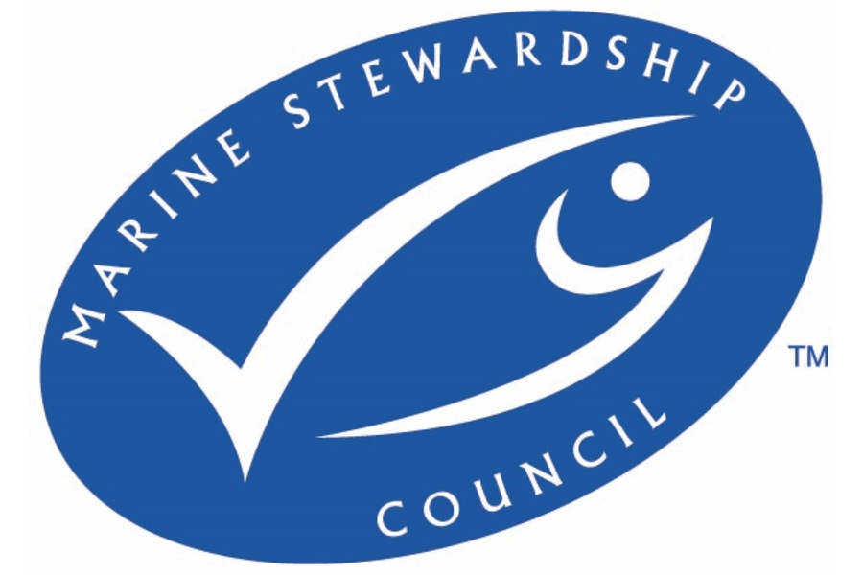

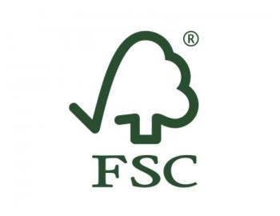
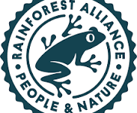



Voluntary Sustainability Standards

Slide 15
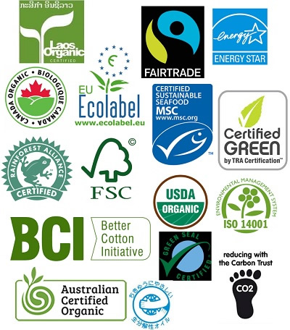
Voluntary Sustainability Standards (VSS)
“Standards specifying requirements that producers, traders, manufacturers, retailers or service providers may be asked to meet, relating to a wide range of sustainability metrics, including respect for basic human rights, worker health and safety, the environmental impacts of production, community relations, land use planning and others.” (UNFSS, 2013, p.3)
Applicable throughout the entire value chain from producers in country X to retailers in country Y and all actors in between.

Slide 16
VSS Rise

Slide 17
VSS standard-setting
1
Formulate general principles
based on, inter alia, international treaties and conventions
2
Refine the general principles into more specific standards and criteria
3
Operationalize the standards and criteria through one or more specific and measurable indicators

Slide 18
VSS conformity assessment
Top-down (ex ante) compliance assessment
Bottom-up (ex post) compliance assessment
VSS organization
Specification of sustainability standards
Can file complaint
to
Identifies
Can file complaint
to
Sets requirements
Accreditation body
Quality control
Can file complaint
to
External stakeholders
Affected by VSS system
Checks competence
Certification body
Conformity assessment (audit)
Checks compliance
Can file
complaint to
VSS adopter
Implements sustainability standards

Slide 19

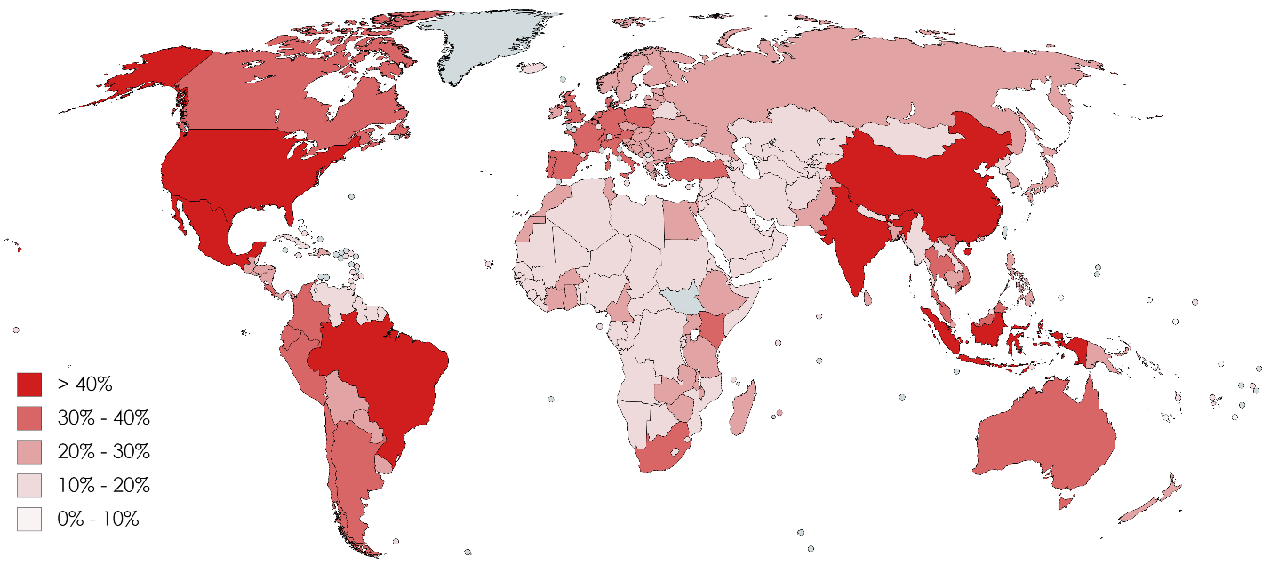
VSS Adoption – Country Level

Slide 20
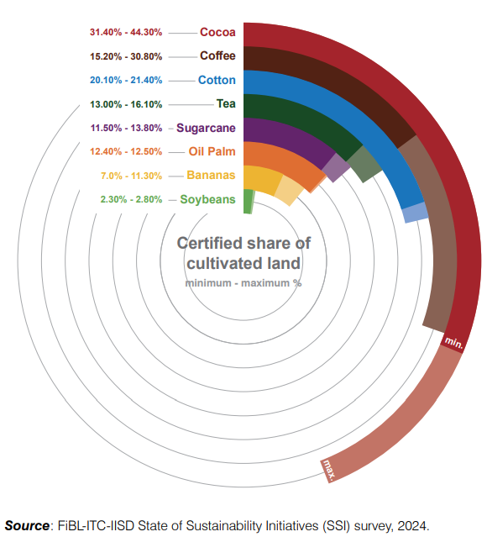
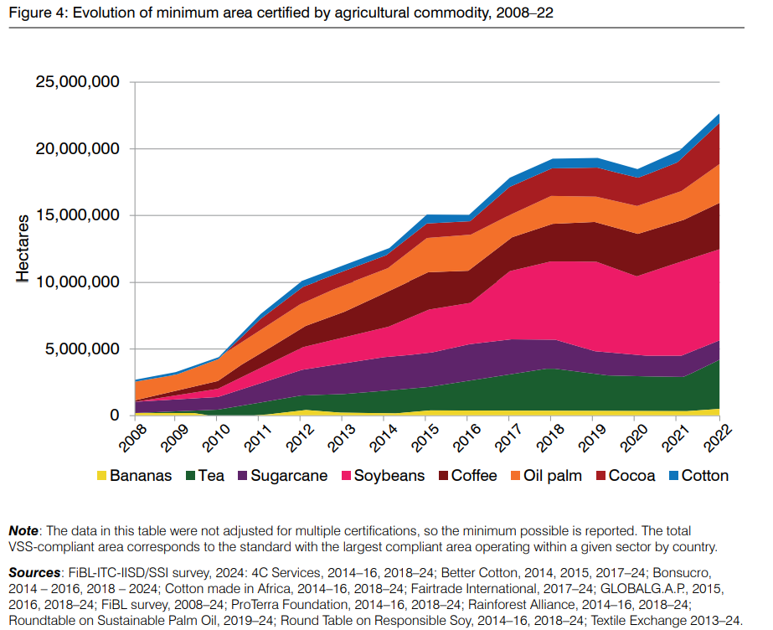
VSS adoption
Source: Kemper, L., Sampson, G., Bermúdez, S., Schlatter, B., Luna, E., Dang, T.D., and Willer, H. (2024). The State of Sustainable Markets 2024: Statistics and emerging trends. ITC, Geneva.

Slide 21
Due Diligence - VSS

Slide 22
Due Diligence – VSS: substantive comparison
Commitments: standards and risks
Start from similar ‘normative’ basis => international commitments
  To define standards VSS refer to international conventions
  To identify risks DD-measures refer to international conventions (see for example annex 1 in CSDDD)
  Overlap between the two: environmental agreements, ILO Conventions

Slide 23
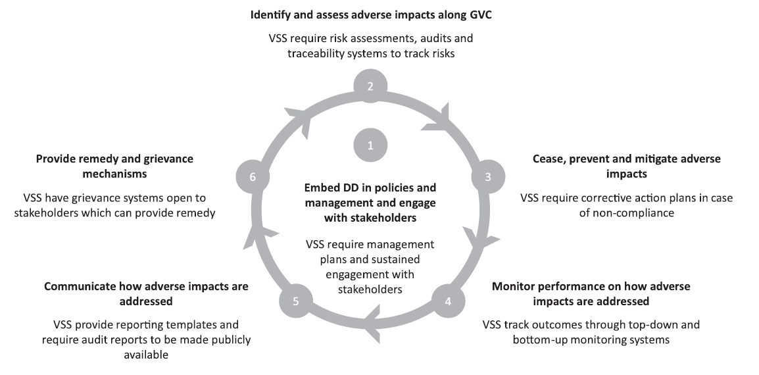
Due Diligence – VSS: Procedural comparison

Slide 24
Convergence
VSS engaging with due diligence requirements
  New services provided which provide proof of compliance with due diligence requirements
  Engage in benchmarking / OECD – Benchmarking Assessment for Textile Sectors

Slide 25
Convergence
Rainforest Alliance (RA) has undertaken a comprehensive overhaul of its system to cater to different companies’ needs, including various modules (e.g. risk assessment solution, social certification standard, sustainable agricultural certification standard). RA perceives due diligence as a “game changer” that “shifts the sustainability curve” (leveling the playing field) through mandatory requirements and forces them to reinvent their system.
Forest Stewardship Council (FSC) has adopted an approach of full alignment with due diligence requirements for companies. FSC aims to “harmonize forest management certification with the demands of the EUDR” (website) and is also following other due diligence regulatory developments such as CSDDD closely to “ensure that the certification system remains relevant in the evolving regulatory landscape” (website).

Slide 26
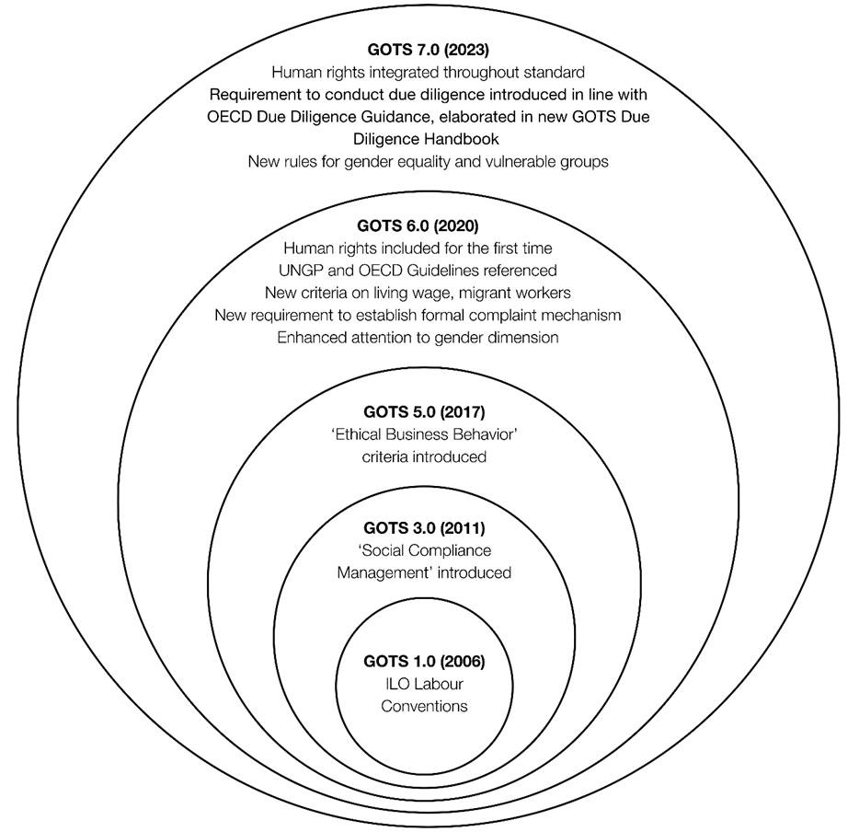
Convergence

Slide 27
Conclusion
Sustainability Due Diligence in Turbulent Times

Slide 28
Conclusion
Sustainability due diligence approaches oblige companies to govern for sustainability in their own operations and across borders
Requires companies to fully engage with the sustainability agenda => can take different approaches and options
Voluntary Sustainability Standards offer an established instrument to deal with this challenge, BUT
  No ‘Safe Harbour’
  Costly (for companies and suppliers)
  Deal with issues of greenwashing/credibility => not all VSS are equal!

Slide 29
Conclusion
Doubts on the ‘sustainability’ of sustainability due diligence agenda
  New political/geopolitical reality
  Concerns over competitiveness => Draghi repport
  Omnibus negotiations => weakening of EU Corportate Sustainability Due Diligence Directive in scope (substantive, companies in reach, suppliers in value chain)
Uncertain/Turbulent future

Slide 30
Thank you!
axel.marx@kuleuven.be

